Slide 1










-Afternoon Session-

Slide 2
Welcome Back
Agenda:
13.30 GHG Workshop about measurement method/programme, by Sebastien
14.30 Peatlands workshop with focus on Irish pilot, by Terry
15.45 Tea & coffee break
16.00 Peatlands policy workshop
17.30 End of day 1 -> Informal social

Slide 3
Welcome Back
Agenda:
Introduction to the Care Peat Project (Terry)
Research I (UCD - Florence Renou-Wilson)
Conservation (IPCC – Catherine O’Connell)
Management (NPWS – Maurice Eakin)
Research II (Trinity College – Matt Saunders)
Sphagnum successes (Lancashire Wildlife Trust - Jo Kennedy)
Wrap up and discussion on future directions

Slide 4
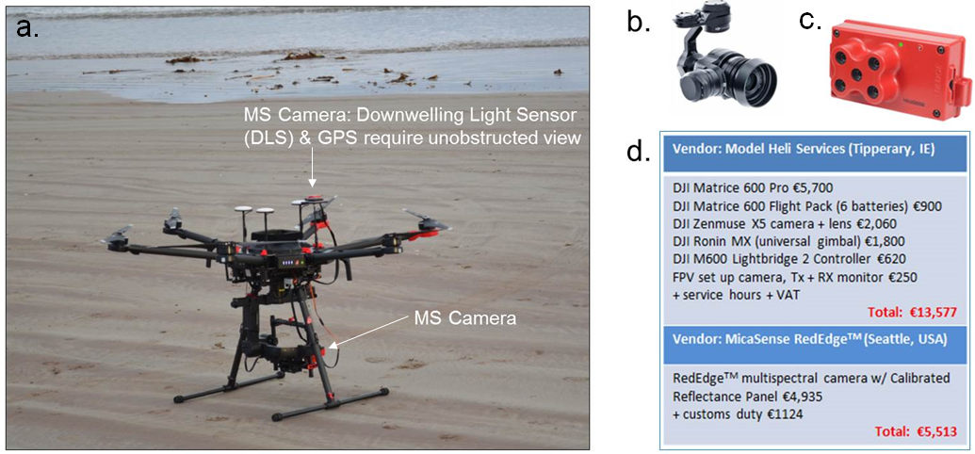
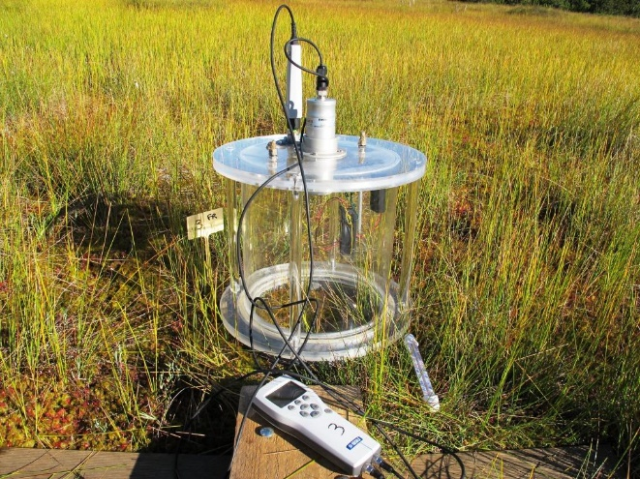
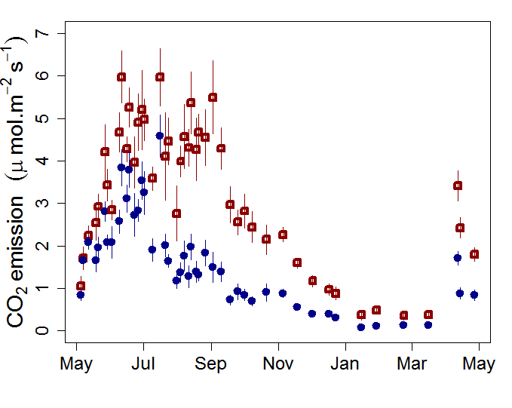
What are we doing?
Demonstration projects
Carbon reduction capacity of rewetting peatlands
Use of novel techniques
  Collar - UAV- satellite measures
  GHG modelling
  Decision support tool
Joint restorations and monitoring
Exchange of restoration methods & best practices
Influencing / promoting policy

Slide 5
Care Peat
Who?
Lead Partner – Natuurpunt
Project Manager - Katrien Wijns
Communication Manager – Han Lagring
Fatima Laggoun
Jo Kennedy
Terry and Niall
Arnoud Popping
Laurent Andre
Chris Field
Sébastien Gogo
Kristijan Civic
Technical Work Packages
Management Work Packages

Slide 6
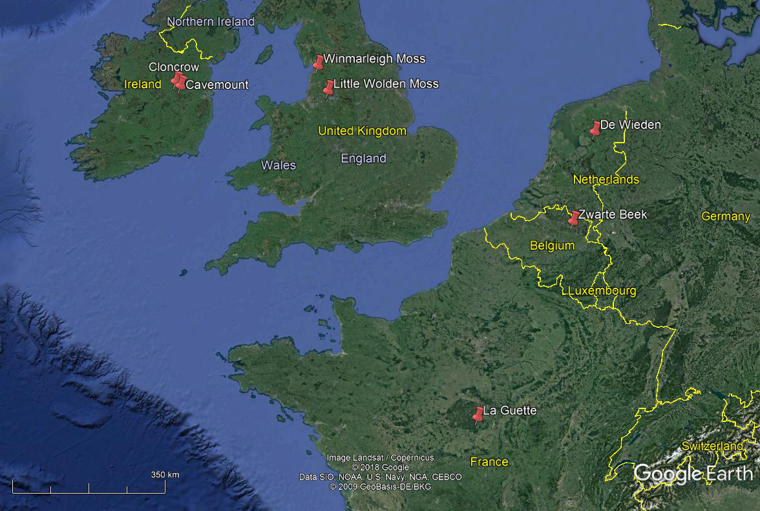
Where are we doing it?

Slide 7
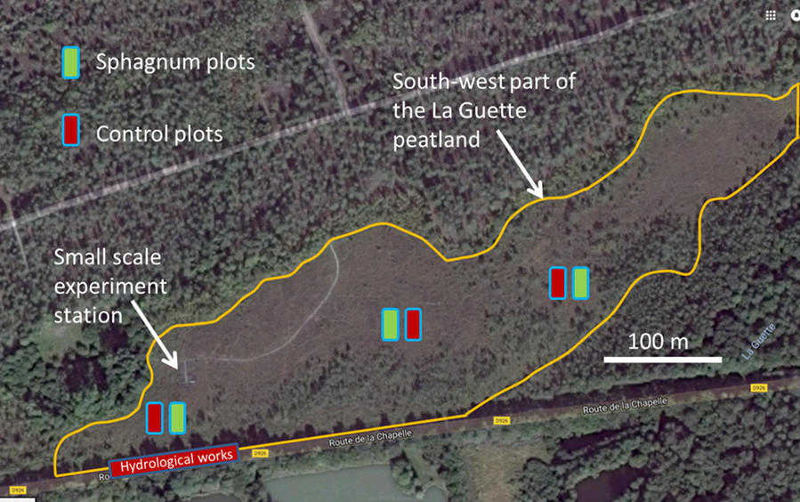
La Guette - France
23 ha peatland
Pilot 0.12ha
Methods:
Stripping of degraded peatland vegetation
600 m2 plots
Revegetation with Sphagnum

Slide 8
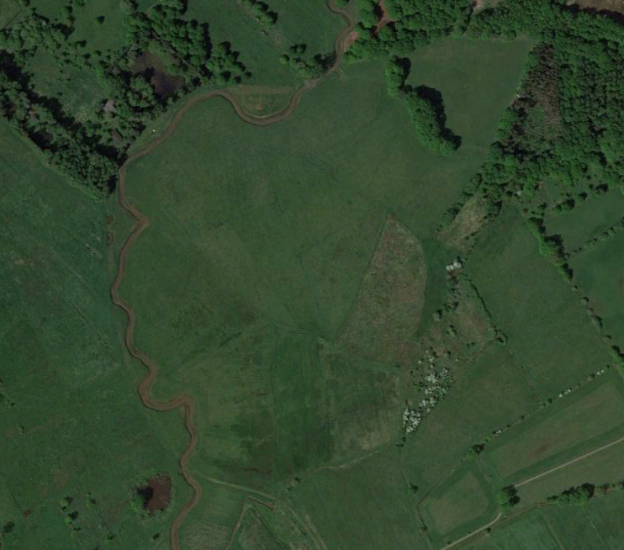
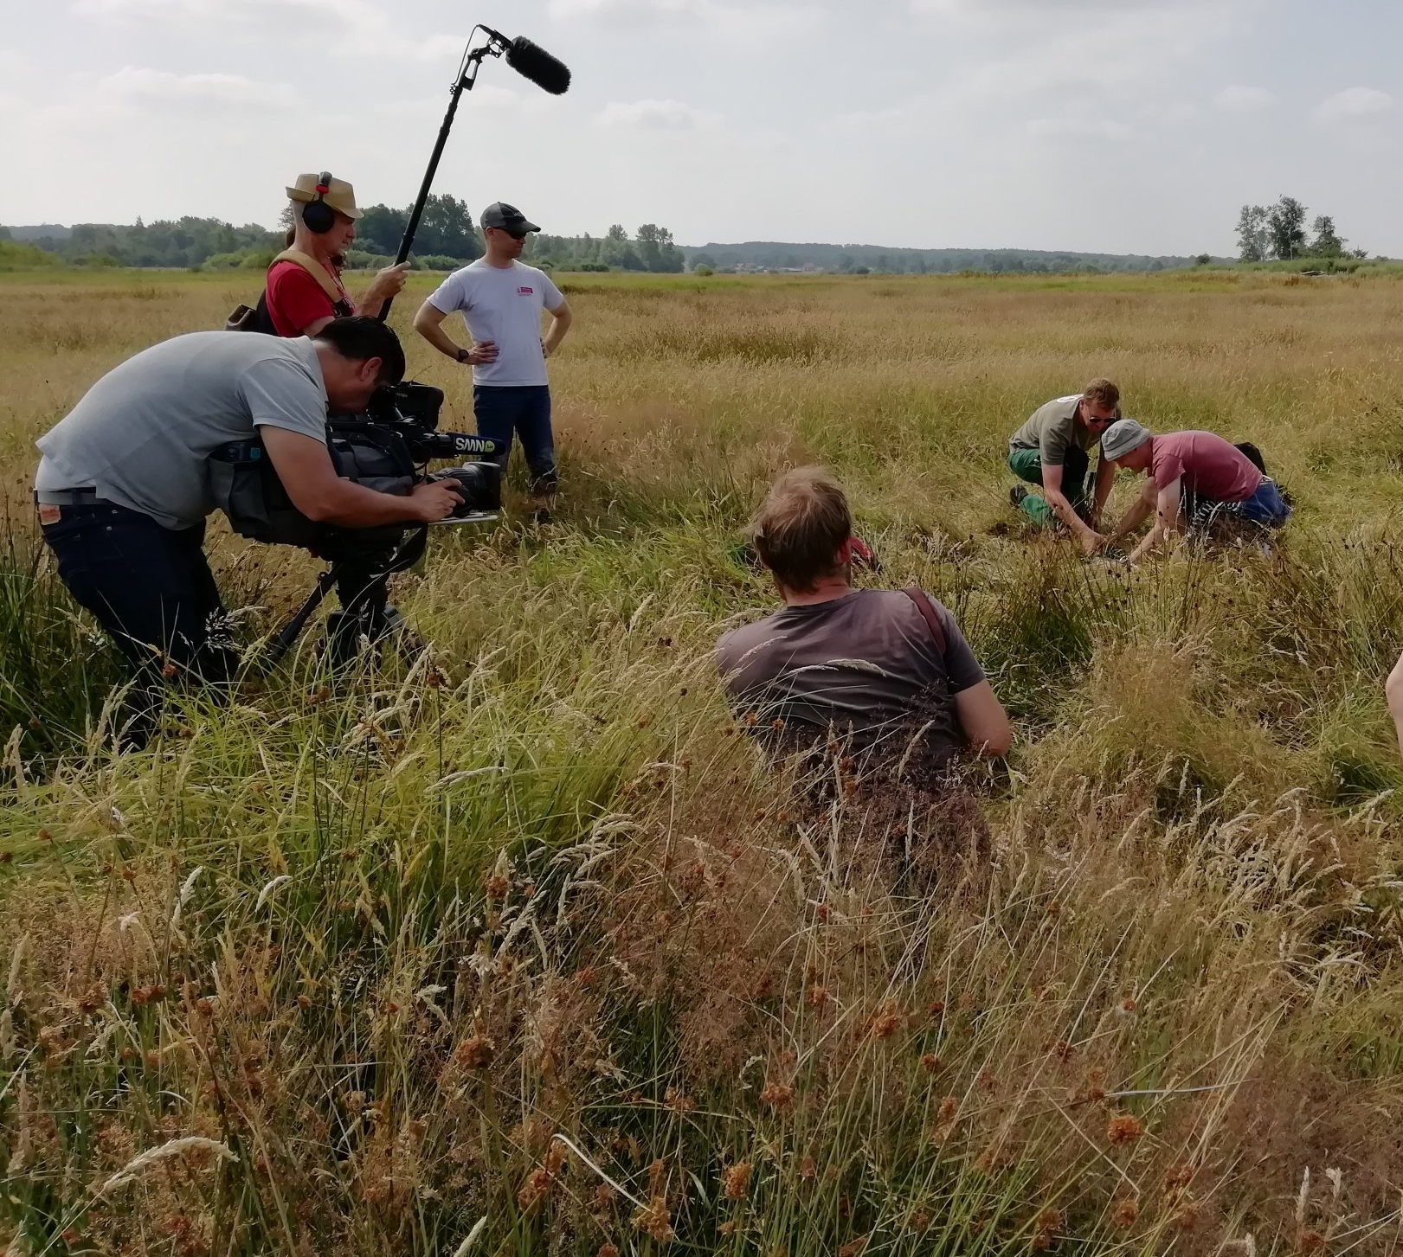
Vallei van de Zwarte Beek - Belgium
Drained valley bottom peatland
Size: 250 ha
Plan: Rewetting by Drain blocking

Slide 9
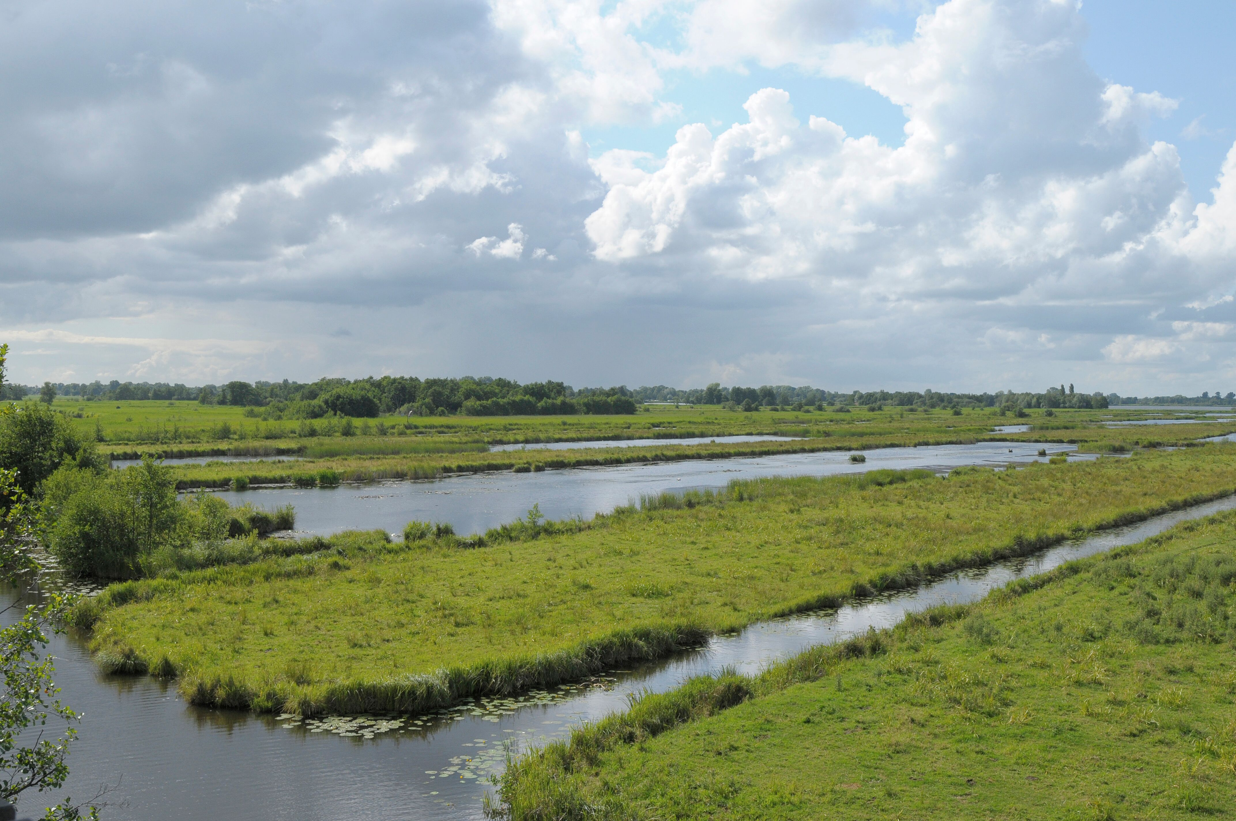
Die Wieden - Netherlands
Natura 2000 Site
Former excavated peatland
Forested Fen of ~10ha
Method
Excavation of fen and transfer to foreshore area (5ha)

Slide 10
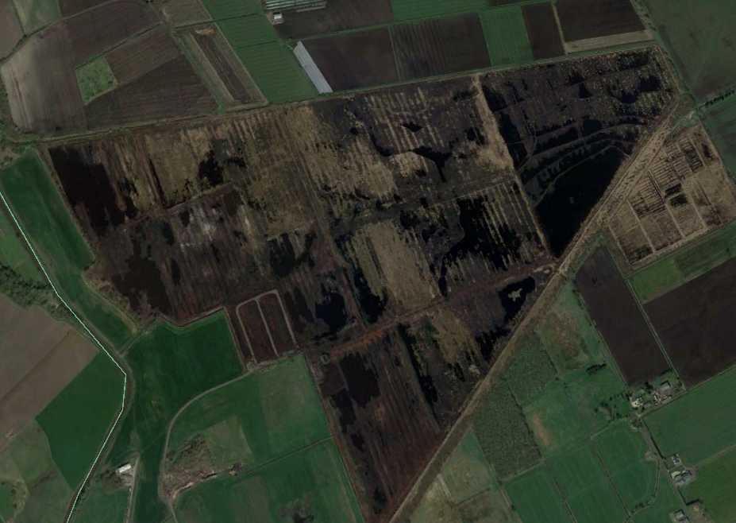
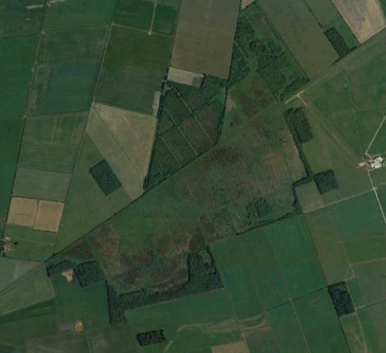
Little Wolden Moss and Winmarleigh Moss - England
Little Wolden Moss 107ha
Former peat-extraction site, ongoing restoration
2ha pilot of companion species planting
Winmarleigh Moss 89ha
Purchase of 20ha of reclaimed grassland
Restoration to peatland
4ha Sphagnum farm

Slide 11









Irish Pilot and Partners

Slide 12
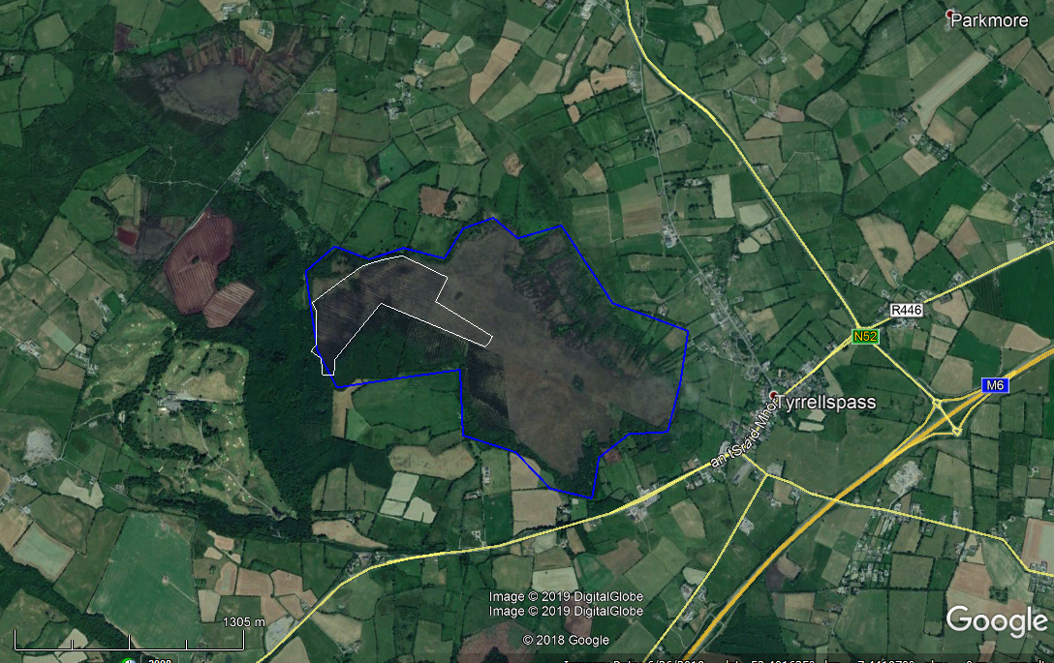
Pilot: Cloncrow NHA,
Entire bog ~200 ha (blue)
Pilot site of ~26ha (white)
Active community group in Tyrellspass

Slide 13
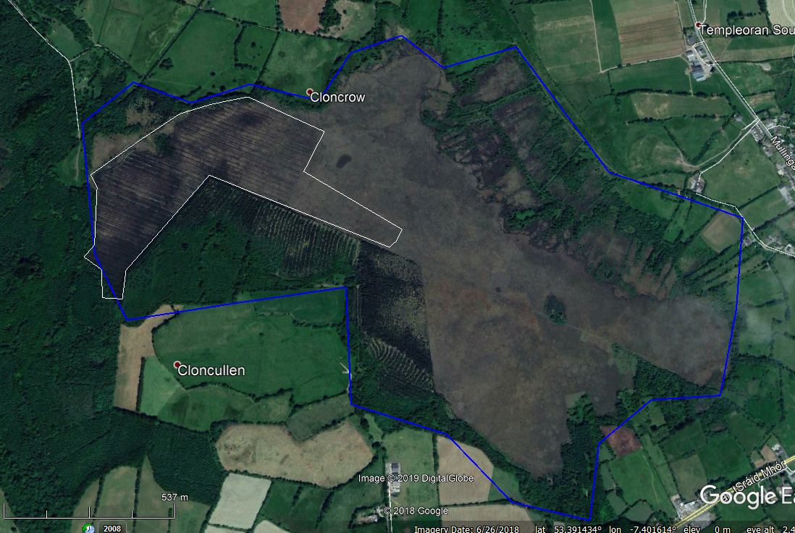
Pilot site.
Drain blocking and monitoring with sphagnum transfer.
Private cutaway. Potential landowner involvement
High Bog - Donor area
Coillte (State) Forestry
Potential involvement

Slide 14

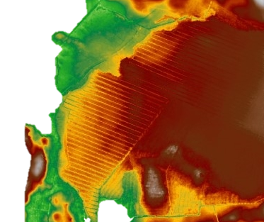
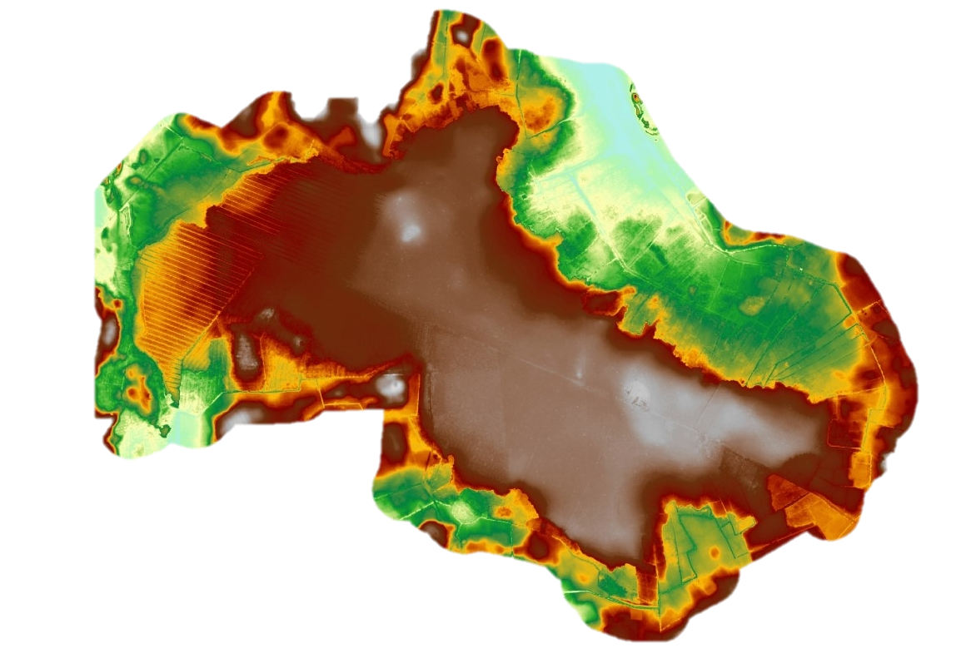
Investment WP I4
Cloncrow Bog
Total Bog: ~200ha | Pilot: 26 ha
Owned by NPWS with state and private landownership:
Condition: Extensive Private cutaway, plus afforestation
Goals:
  Block drains in a 26ha pilot
  Instrumentation
  Sphagnum transfer trials (IPCC & ETHOS).
  Engage landowners in N.E. section for socio-economic or other trials
Image source: RPSGroup

Slide 15
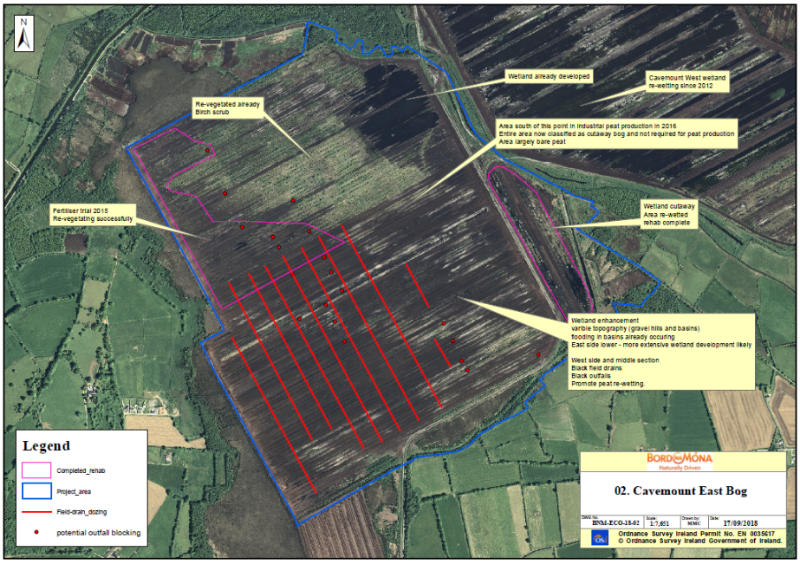
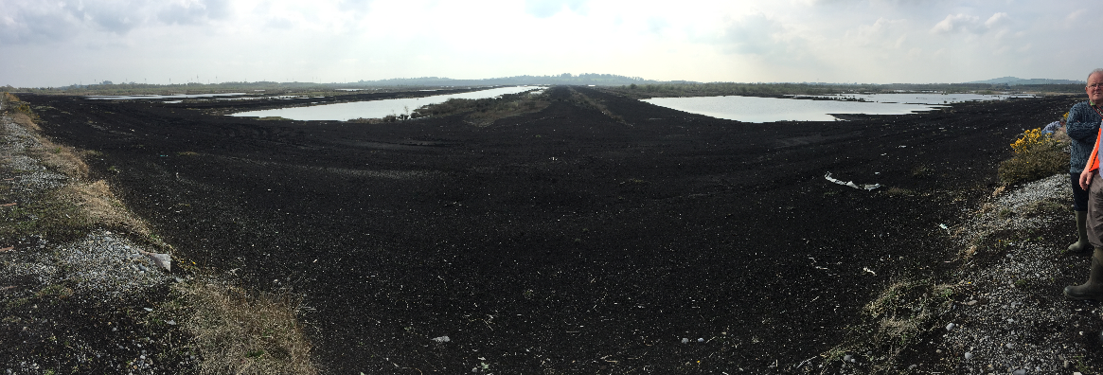
Sub-Investment WP I4
Cavemount Bog
‘Associate’ pilot ~200ha (blue outline):
Former industrial bog
Needed to link main pilot to industrial emissions in same period, and we need monitoring at such sites.
1Ha ‘trial’ Link

Slide 16
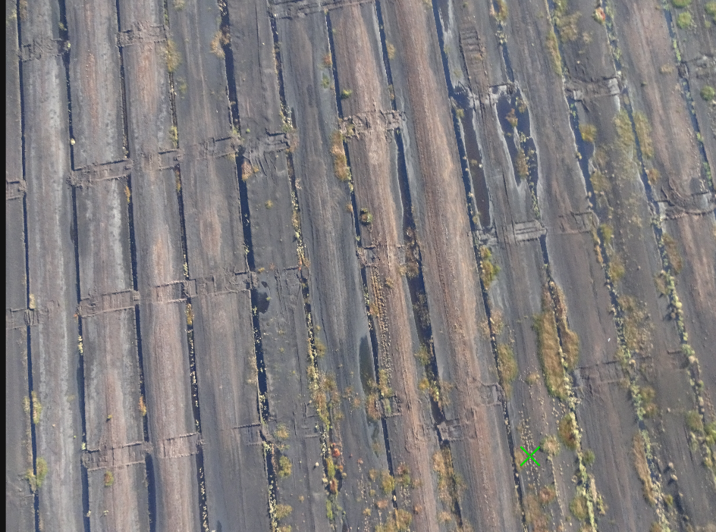
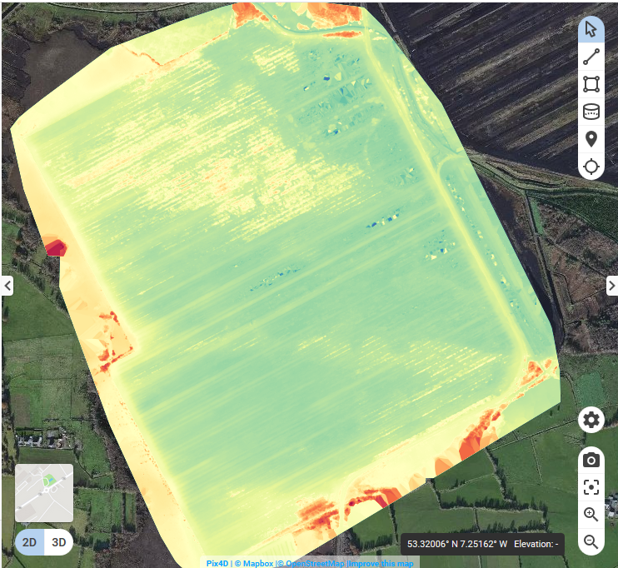

Slide 17
Existing Irish Peatland/Carbon Projects
National (EPA)
  AUGER: Peatland properties & GHG Emissions and Removals
  IHabiMap: Habitat Mapping with high resolution imagery
  SmartBog: Peatland sensor network
  SWAMP: Strategies to improve Water quality from Managed Peatlands
  SeQUEsTER: Defining pathways for Irish Agric. Sector to be C-neutral
Joint National-EU ‘Water Quality’
  EPA-JPI: Water Management for Sustainable Use of Peatlands - NUIG
  EPA-JPI: Reducing Effects of Forest Management to Inland Waters - UCD
EU Projects
  Care Peat
  CConnects: GHG emission on agricultural lands
  Life – Irish Raised Bogs Project

