Slide 1
Irish Peatlands: A Research Compendium
Dr Florence Renou-Wilson and Dr David Wilson
Notes:
Partners in carepeat, a very positive project; doesn’t operate in a vacuum. SO give context. And before I go back in time, I’ll start with the news where peatlands seem to appear more and more for all the wrong reasons. In the spotlight and Indonesia’s forest peat fires are once more a national ‘embarrassment upsetting their neighbours the worse annual fires since 2015 and that saw the equivalent of all USA emissions. This is a bit swamp with the UN climate summit the latest report on the oceans,

Slide 2
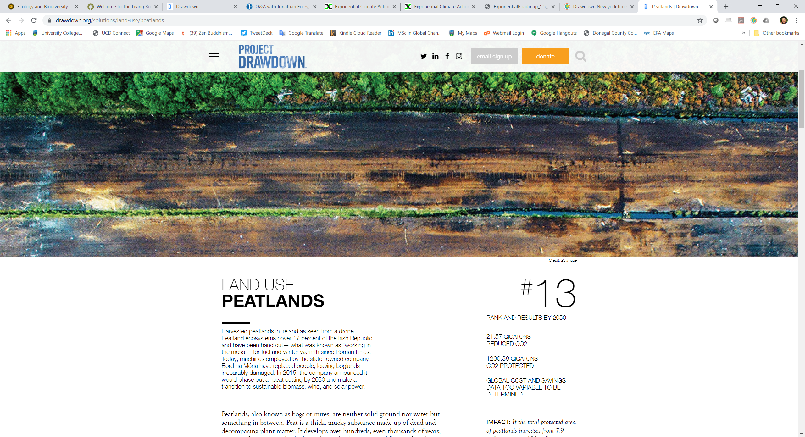
Notes:
On this morinng business news on the radio, I heard Catherine Foster from Project Drawdown, (NY best selling book this year) becoming the world’s leading resource for climate solution 100 solutions; she is in Ireland to Irish businesses so I found that peatlands appeared in #13. our American friends chose Ireland as the example.

Slide 3
https://exponentialroadmap.org/
Notes:
Last week they released this report: Peatland management and protection appears 46 times. New panacea. Peatland protection and peatland restoration are easy words to print on paper but as we all know in this room the story is a bit more complicated than that; first on this island of Ireland, these efforts didn’t just appear last week.

Slide 4
Notes:
Peatland owner, manager, conservationist both from the Govern and NGOs and have been working for 4 decades; but impetus stemmed from the Dutch Irish bog conservation foundation (links with EU already existed in the 1980s).
BnM has been funding research in all aspect of peatland reclamation, rehabilitation, rewetting and restoration with by 2020, will see 20,000 ha rehabilitated (not necessary C sink).
Coillte has benefited from the LIFE fund to rewet just under 3000 ha of blanket and raised bogs; The government also benefited from LIFE to restore 12 sites aims to restore over 2600 ha
Meanwhile the scientific communities didn’t stay idle, EPA

Slide 5
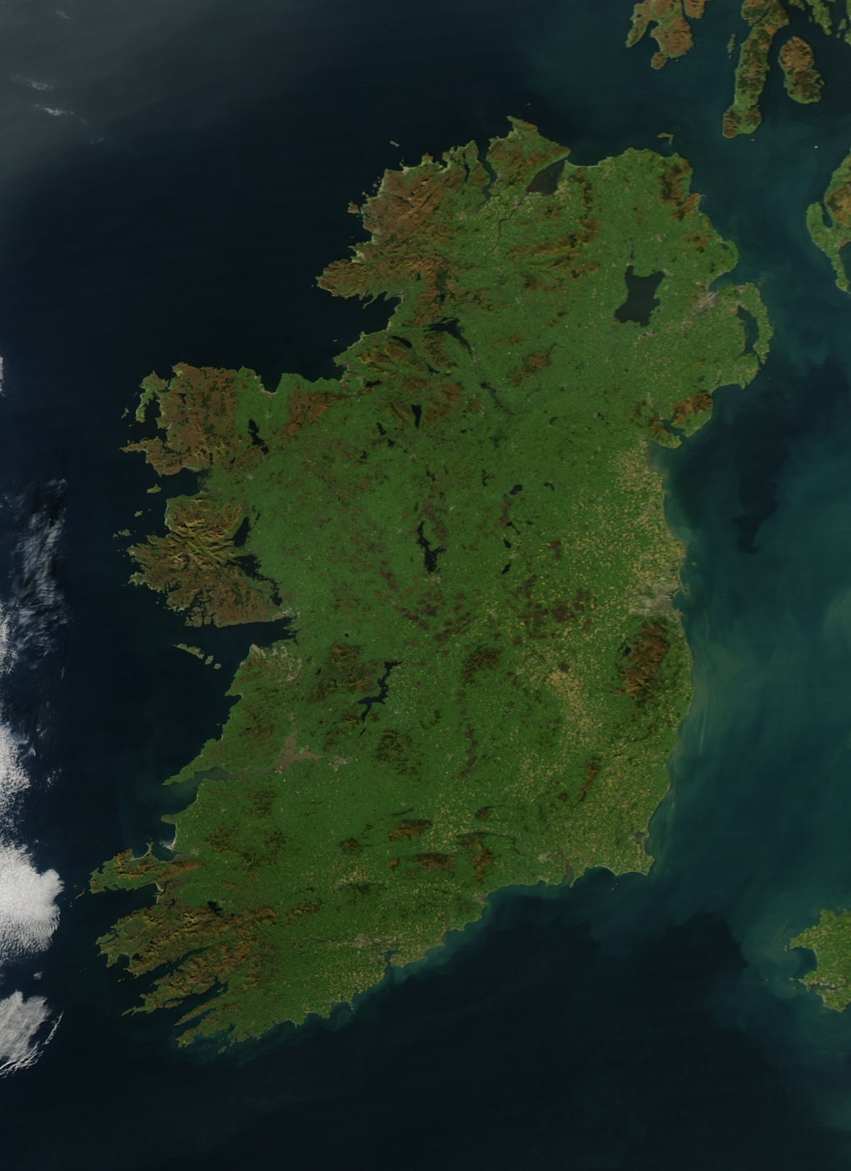
BOGLAND/CARBON_Restore / Peat GHG/ CALISTO/NEROS/A framework for the restoration of degraded peatlands
Glenvar
Organic soils under grassland;
Nutrient poor; deep & shallow drained & rewetted
Lanesborough
Organic soils under grassland;
Nutrient rich; deep drained
Bellacorick
Drained & Rewetted industrial cutaway
Nutrient poor
Clara
Restored raised bog & drained cutover
Lullymore
Abandonned industrial cutaway
Moyarwood
Drained & Rewetted cutover
Nutrient poor
Lodge bog
Rewetted
Glenlahan
Restored blanket bog & drained cutover
Blackwater
Drained & Rewetted industrial cutaway
Nutrient rich
Abbeyleix
Drained & Rewetted cutover
Nutrient poor
Boora
Bare peat industrial cutaway
Sopwell
Restored afforested raised bog
Turraun
Drained & Rehabilitated industrial cutaway
Nutrient rich
Pollagoona
Restored afforested blanket bog
Glencar: Intact blanket bog site!
Research Study Sites
Notes:
collaboration with these stakeholders but also at a national level, Since the first EPA funded project that I led in 2006 (BOGLAND) they funded 12 projects involving all Universities from 4 corners of Ireland; as well as abroad Utrecht is still closely associated with raised bog studies. Beltman and Bjorn Robreck

Slide 6
AUGER (2016-20)
QUBBES (2016-20)
SMARTBOG (2019-
SWAMP (2019-
REFORMWater (2019-
WaterPeat (2019-
Notes:
Having set the scene for research and on-going work on peatland in Ireland, I’d like to set the scene of Irish peatlands in 2019; Amey Tilak

Slide 7
Land use of Irish peatlands
Adapted from Wilson et al. (2013) Irish Geography, 46(1-2), 1-23.
Notes:
Wide range of research which reflected the various land use categories. Put this out for our partners as it is easily misunderstood what kind of peatlands are in Ireland and what’s happening so now I’ll do a quick update starting with policy context.

Slide 8
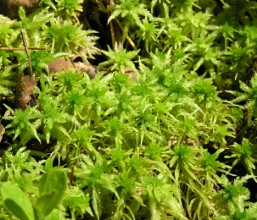
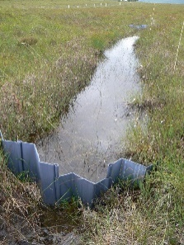
Irish peatlands and policy
BOGLAND (2011 Environmental, Social, Economic and Institutional)
National Peatland Council (since 2013: all stakeholders except Turf cutters)
First National Peatland Strategy (2015)
Climate Action Plan (2019)
Notes:
In the background of IPCC, UNFCC, FAO and other , Irish policies were slow to kick start but are now fully integrated into Govern plans

Slide 9
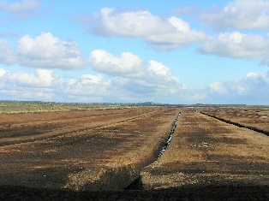
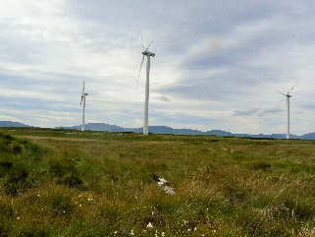
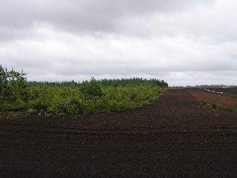
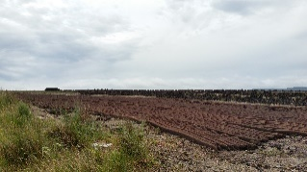
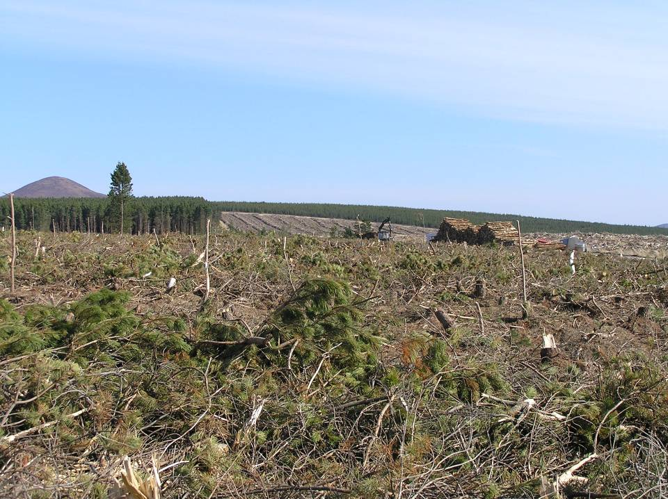
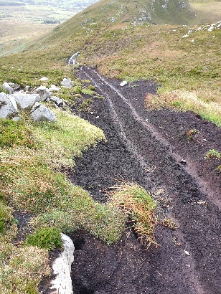
Irish Peatlands 2019 facts checking
Industrial peat extraction for energy to be phased out by 2028
Increased peat extraction for horticulture and bedding (growing market)
Continued domestic turf cutting everywhere but on protected Raised Bogs
Decreased state afforestation on peat
Moderate increase in private afforestation
Other increasing pressures from wind farm, infrastructural developments, recreation activities, invasive species and climate change.
Notes:
What’s up with our peatlands in the 21st century?

Slide 10
Irish Peatlands 2019 facts checking
Industrial peat extraction for energy to be phased out by 2028
Increased peat extraction for horticulture and bedding (growing market)
Continued domestic turf cutting everywhere but on protected Raised Bogs
Decreased state afforestation on peat
Moderate increase in private afforestation
Other increasing pressures from wind farm, infrastructural developments, recreation activities, invasive species and climate change.
Hydrologically and ecologically functioning peatlands (sequestering Carbon and accumulating peat) have become rare! LOSS of biodiversity
Hot spots of CO₂ and N₂O (20% of national GHG emissions!) Loss of Carbon
Polluted water from drained bogs! Loss of water quality
Notes:
More green city parks in Dublin than ‘active’ (i.e. Carbon sequestering) raised bogs; we have our share of national embarassement

Slide 11
Holistic approach to managing peatlands to meet multiple benefits
Biodiversity: micro to macro level
GHG: CO₂, CH_{4,} N₂O
WATER: DOC, POC, NH₄⁺
+POC
Ammonium
Notes:
The 21st century saw New ERA of investigating peatlands to dream of managing them sustainably, meeting multiple benefits for planet and for people

Slide 12
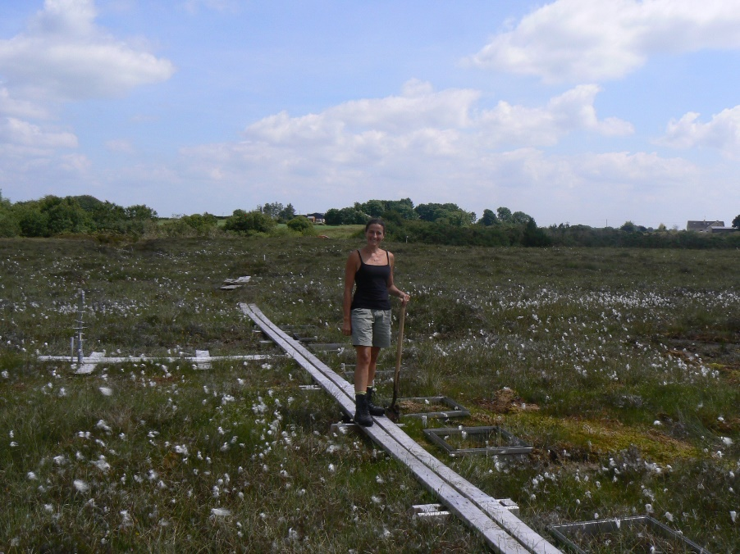
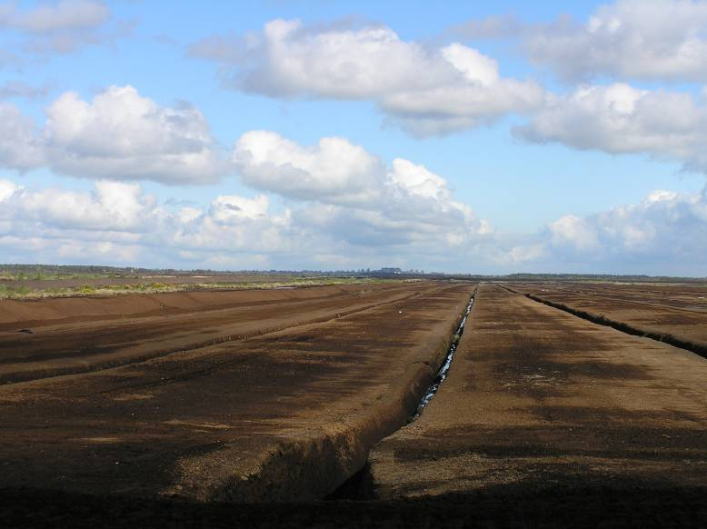
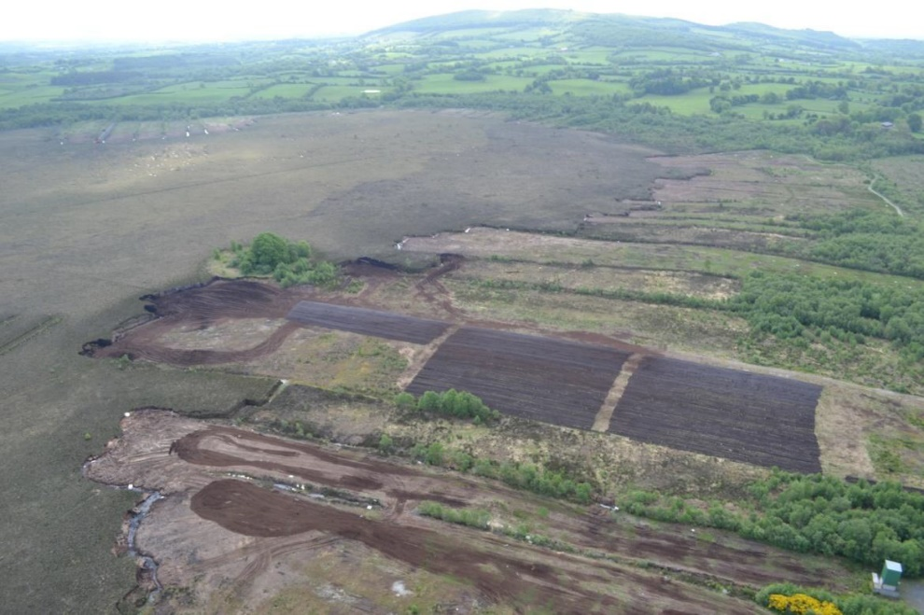
Peatlands and biodiversity:
Where are we losing Biodiversity?
Industrial and domestic peat extraction
Drained grassland
2) Where can we gaining Biodiversity ?
Well managed protected restored bogs
Well managed rewetted bogs
Notes:
And guess what we found…

Slide 13
Peatlands and climate:
Where are we losing Carbon?
Industrial and domestic peat extraction
Drained grassland
2) Where can we gaining Carbon ?
Well managed protected restored bogs
Well managed rewetted bogs
Notes:
Studies across this Island of Ireland showed:

Slide 14
Peatlands and water:
Where are we losing Water quality?
Industrial and domestic peat extraction
Drained grassland
2) Where can we gaining Water quality ?
Well managed protected restored bogs
Well managed rewetted bogs

Slide 15
2 actions towards sustainable management of peatlands
Restoration of protected peatlands
Rewetting of degraded peatlands
→ Biodiversity loss
→ Water pollution and cost of cleaning water
→ Climate mitigation (stopping CO2 emissions)
Notes:
Clear message: 2 actions to combat 3 ennemies

Slide 16
Restoration, Rehabilitation, Rewetting (IPCC, 2014)
Restoration aims to permanently re-establish the pre-disturbance wetland ecosystem, including hydrological and biogeochemical processes typical of water saturated soils, as well as vegetation cover that pre-dated the disturbance

Slide 17
Restoration, Rehabilitation, Rewetting (IPCC, 2014)
Restoratino aims to permanently re-establish the pre-disturbance wetland ecosystem, including hydrological and biogeochemical processes typical of water saturated soils, as well as vegetation cover that pre-dated the disturbance and usually involving rewetting.
Rehabilitation can involve a large variety of practices on formerly drained peat soils which may or may not include rewetting.

Slide 18
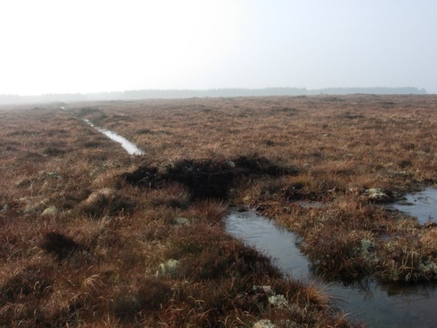
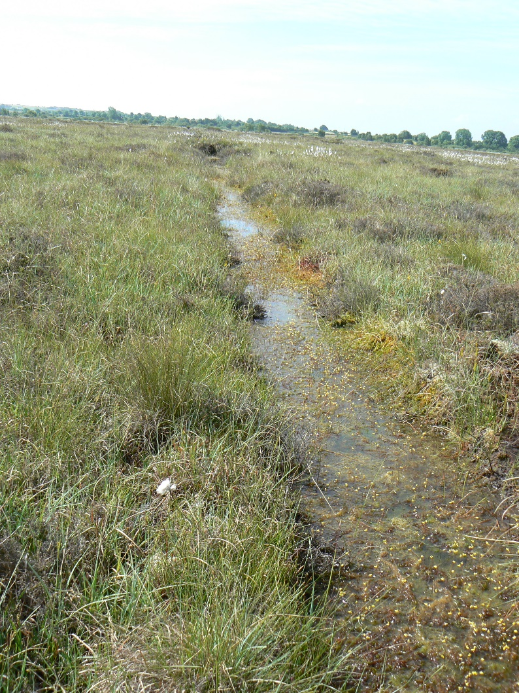
Rewetting is the deliberate action of raising the water table in soils that have previously been drained …….. in order to re-establish and maintain water saturated conditions
Notes:
Rewetting is are first remedy like all medication, the instructions are important and as we medicine taken with other instruction such as restoration can have synergistic effect

Slide 19
Biogeochemical dynamics in rewetted peatlands
Carbon dynamics
Vegetation communities
Current land Management
Previous land use
Nutrient status
Time since rewetting
Every rewetted site is unique!
Notes:
Impact of rewetting is a highly site specific with the following drivers being at play

Slide 20
Biogeochemical dynamics in rewetted peatlands
Carbon dynamics
Vegetation communities
Current land Management
Previous land use
Nutrient status
Time since rewetting
Natural or
pro-active recolonisation
Residual peat depth
Active rewetting;
Paludiculture
Climate/
geography
Every rewetted site is unique!
Notes:
We need to be pro active such as rewetting now where we can; if we just switch off the pumps and walk away hoping for some water to stay around the site becomes even more dynamic;
also our latest study showed the more we wait to rewet the longer it will take; rewetted sites are not as resilient as intact ones

Slide 21
Rewetted peatlands vs Natural peatlands
Notes:
error bars Greater interannual variation;

Slide 22
Take home message
Holistic approach to tackle current environmental and socio-economic issues
Peatlands can be part of the solution but not one silver bullet
Build on existing knowledge and need to make sure recommendations are replicable
Predictions are difficult at best but really unknown in face of climate change

Slide 23
