Slide 1
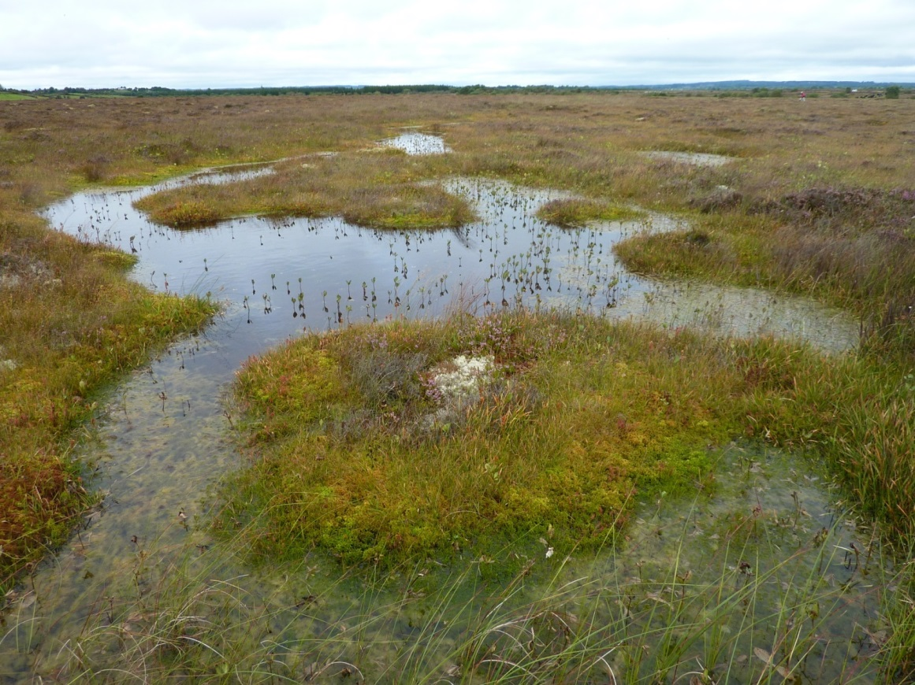
Restoring Ireland’s Raised Bogs
Dr, Maurice Eakin,
Senior Wetland Ecologist,
National Parks and Wildlife Service
CARE-Peat meeting
25th September, 2019

Slide 2
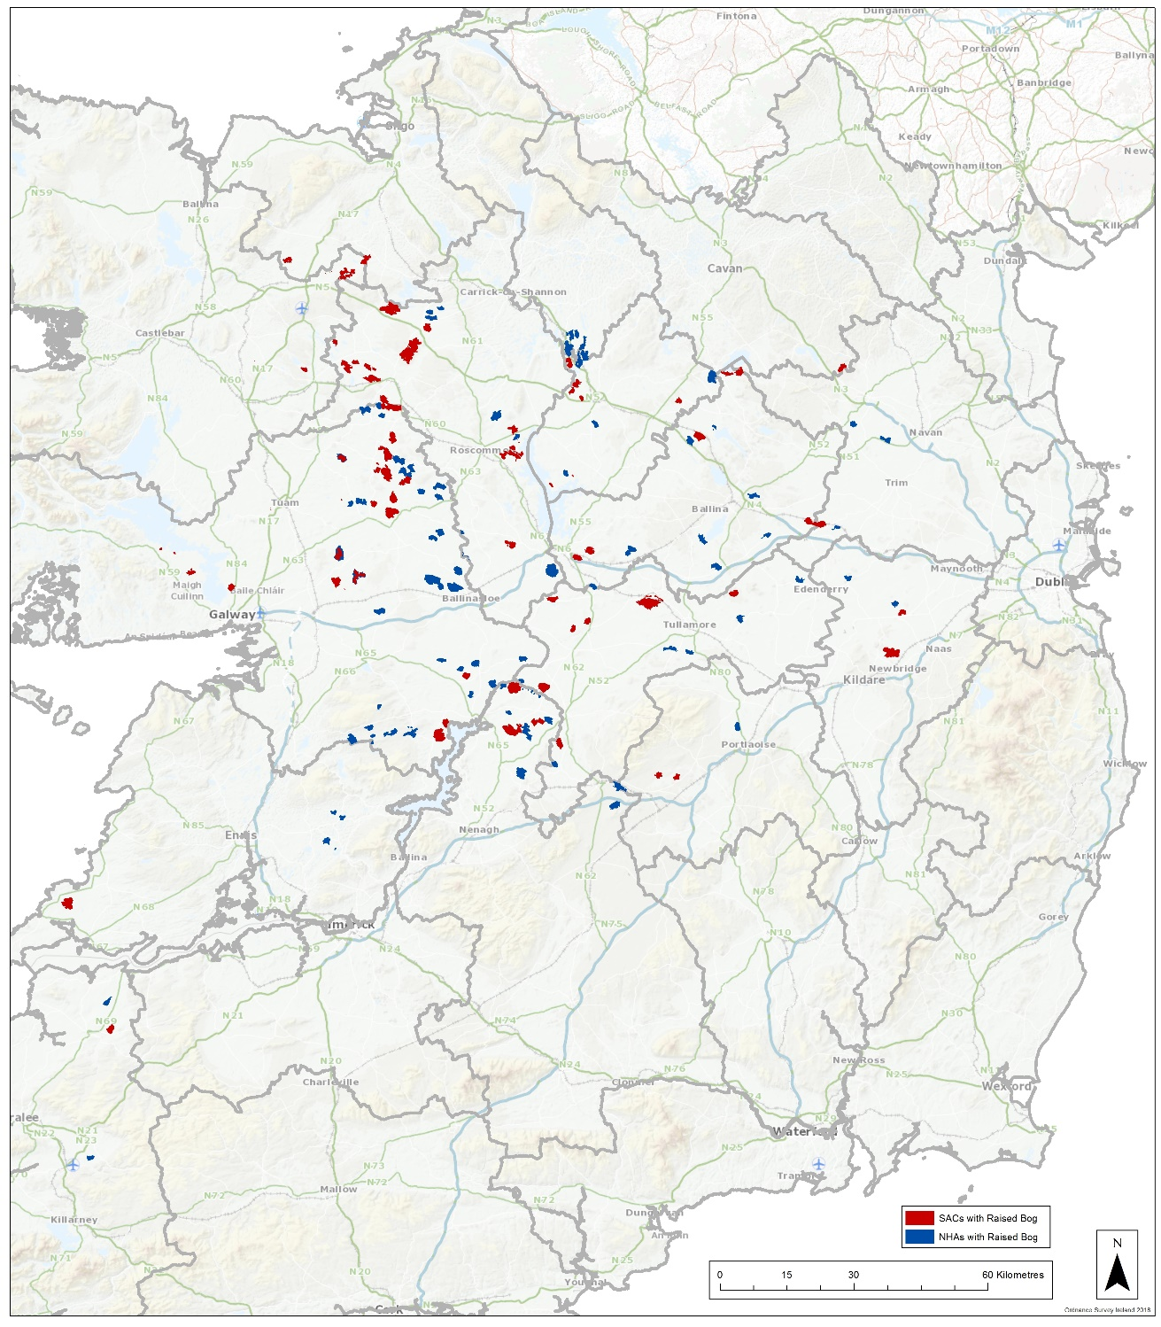
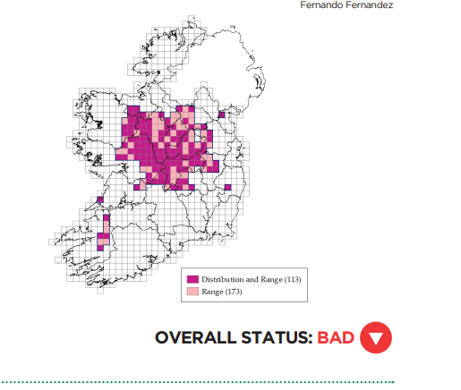
Ireland’s network of designated raised bogs:
53 55 raised bog sites as Special Areas of Conservation: designated 1997-2002 under Habitats Directive
75 61 raised bog as Natural Heritage Areas: designated 2002-2004 under the Wildlife Acts.

Slide 3
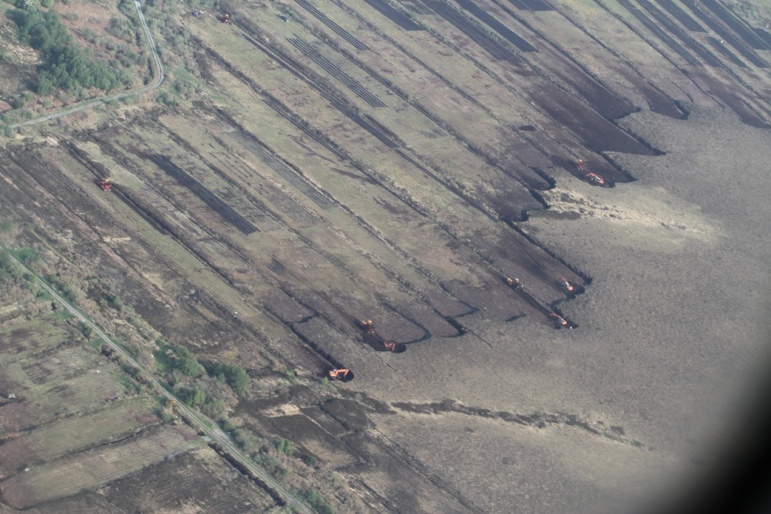
Ireland, the EU and raised bogs
January, 2011 - European Commission issued a Letter of Formal Notice re continued turf-cutting in SACs/NHAs.
Reasoned Opinion in June 2011
Further Reasoned Opinion in November 2018
Notes:
CONSERVATION MEASURES - SIs, - CONSERVATION OBJECTIVES
VISITS TO BRUSSELS – VERY REWARDING
MEETINGS WITH DEPUTY FITZMAURICE (TCCA)

Slide 4
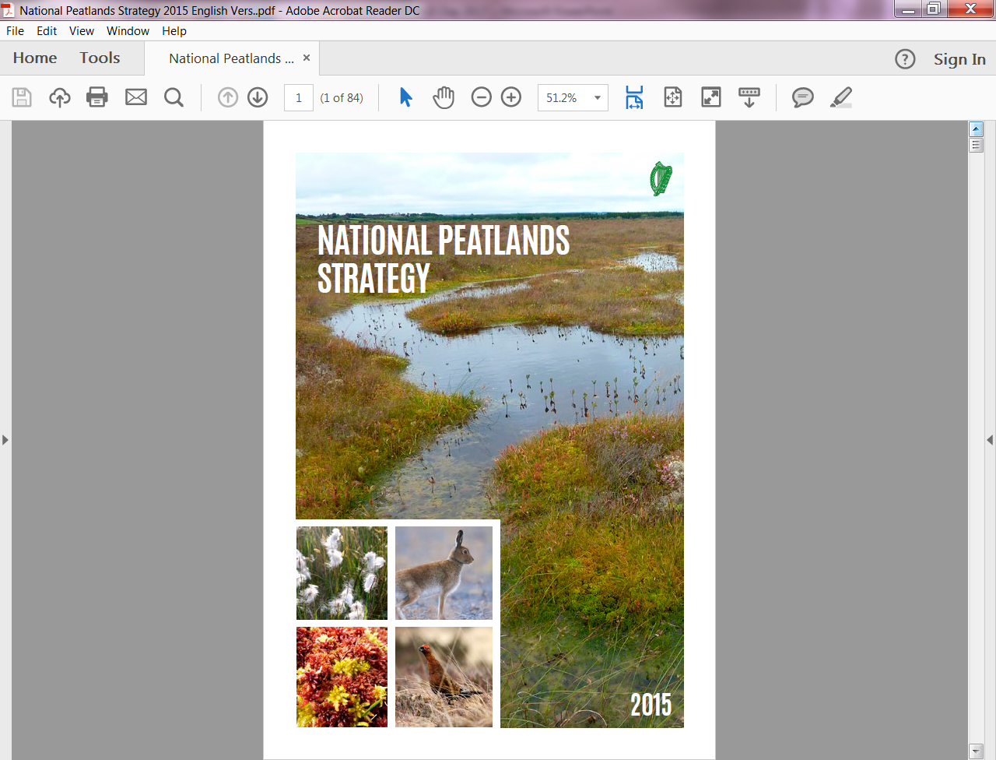
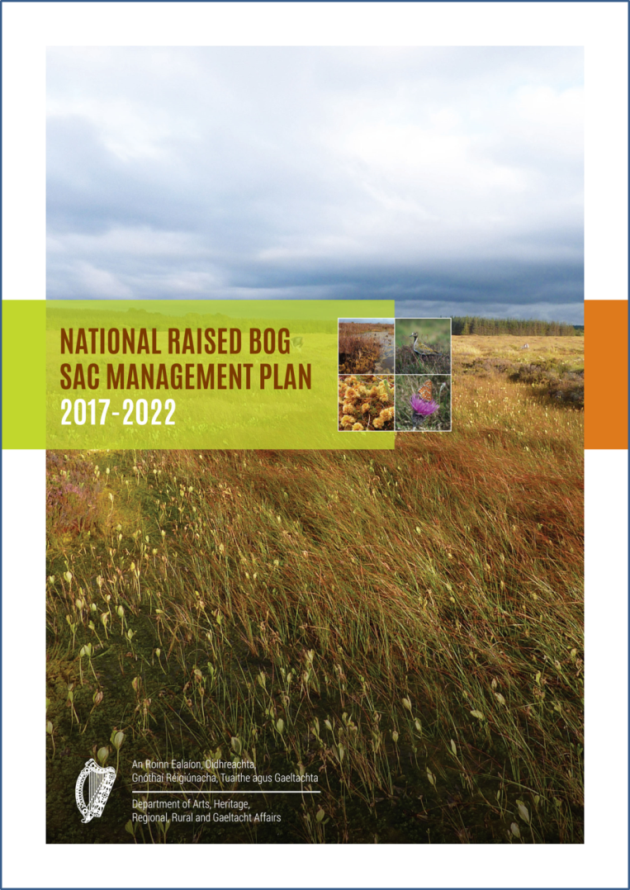
VISION STATEMENT:
“This Strategy aims to provide a long-term framework within which all of the peatlands within the State can be managed responsibly in order to optimise their social, environmental and economic contribution to the well-being of this and future generations.”
“This National Plan for the raised bog SAC network now for the first time sets out a roadmap for the long-term management, restoration and conservation of protected raised bogs.”

Slide 5
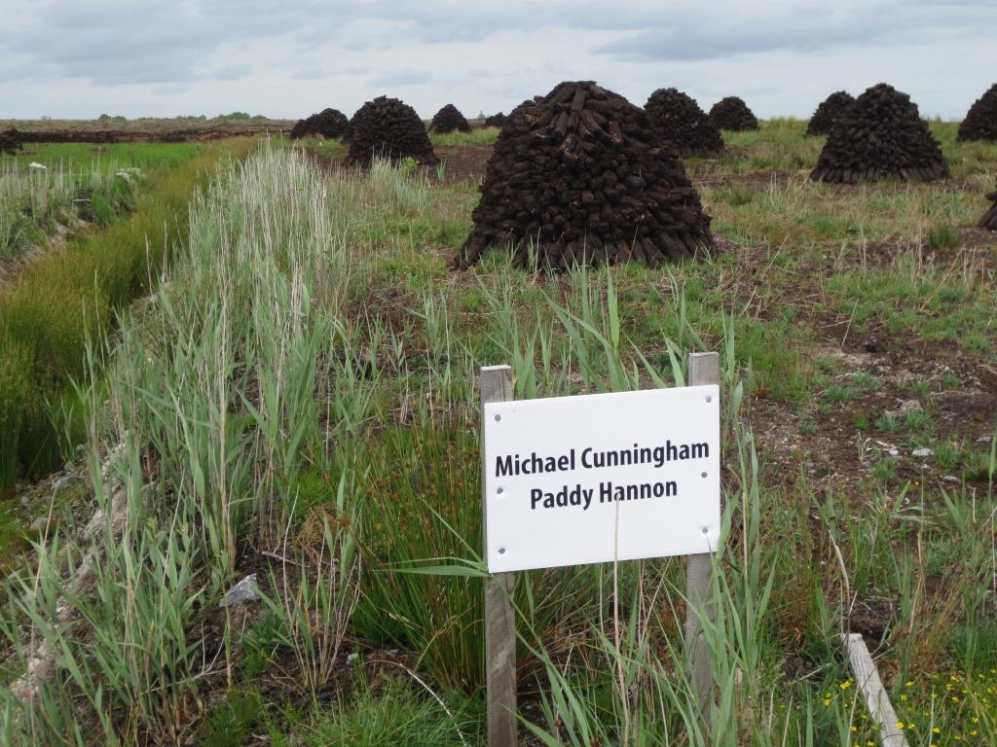
Cessation of Turf Cutting Compensation Scheme (CTCCS)
3,351 applications for raised bog SACs.
15,332 payments and 902 deliveries of turf.
= €23.2 million.
Scheme extended to raised bog NHAs - 651 applications received and 1078 payments made (= €1.6million).
C.€2.6m spent on relocation with 603 applicants continuing to express an interest
Niall Ó Brolcháin
Terry Morley

Slide 6
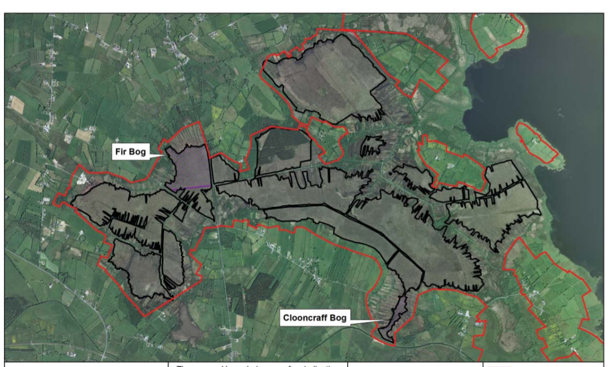
“Article 6.3” (Habitats Directive) Investigations to allow turf cutting in SACs
Drainage Management Plans

Slide 7
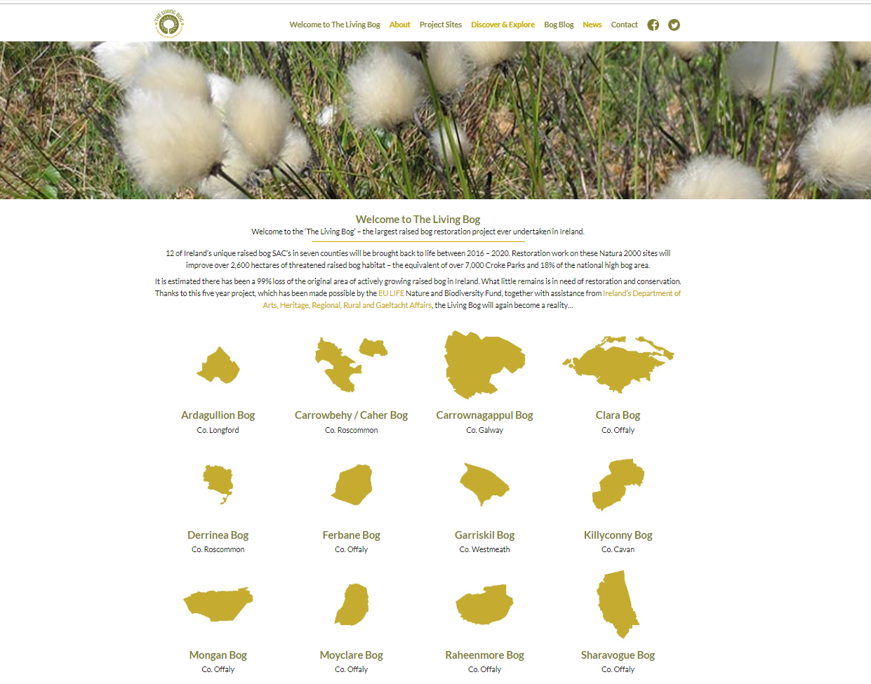

Slide 8
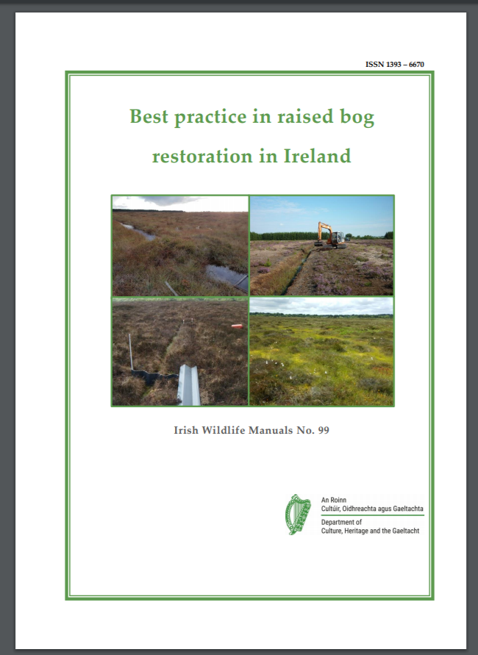

Slide 9
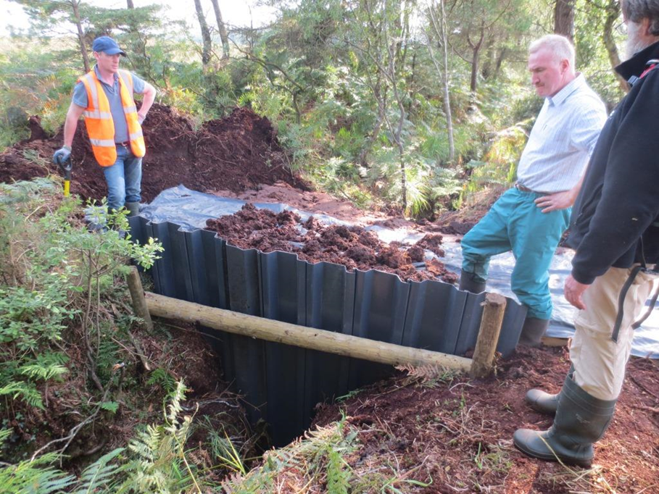

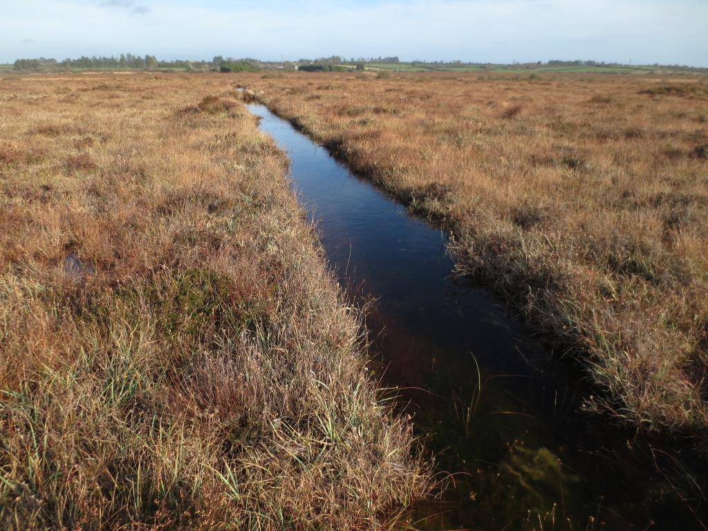

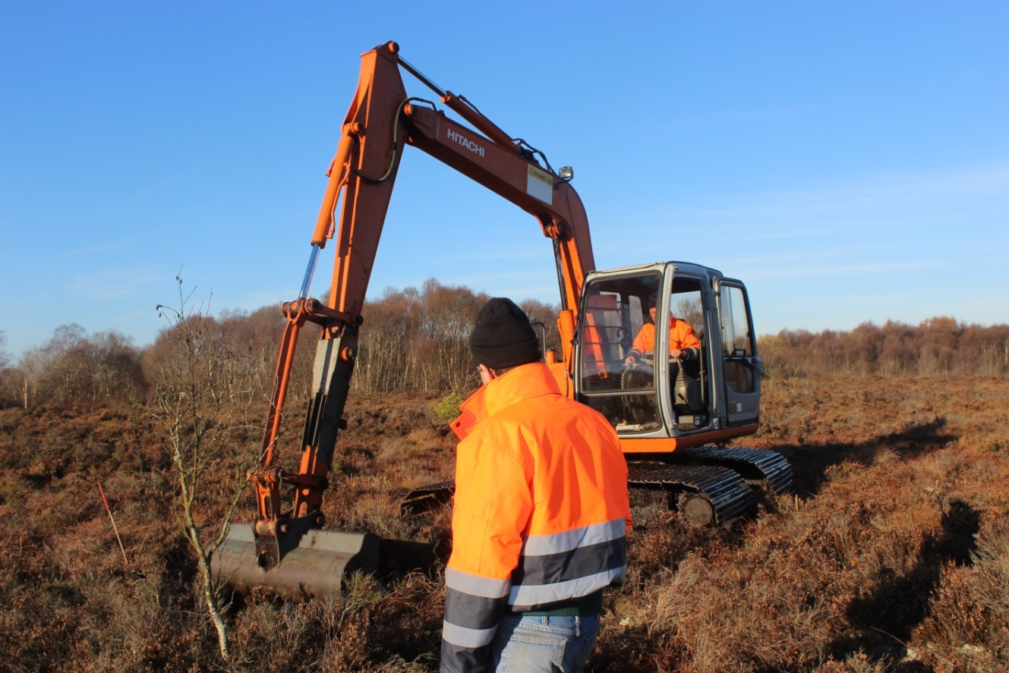

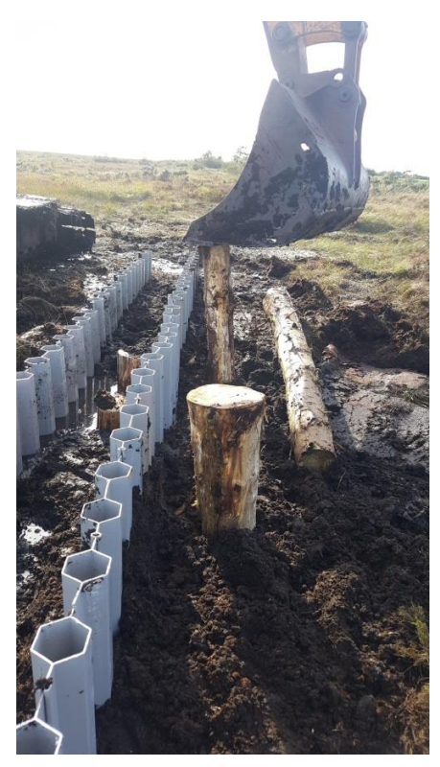
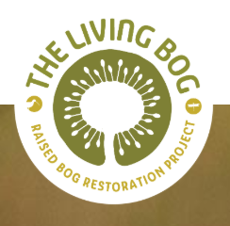
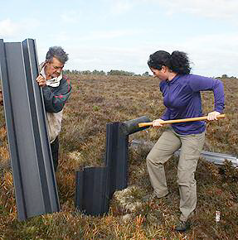
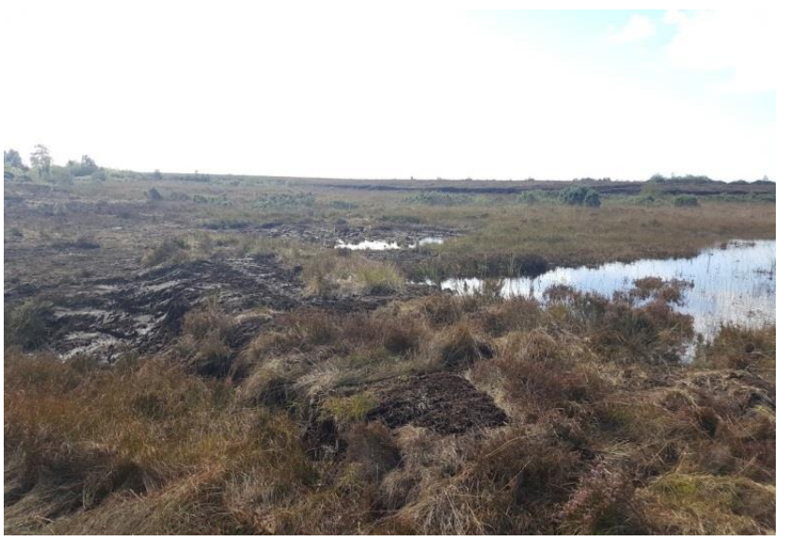

At Work:

Slide 10
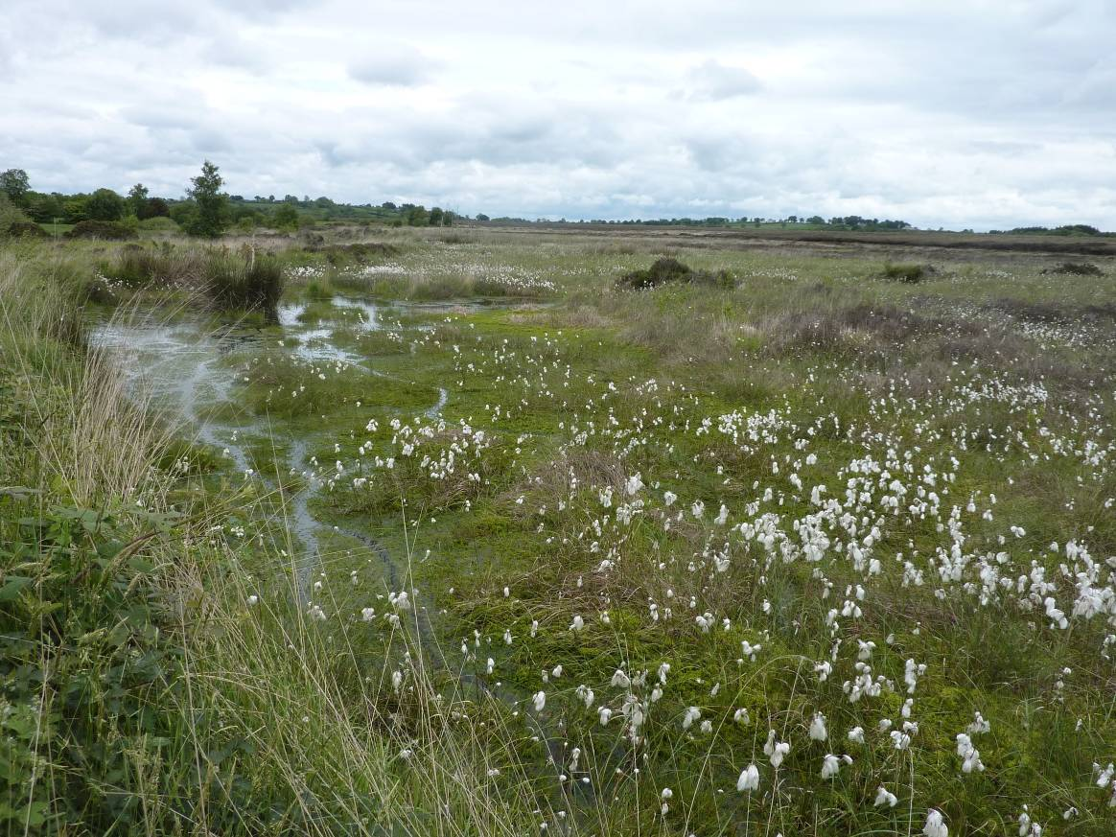
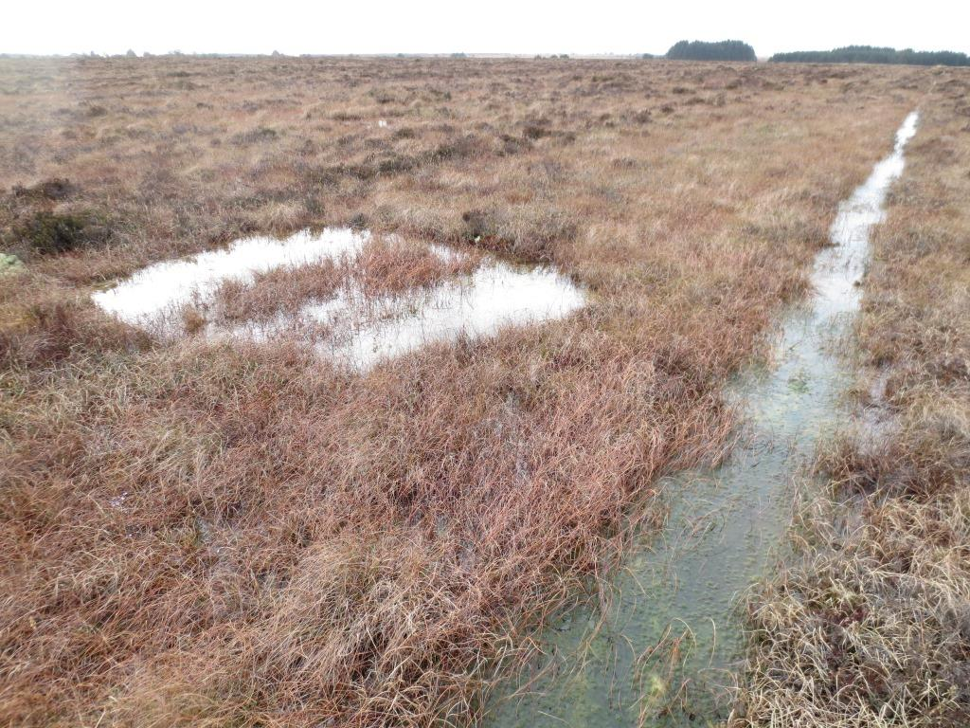
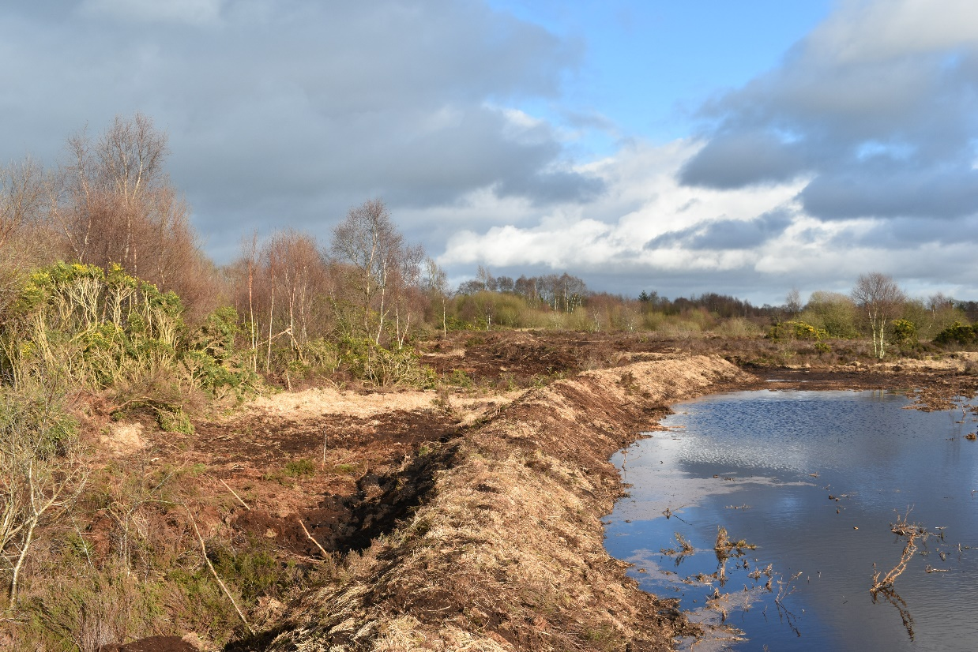
Results:

Slide 11
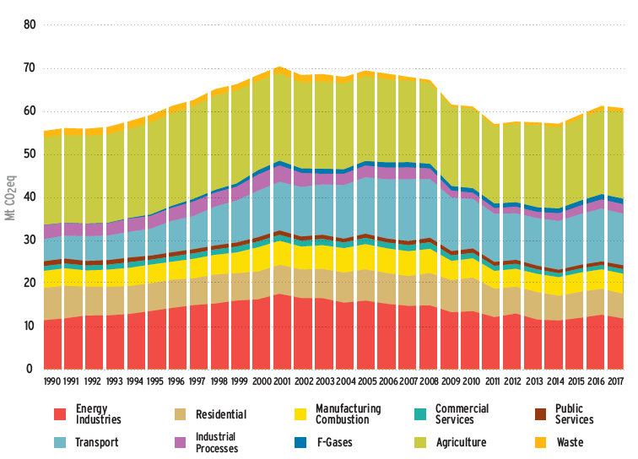
Carbon emissions
~ 7 Mt CO₂ equivalent (global warming potential)
Sink: ~ 60 Kt C-CO₂ year⁻¹
Source: ~ 1.5 to 2 Mt C-CO₂ year⁻¹
Large source due to persistently lowered water tables that increase CO₂ emissions due to the decomposition of the surface vegetative layer and shallow peat
In 2018, EU Parliament amended LULUCF legislation in the 2030 climate and energy framework including managed wetlands.
Reporting from 2021 or 2026.
EPA, 2017

Slide 12
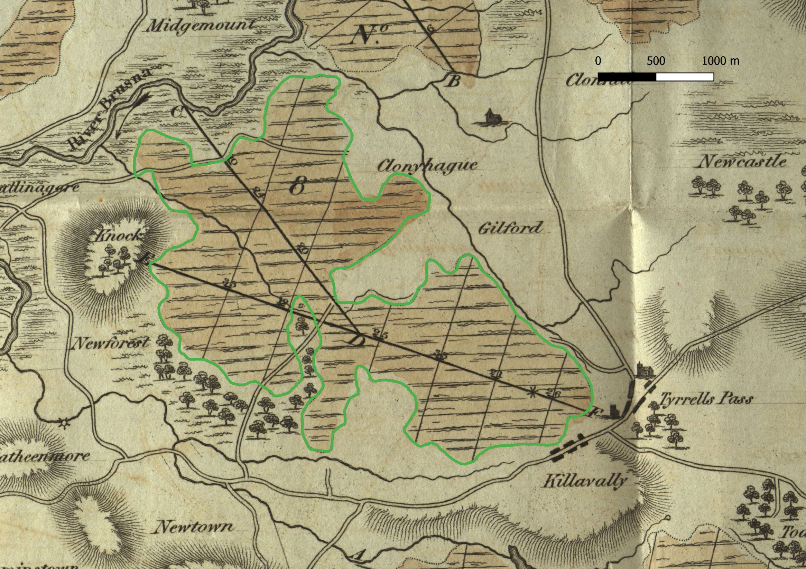

Slide 13
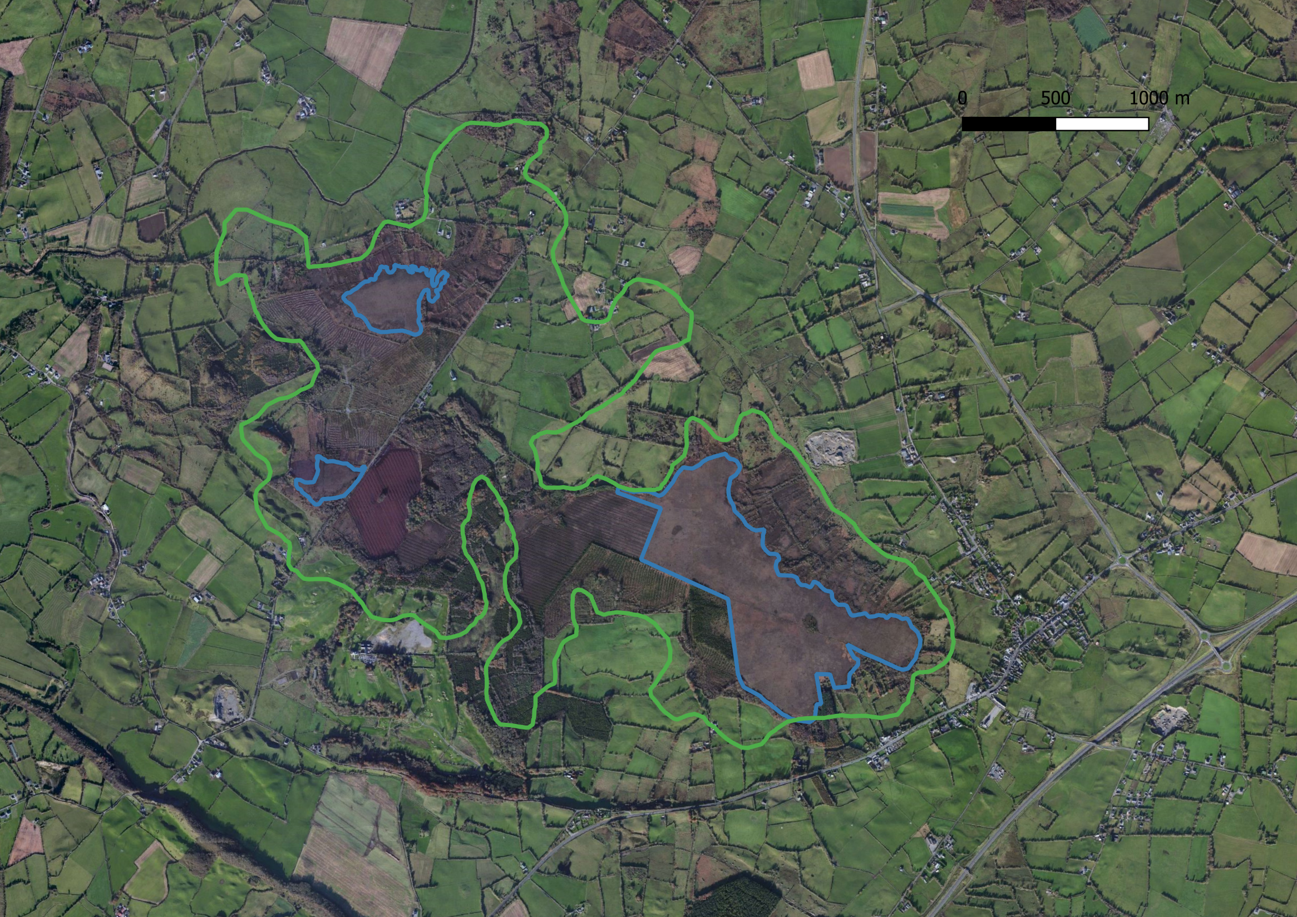
Original area ~610 ha. Current non-modified = 97 ha thus a 84% loss from original

Slide 14
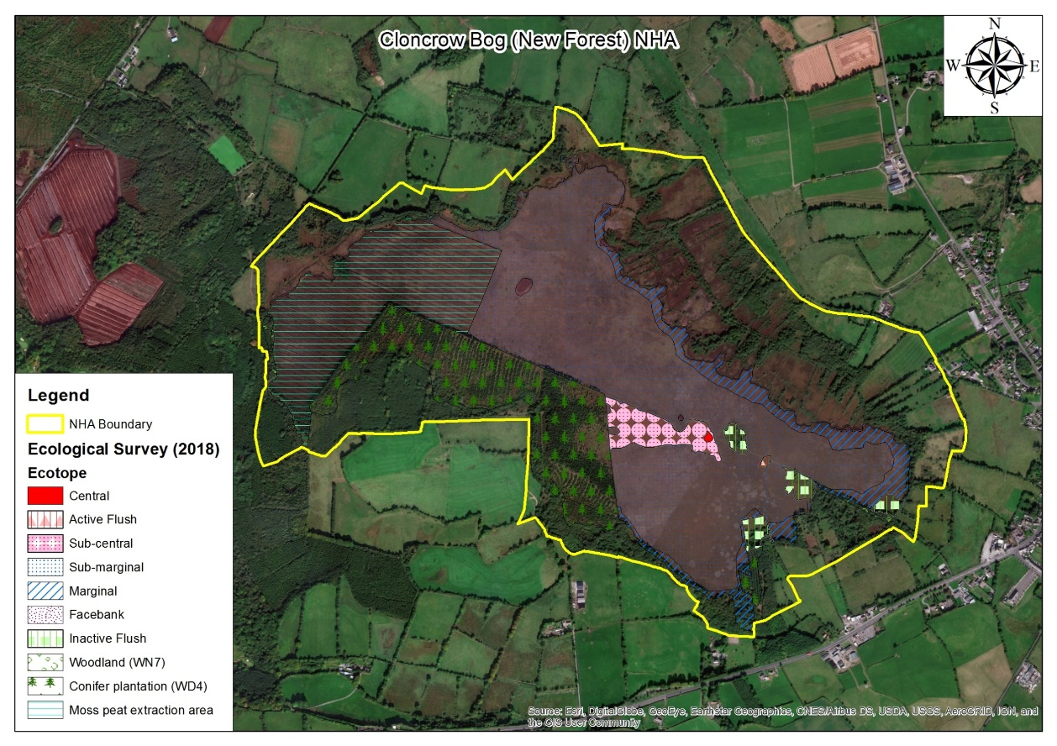

Slide 16
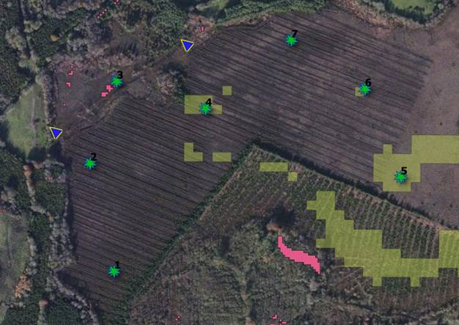

Slide 17
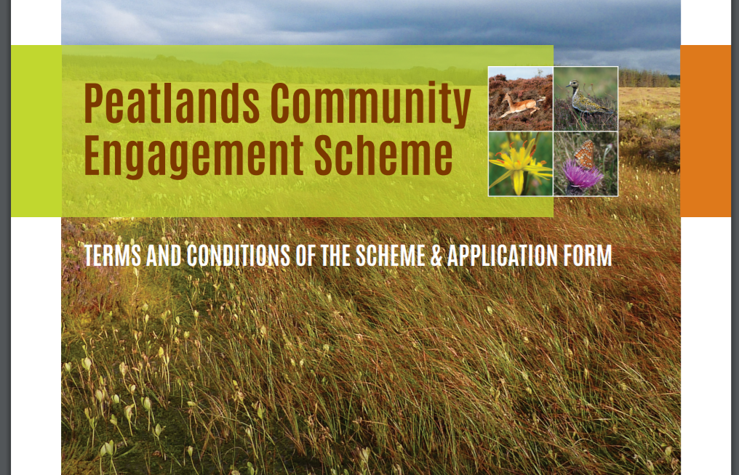

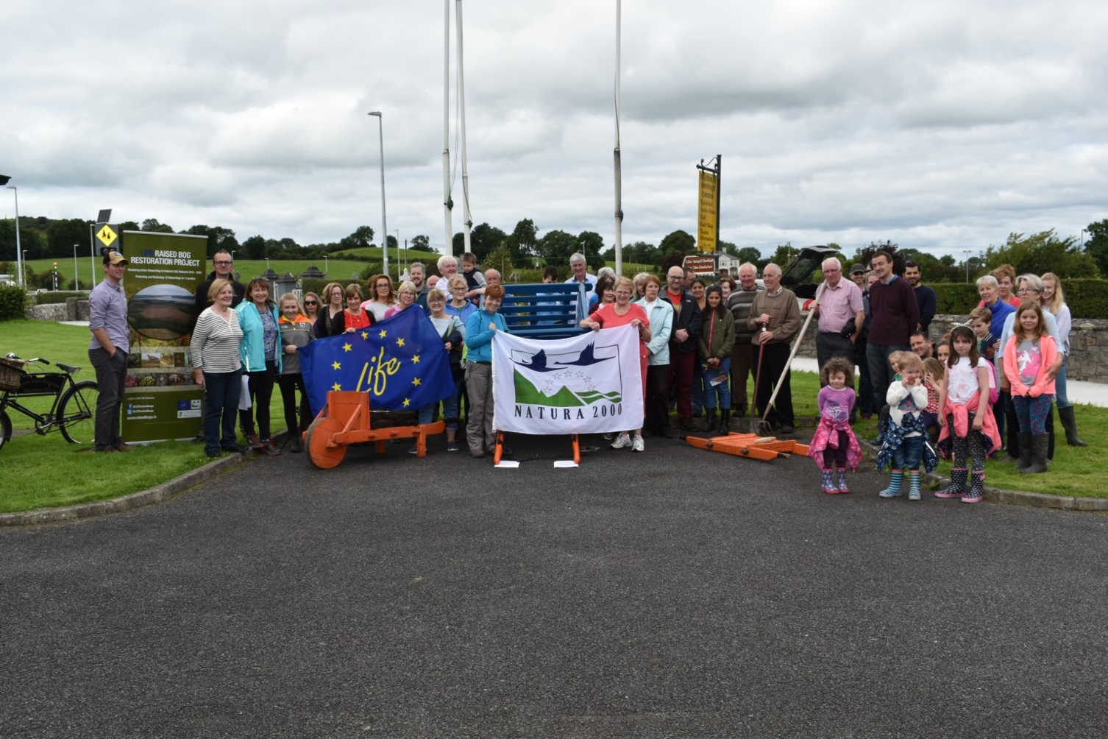
Thank You!

