Slide 1
Workshop : GHG fluxes measurement plan
What? How? Where? When?
Sébastien Gogo

Slide 2
Plan of the workshop
⇒ Measurement plan in CARE PEAT
⇒ The case of the Dutch site
⇒ Discussion

Slide 3
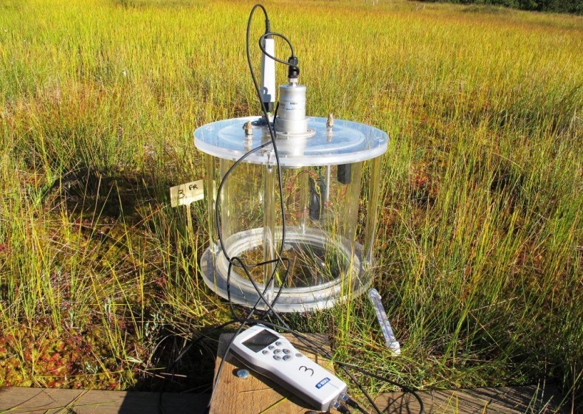
1.1. What and how do we measure?
The whole C budget of the ecosystem?
⇒ very expensive, a lot of human ressources
⇒ in CARE-PEAT focus on greenhouse gases CO₂ and CH₄ budget
Which technique?
⇒ many techniques available (profiles, eddy covariance, chamber)
⇒ in CARE-PEAT : chamber measurements
⇒ CO₂
⇒ CH₄
Los Gatos Research equipement

Slide 4

1.1. What and how do we measure?
CO₂
GPP
Ecosystem
NEE = ER – GPP
ER
Sol
GPP : Gross Primary Production
ER : Ecosystem Respiration
NEE : Net Ecosystem Exchange
NEE > 0 : source system
NEE < 0 : sink system

Slide 5
1.1. What and how do we measure?
CH₄
CO₂
GPP
Ecosystem
NEE = ER – GPP
ER
Sol
GPP : Gross Primary Production
ER : Ecosystem Respiration
NEE : Net Ecosystem Exchange
NEE > 0 : source system
NEE < 0 : sink system

Slide 6
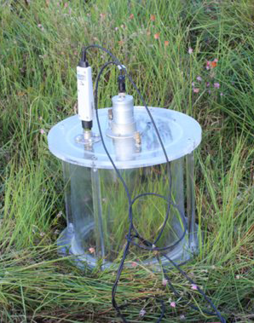
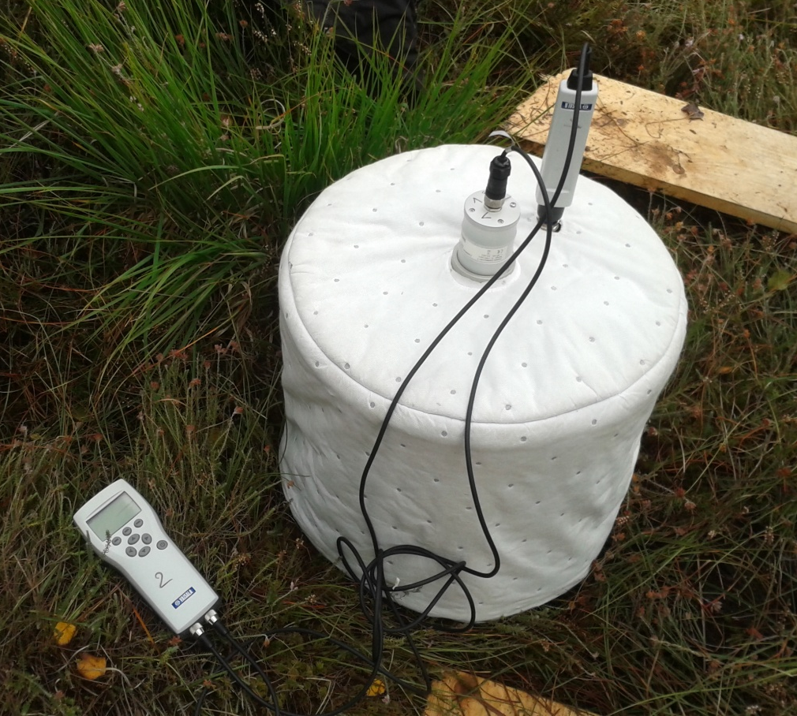
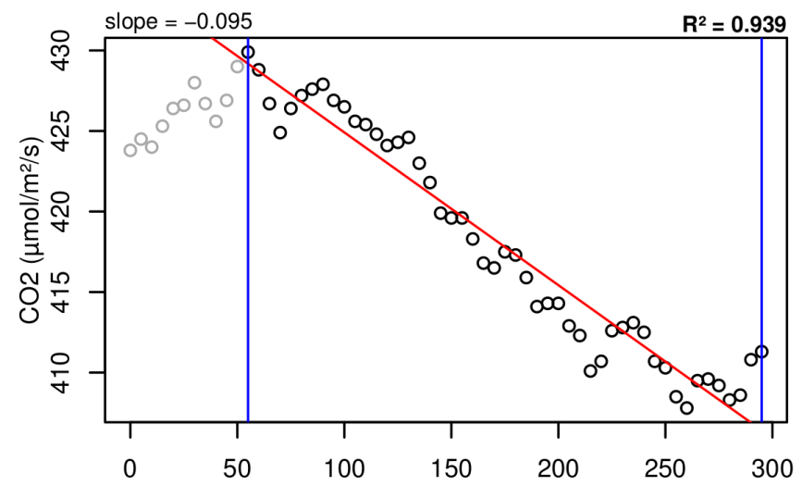
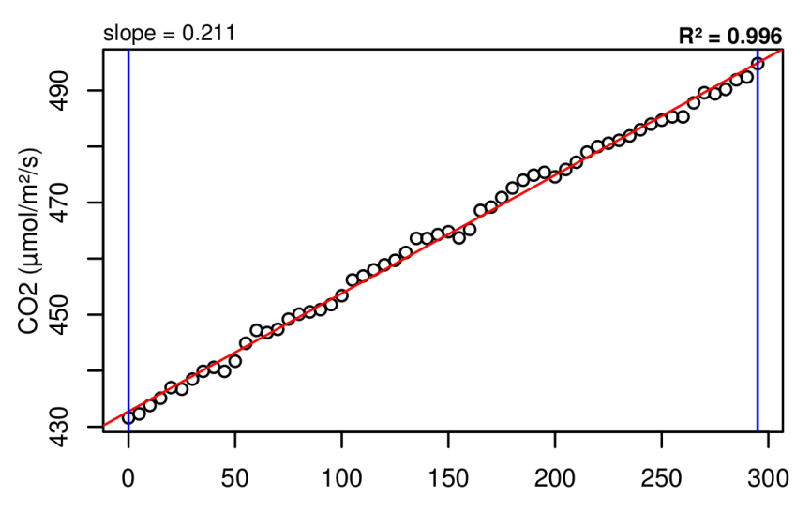
1.1. What and how do we measure?
NEE = ER - GPP
_{Full light}
ER
_{Dark}
CO₂
CO₂
GPP
ER
ER
[CO₂]
(ppm)
[CO₂]
(ppm)
Time (s)
Time (s)

Slide 7
1.1. What and how do we measure?
Use nets to have the light response of CO₂ fluxes
Nets with different mesh
Ancillary variables, high frequency (1 hour min)
Water table depth
Air and soil temperature
Solar radiation
Vegetation % cove
Soil water content, if possible

Slide 8
1.2. Where and when do we measure?
GHG budget before and after restoration works?
⇒ not possible, need of many years timeseries
⇒ in CARE-PEAT: focus on comparison between restored and control area to assess the effect of restoration actions on GHG budget
RESTORED area
CONTROL area
To better take into account the spatial heterogeneity
Site
Measuring plots
Sub-area RESTORED #1
Sub-area RESTORED #2
Sub-area CONTROL #2
Sub-area CONTROL #1

Slide 9
1.2. Where and when do we measure?
⇒ French pilot
SITE
La Guette
Stripped + Sphagnum
AREA
Control
SUB-AREA
Molinia
Erica
Sphagnum
Bare peat
REPLICATE
x3
x3
x3
x3
Measurement at what frequency?
⇒ At least 12 campaigns
⇒ 1 light response curve per plot, per campaign

Slide 10
1.3. To do what with the data?
From low frequency data to annual budget?
a) Time series from field campaigns
c) Variables measurement at high frequency
FLUX
b) Models building
FLUX = a.VARIABLE + b
Variable
d) Calculation of high frequency flux time series
e) Integration of the fluxes to obtain the yearly GHG budget

Slide 11
1.4. Modeling approach in CARE-PEAT
All pilot managers
BRGM
Methods and tools
UO, NUIG, MMU
WP T3
All pilot managers
UO, NUIG, MMU
Model based on vegetation
The whole consortium (associate partners)
Decision Support Tool
BRGM
WP LT
peatland managers

Slide 12
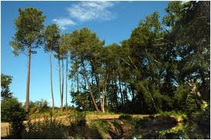
2. The Dutch site
Water
Peat
bare peat under water
natural succession towards Phragmites
bare peat under water and floating mats
natural succession
towards Phragmites

Slide 13
2. The Dutch site
Water
Peat
bare peat under water
natural succession towards Phragmites
bare peat under water and floating mats
natural succession
towards Phragmites
What do we do?

