Slide 1
WP T3 Transnational preparation, implementation and demonstration of new techniques and methods to restore C-sequestrations in peatlands
MMU in collaboration with all partners

Slide 2
Agenda and objectives
Review information in draft restoration plans
Review practical works
Discuss issues and opportunities
Make plans to finalise over next 3 months for Dec 2019

Slide 3
Key activities
Transnational analyses and (re-)development of the pilot site restoration plans – by 31st October 2019 (some say 31/12/19)
Preparation and implementation of pilots (Reports due April 2021-April 2022)
Monitoring of the pilot sites on CO₂ reduction and/or Carbon storage (some in WP T1) – reports due May 2020-April 2022
Transnational demonstrations and discussions – due Sept 2020

Slide 4
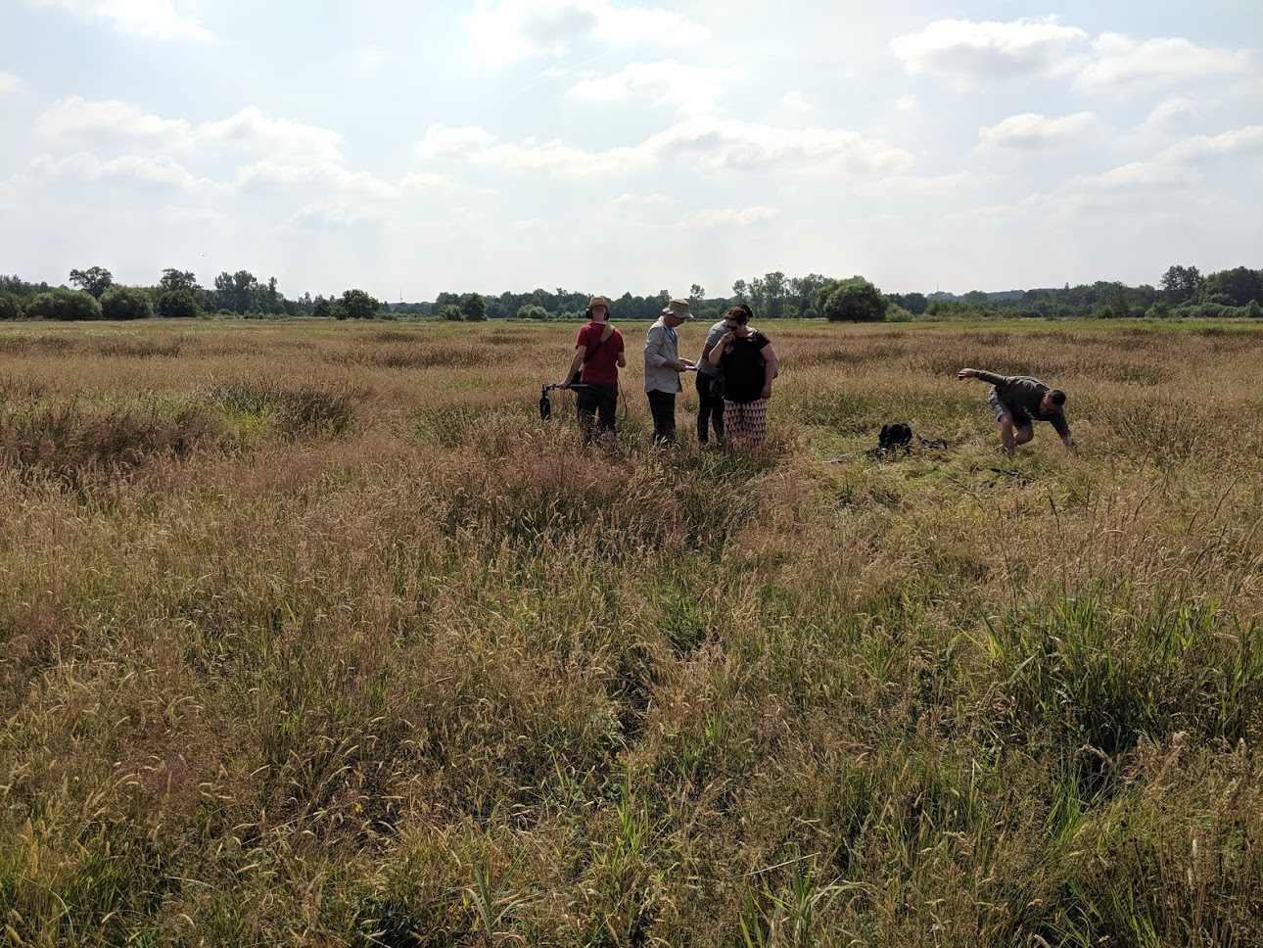
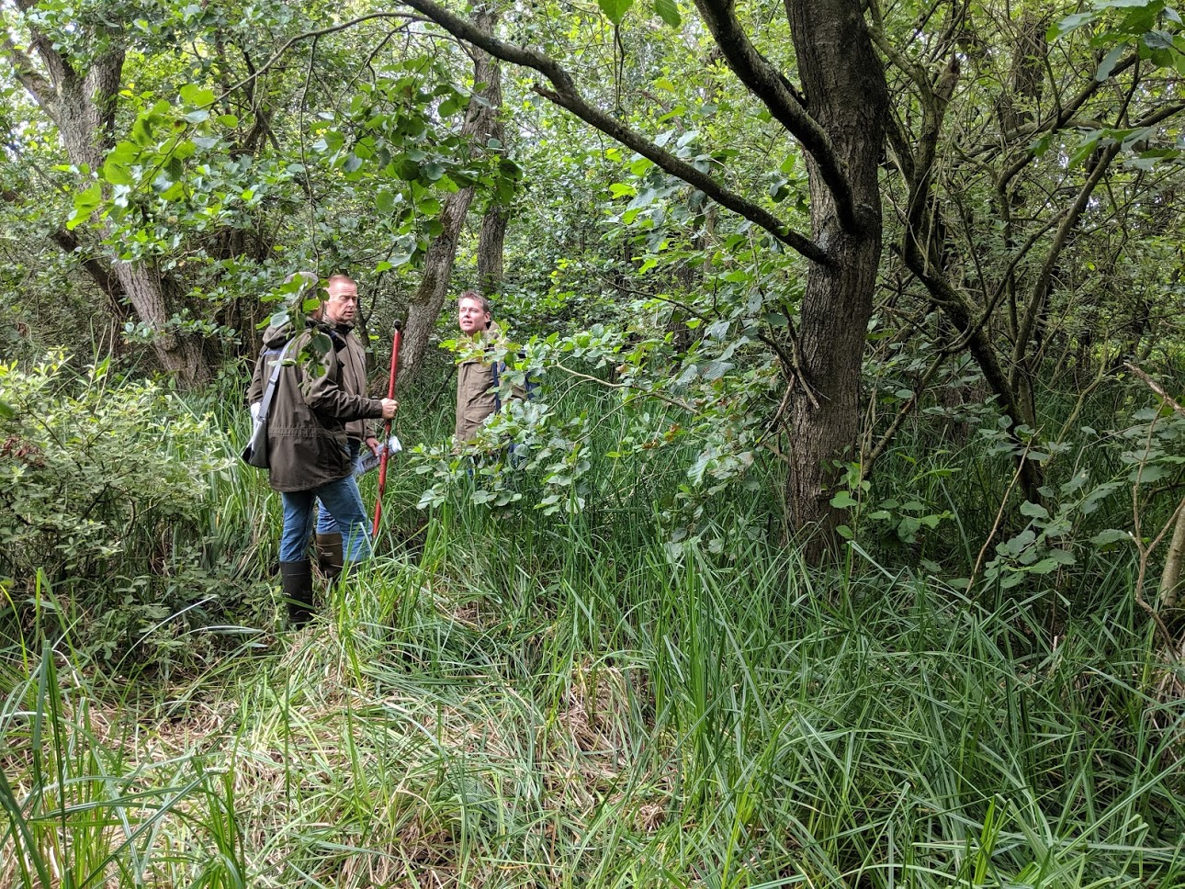
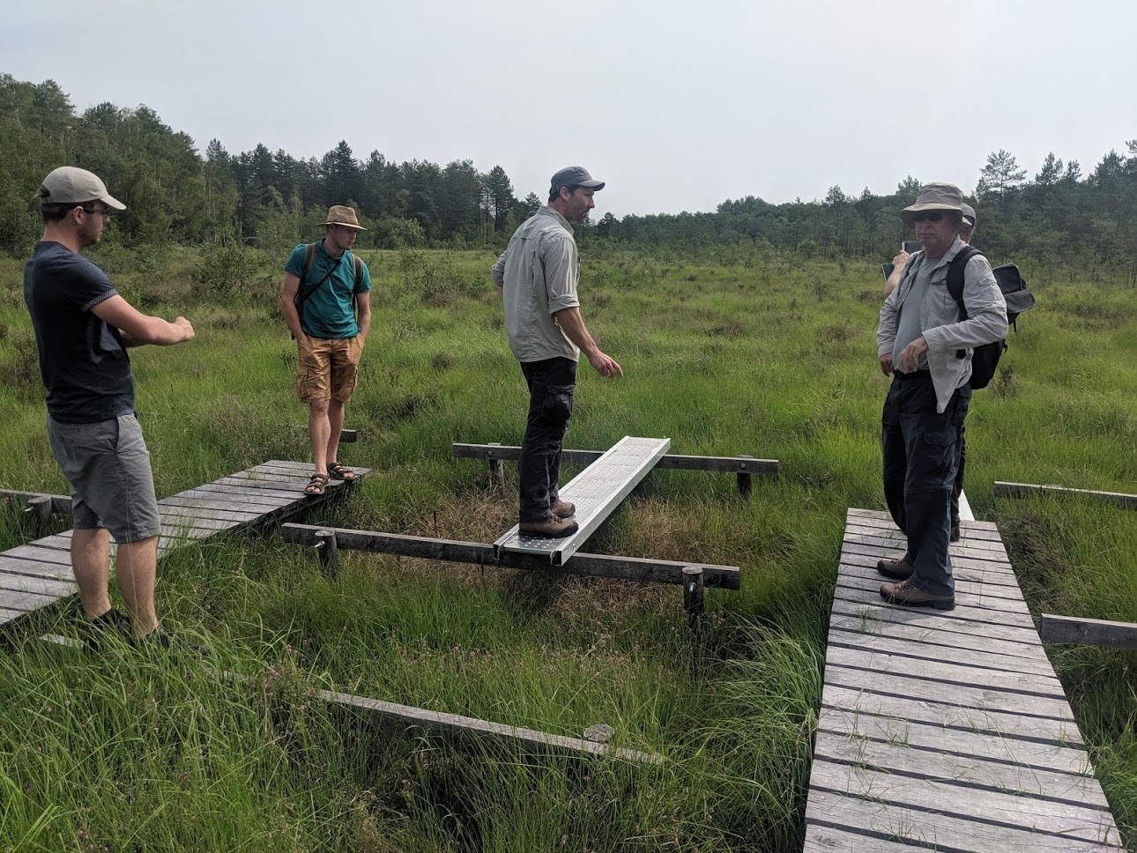
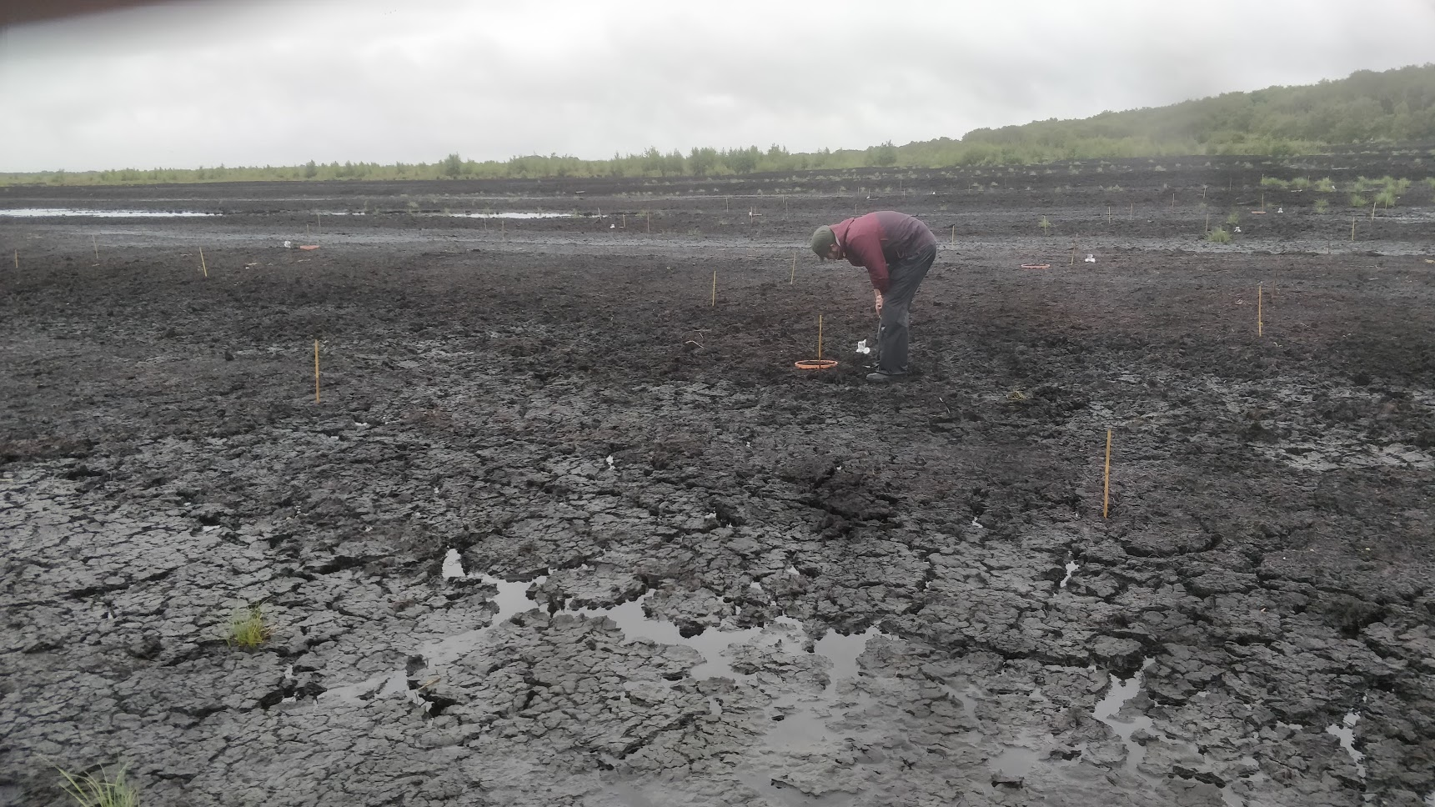
2019 site visits

Slide 5
Current status
All sites (except Ireland) visited July/August 2019
Basic vegetation surveys and soil + soil water samples collected
Soil chemistry: available N, pH, LOI carried out
Comparison with desired state and other data complete
Draft restoration plan templates received from all
Satellite work: in progress, initial images captured.
Drone monitoring: done (by NUIG), need to interpret for topography and wetness index

Slide 6
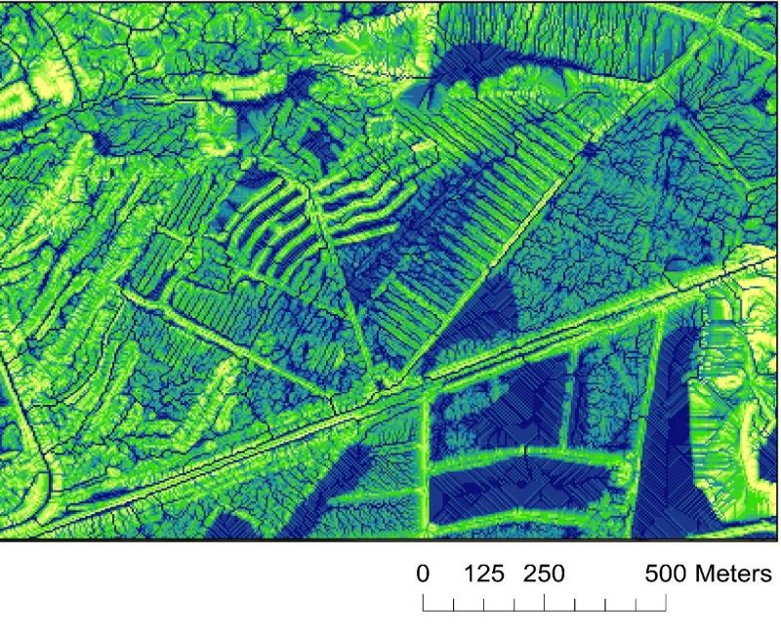
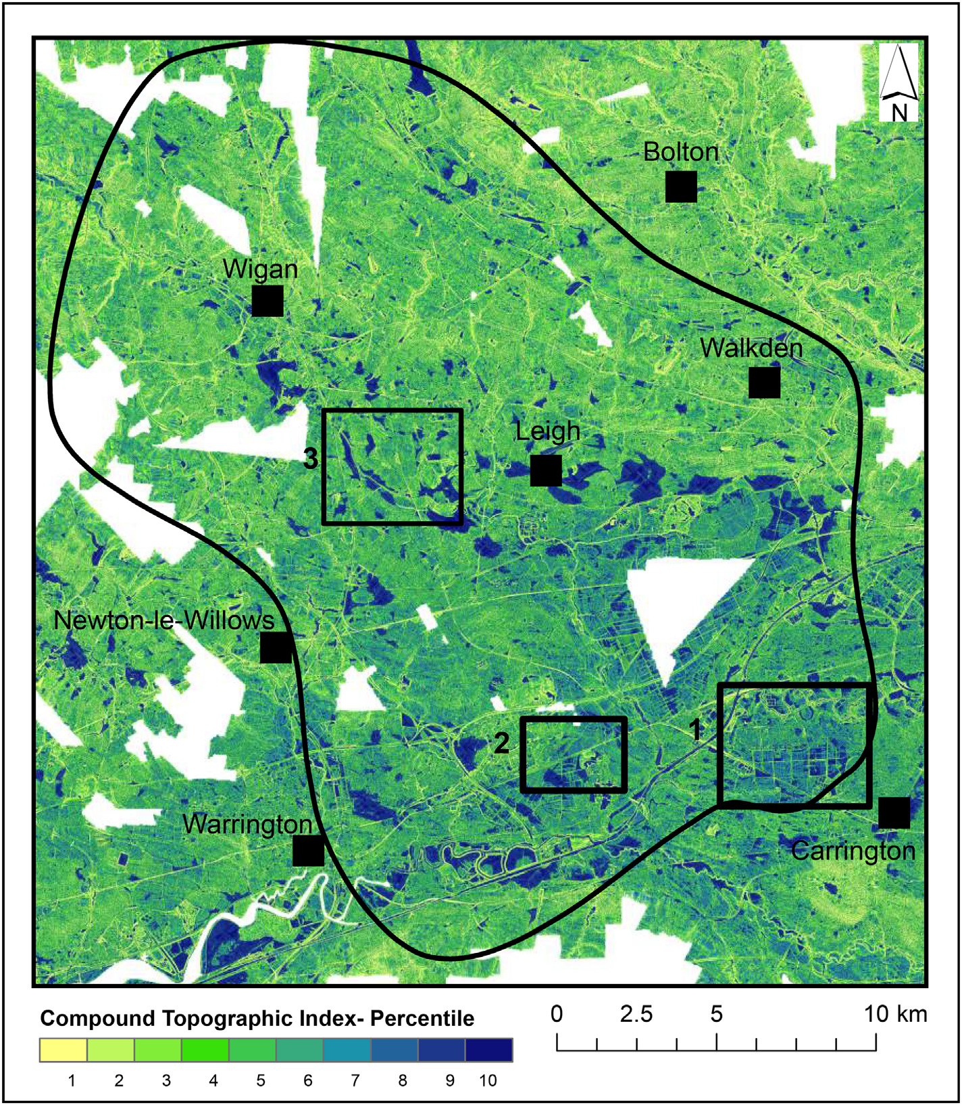
Higginbottom et al (2018)
Ecological Informatics 48

Slide 7
Site overview
Site | Peatland type (size/pilot size) | Habitat | Current vegetation | Desired state/habitat | Pollution (current/ historic) | Meteorology
Zwarte Beek (Black Creek) | Iron rich fen peatland (drained) 750/250ha | Wet grassland (D.3.41) Quaking bog and Transition mire (D2.3) | Grass/sedge/Forb/ occasional Sphagnum | Quaking bog and Transition mire (7140/D2.3) | N dep: ~20 kg Nearby agriculture, Iron rich | Rainfall: 808 mm Temperature: Jan: -0.5 ºC Jul: 22.1 ºC
Cloncrow Bog | Raised bog (drained) 200/26 ha | Raised bog active (7110/D1.1) + degraded (7120/D1.1) | Bare peat Bog species in active areas/grassland/ woodland | Active raised bog (7110/D1.1) | N dep: ~15-20 kg | Rainfall: 925 mm Temperature: Jan: 2 ºC Jul: 19 ºC
De Weiden | Forested fen 10 ha Foreshore 5 ha | Broadleaved deciduous Forest (T1.5/9080) | Alder woodland with birch Occasional Sphagnum Open water | Pits: quaking mire Foreshore: Reedbed | N dep: ~18 kg | Rainfall: 856 mm Temperature: Jan: 1 ºC Jul: 26 ºC
La Guette | Degraded Fen 23/0.12 ha | Wet heath (F4.1/4010) Fen (D2.3/7140?) | Molinea/Erica shrubs/Sphagnum | Sphagnum/Tricophorum (Rynchospora)/ Eriophorum (7140/D2.3) | N dep: ~10 kg | Rainfall: 641 mm Temperature: Jan: 2 ºC Jul: 21 ºC
Little Woolden Moss | Raised bog (extracted) 105/~2ha | Raised bog degraded (7120/D1.1) | Bare peat | Raised bog active (7110/D1.1) | N dep: ~20 kg Historic pollution from industry | Rainfall: 929 mm Temperature: Jan: 1 ºC Jul: 21 ºC
Winmarleigh | Raised bog (drained for agriculture) 20/4 ha | Agricultural grassland | Grass/Forbs | Sphagnum farm! | N dep: ~27 kg Nearby agriculture, high ammonia | Rainfall: 1044 mm Temperature: Jan: 5 ºC Jul: 19 ºC

Slide 8
External factors
Site | Designation | Rare/protected species | Cultural/Historic | Nearby habitats/ land use | External stake holders
Zwarte Beek (Black Creek) | Heritage landscape | Common Snipe population Marsh grasshopper, occasional Corncrake, Curlew | Partly protected landscape for cultural heritage | Heathland, Grassland, Woodland Agriculture, Residential | Small, private landowners on land that could be restored
Cloncrow Bog | Natural Heritage Area (NHA) | Good mix of wetland species and several bog mosses | Nearby earthwork and souterrain. Peat cutting. | Peat cutting/bare peat Forestry (on peat) Agriculture, grazing (on peat) | Coillte (Forestry authority), Local landowners/farmers
De Weiden | National Park | None – common birds in wooded areas Some flycatcher and willow tit. The wet areas support rare birds – Bitten, Snipe | Peat extraction/pits. Water courses. | Wet heath, bog Open water, reed beds (some farmed), marsh, forest, peat pits, residential | Water board Farmers
La Guette | None? | Locally rare: Rynchospora alba (Trichophorum cesp.), Eriophorum ang., Drosera rot., Gentiana, 11 Sphagnum spp. | None | Woodland in private ownership and local authority. | Little agriculture or industry in surrounding area.
Little Woolden Moss | Local Nature Reserve Manchester Mosses Special Area for Conservation (SAC) | Currently bare but rare species in local area: willow tit, adder, water vole, hare, lizard | None in specific area. Bog oaks and other historic find local and potentially on site. | Bare peat Agriculture – grazed livestock, winter feed, arable. | Local farmers. Tenant farmer, land owners. Salford City Council
Winmarleigh | None but borders Winmarleigh Moss SSSI | Agricultural grassland Water voles in ditches. | None | Agriculture – grazed livestock, winter feed, arable. Woodland | Local landowner and tenant farmers. Natural England.

Slide 9
Peat condition
Site | Peat condition | Humification and formation | Hydrology (1= heath, 5=swingmor) | Potential for restoration
Zwarte Beek (Black Creek) | Degraded through drainage. Organic surface soil with root matt, 2-3 m up to 6-8 m Some slumping, surface crust, some loose peat but little bare | Highly humified, compacted. Sedge peat, some wood peat. | Some areas very wet, swingmor (5), others very dry (3). Losing water | High due to water availability.
Cloncrow Bog | Bare peat and active bog 4 m depth – on degraded bog? Good condition but dried in places. | Humification? Sphagnum peat? | Active bog, very wet (4) Drained bog (2) – losing water via drainage ditches | Good, by blocking ditches
De Weiden | Organic surface soil over humified peat (50-150 cm) | Humified. Formed from reeds, sedges | Forest area – wet (3-4) Surface water around. Water table controlled externally | Good but raising WT only very localised.
La Guette | Degraded through drainage Peat depth 40 - 180 cm No bare peat | Very humified over sand then clay | Overall quite dry (2), wet in parts (3) | Possible to slow the flow of water, pilots indicate revegetation ok
Little Woolden Moss | Bare peat, now rewetted. 30 cm - 200 cm | Highly humified poor quality peat. Sphagnum/sedge. | Firm surface but very wet, can dry whilst bare (3-4) | Good, nearby peat bog
Winmarleigh | Organic soil (~30 cm) over peat. Drained. Depth? | Mixed, Sphagnum fragments visible @50cm | Drained (2-3) | ?? Sphagnum farm

Slide 10
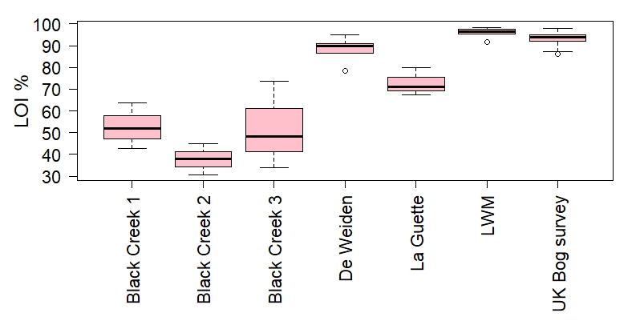
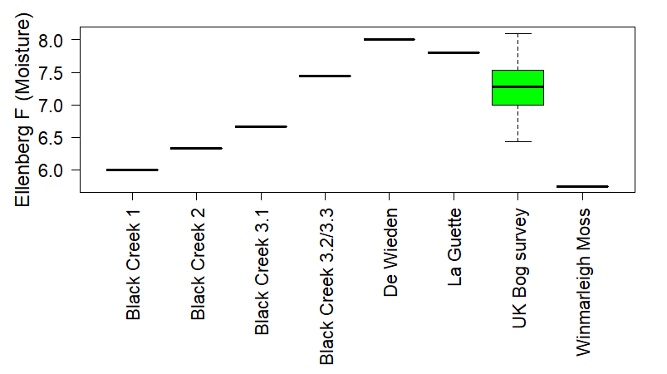
Organic matter (LOI) and Ellenberg moisture
Peat LOI > 80-90%
possibly > 50%
Organic soil LOI > 30%
De Weiden, and LWM fit well with a range of bogs
Zwart Beek surface is less peaty, La Guette in between
De Weiden and La Guette site are at the wetter end
Zwart Beek and Winmarleigh are notably drier sites

Slide 11
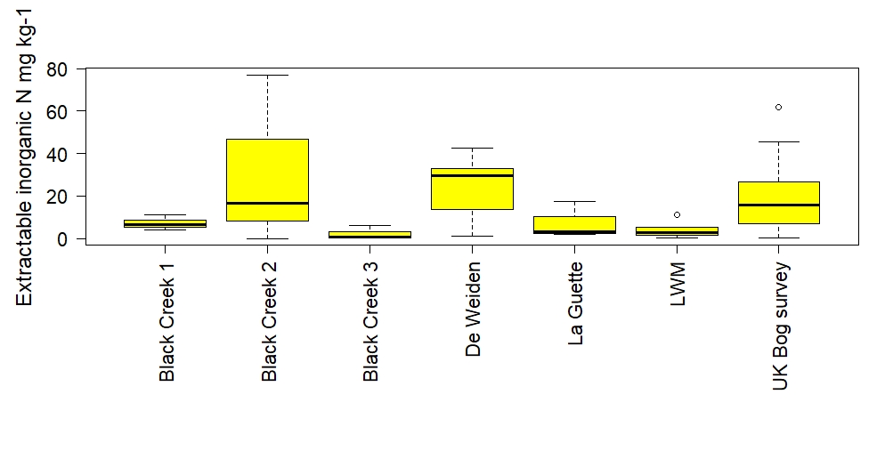
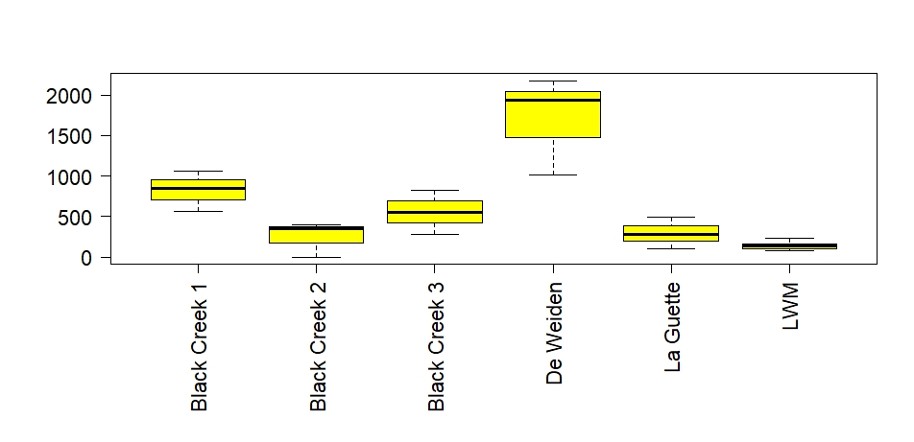
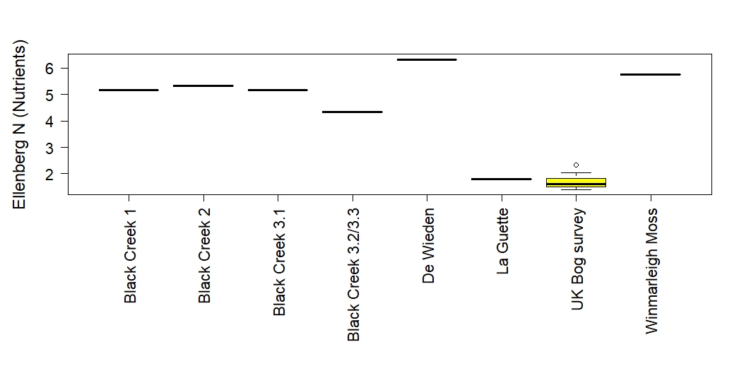
Site nutrients and hydrology
Bog = oligotrophic
Fen = mineratrophic
Is La Guette a bog or a poor fen?
NB: Phosphate also high in De Weiden
Extractable Ca mg kg-1

Slide 12
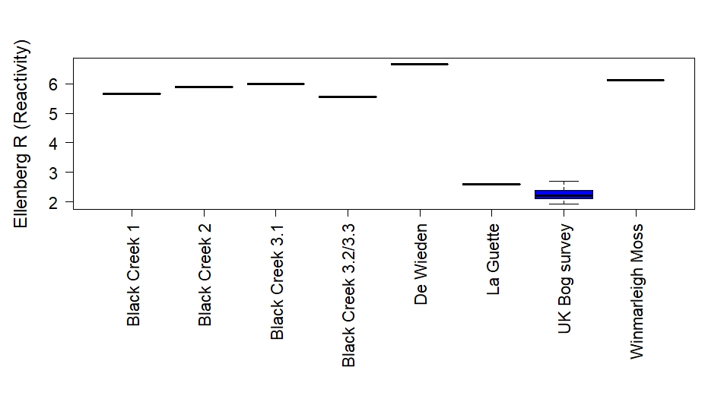
Acidity and Ellenberg R
Soil pH at France (?) and UK fits well with other UK bogs indicating good potential for restoration to raised bog (pH<4.2)
Belgium pH indicative of poor fen (pH 4.5-5.5)
Netherlands – rich fen (pH 5.5-6.9)
Current vegetation supports soil pH data

Slide 13
Winmarleigh plant available N by profile
UK bog survey range for top 15 cm (summer): NO₃ 0-33.5 mg kg⁻¹; NH₄ 0-70.04 mg kg⁻¹
Whim Bog N addition experiment (annual means), values between 0.4 to 0.6 for NO₃ and 27 to 109 for NH₄. For the higher values we were adding on 64 kg N ha⁻¹ yr⁻¹

Slide 14
Summary
La Guette – more bog than fen?
De Weiden – very peaty soil, high water table observed, perhaps remove less and revegetate with reeds/Sphagnum?
CO₂/CH₄ balance – small trial?
Decide what joint restoration plans should look like:
Introduction/synthesis summarising across sites including chemistry
Add to local templates with narrative
Practical works plans needed – by IPs
How to integrate drone work?

