Slide 1
Bio-cage #2 – Aquatech
7th November 2019

Slide 2
The issue
Sludge is produced as part of wastewater treatment process
Vast majority of sludge is water
Most sites do not treat sludge onsite
Lots of water being transported by road
→ cost, carbon, congestion

Slide 3
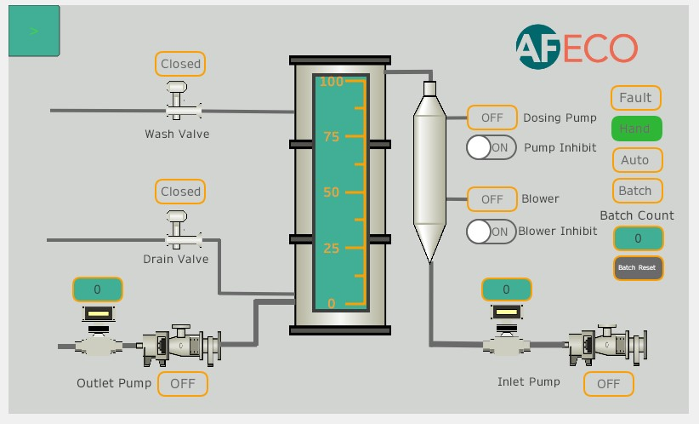
The solution – bio-cage #2
Low cost physical thickening device
Low power; low /no chemicals
Installed inline → no need for two sludge holding tanks
Significantly reduces tankering costs and carbon impact
Builds on success of initial bio-cage product

Slide 4
An overview of AFECO
An integrated team able to deliver all stages of the project and innovation cycle
Process and MEICA engineering excellence
Onsite installation and commissioning
Process and asset optimisation
Product, solutions and project development
Engineering
excellence
R&D
Innovation
Integrated project delivery
Optimisation

Slide 5
Evolution – bio-cage #2
May 2016
Initial trial saw
3 tankers/wk reduced to 1
Apr 2018
bio-cage #2 concept developed
2020
Site trials with WTN to accelerate development
Aug 2016
Roll out underway to over 50 sites
Jul 2019
bio-cage #2 wins WTN Innovation Challenge 1
2020…
Continue roll out of bio-cage #1

Slide 6
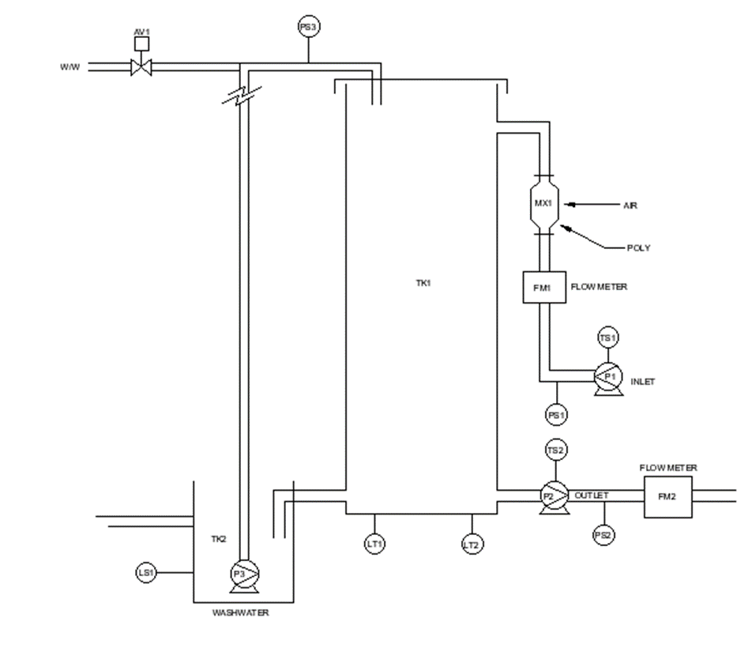
USPs
Rapid return on investment
Significant reduction in tankered sludge volumes
Low power and chemical requirements
Highly portable, skid mounted, automated system with small footprint

Slide 7
Collaboration with WTN
ACCELERATED TIME TO MARKET
Winning the Innovation Challenge 1 will enable AFECO to accelerate the development of bio-cage #2
Access to a WTN test facility will provide unique support and opportunities for testing
Develop further contacts to continue roll out of bio‑cage #1
IMPROVED EFFICIENCY
REDUCTION IN SLUDGE TRANSPORT

