Slide 1
WTN innovation voucher Pesticide free emission of wastewater in a Dutch greenhouse Willem van Baak owner Water Future BV
Aquatech, Amsterdam, The Netherlands 07/11/2019

Slide 2
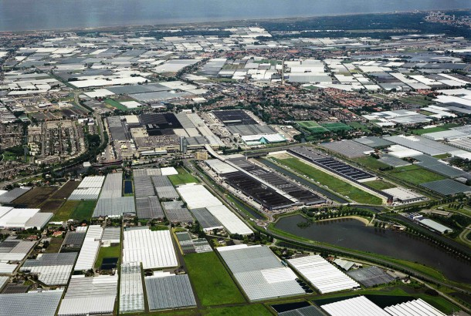
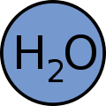
Dutch greenhouse: problem & solution
Discard recirculation water
Reason
high Na⁺
poison for crops
Consequence
pesticide release
environmental pollution
2018: forbidden, degradation obliged
Longer term
2027: zero emission water & nutrients
Greenhouses in the Netherlands
fertilisers
Solution:
Water Future developed new CED technology and system
ion (Na⁺) selective separation by an electrical driven process
Concentrated waste stream is pesticide pesticide free

Slide 3
Greenhouse solution
An ion-selective desalination system in recirculation water
Greenhouse drain
water recycling
+
+
+
+
+
++
+
-
-
-
-
-
-
-
-
Na⁺
Cl⁻
+
+
+
+
+
++
+
-
-
-
-
-
-
-
-
-
H₂O
+
K⁺
NO₃⁻
Ca²⁺
SO₄²⁻
Mg²⁺
pesticide
PO₄³⁻
Discard water
without pesticide
Discard water
without pesticide
stable low Na⁺
re-use in greenhouse

Slide 4
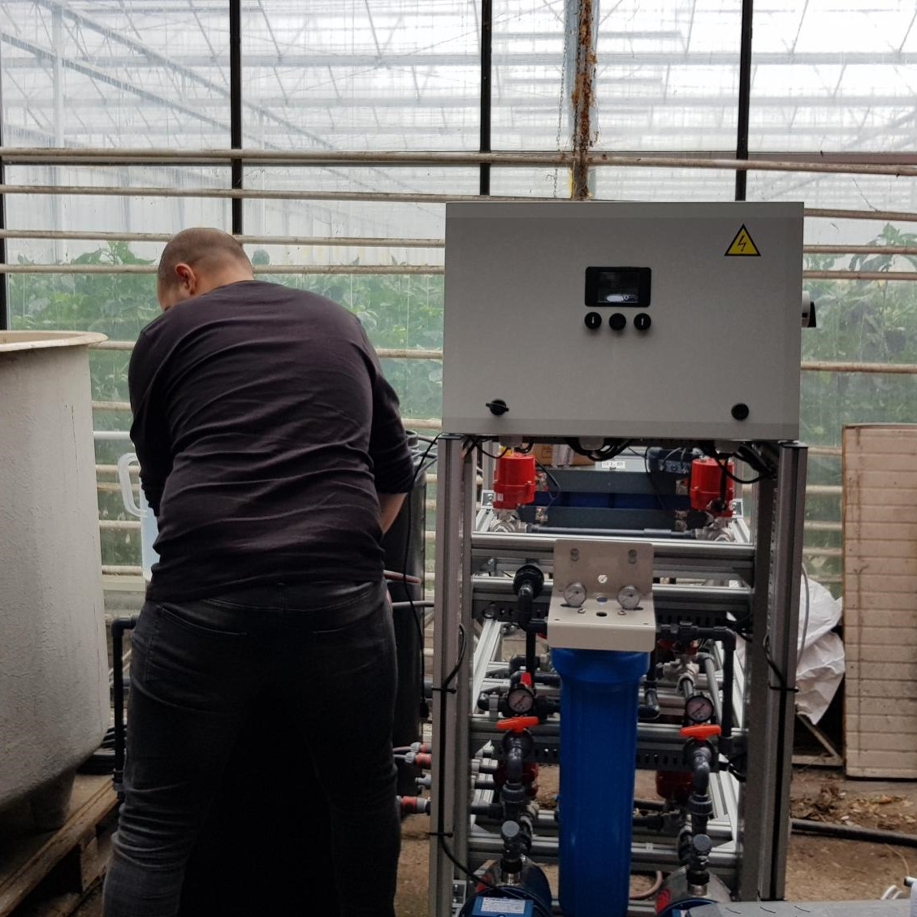
Greenhouse solution :
sustainable & profitable
Advantages
efficient Na⁺ removal
stable Na⁺ level in recirculation water
> 80% water saving
80% multivalent nutrient savings
80% micro nutrient savings
no pesticide emission (< 5%)
simple and efficient
cost effective
more productivity > more money

Slide 5
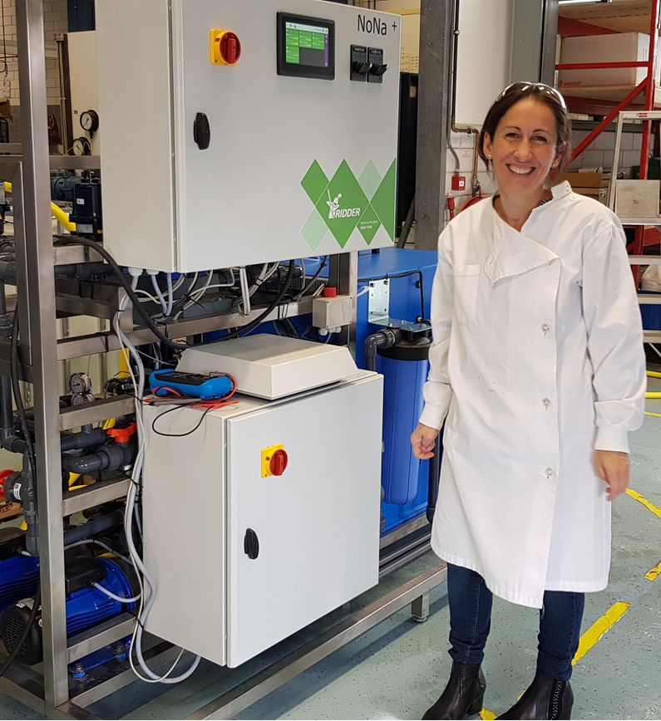
WTN innovation voucher
WTN expertise center - CEW (Leeuwarden NL)
BZG certification is required to permit waste water discard
official to be certified by commission
system has to be approved for
pesticide content is < 5% of standard water (includes 11 pesticides)
obliged to be used in the greenhouse market
CEW experts
know the legislation requirements
know the test protocols
execute the tests (ongoing)
report and request the official BZG approval
expenses covered by voucher excl. materials and analyses
Very valuable for an SME ☺

