Slide 1
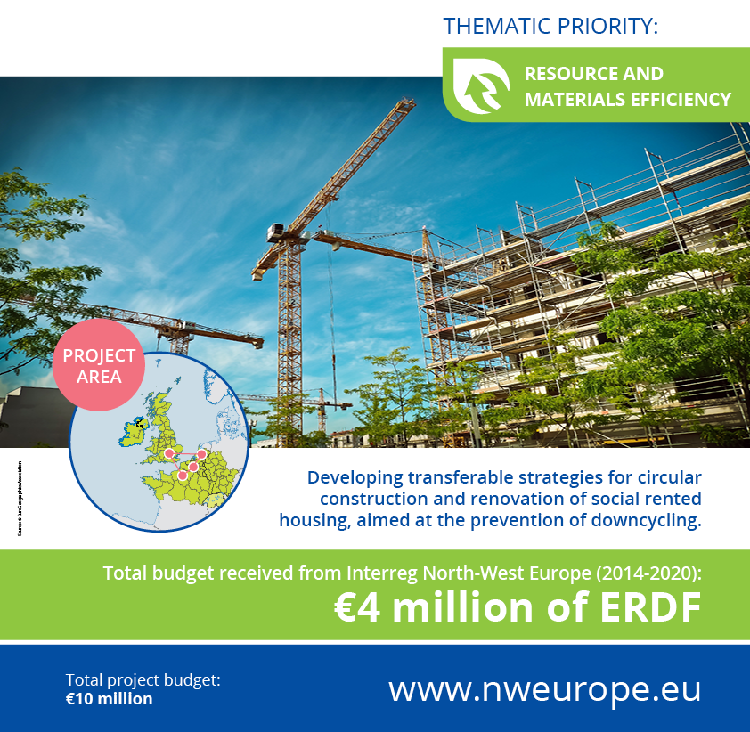



Slide 2
Outline
CHARM in short slide 3
The importance of CHARM slide 4 + 5
Aims, ambitions and goals slide 6 + 7
Products of CHARM slide 8 + 9
Partners and associated partners slide 10 - 12
Time span slide 13
Follow CHARM slide 14 + 15

Slide 3
CHARM in short
CHARM is developing a strategy for circular construction and renovation of social rented housing, aimed at the prevention of downcycling. The main project objective is to optimize the (re)use of material and natural resources.
CHARM is a project, carried out by social housing organisations, universities and organisations in the field of affordable housing. It consists of real housing projects, executed by four social housing organisations in France, Belgium, UK and the Netherlands.

Slide 4
The importance of CHARM
Political awareness and willingness is high
Environmentally awareness is high
Financial possibilities are there
Housing sector has a key position in EU
The time to act is now!

Slide 5
the building sector is responsible for more than 60% of the resource use in Europe
with 30 – 50% of material use taking place in housing construction sector
the sector generates about 1/3 of all waste in the EU

Slide 6
Aims, ambitions & goals
An circular asset management approach which is ready to use and free of charge for all social housing organisations.
This circular approach contributes to several ambitions & goals on circular economy and sustainability:
Political ambitions & goals
Organisational ambitions & goals
Tenants ambitions & goals

Slide 7
Objective: to develop transferable strategies for circular construction and renovation of social rented housing, aimed at prevention of downcycling.
These strategies are being tested in four projects in France, Belgium, UK and the Netherlands.
Based on our demonstrators, these strategies lead to an average material re-use of 62 tonnes per new built house and 38 tonnes per renovated dwelling.
This implies a 36% reuse rate compared to the current maximum reuse rate of 10%.

Slide 8
Products of CHARM
Building strategies for a circular asset management:
reuse of materials
design and construct for reuse after the first use period
Developing guidelines for a circular procurement.
Material exchange platforms to enable circular flows of materials and building components.
Securing long term effects through active knowledge transfer.

Slide 9
The asset management approaches will be available for all social housing organisations and other interested parties. Ready to use and free of charges.
In that way, we use our knowledge and key position in the housing sector to make social housing and social dwellings sustainable by using circularity and preventing downcycling.

Slide 10

Partners

Slide 11
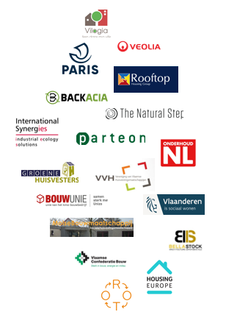
Associate partners
The 18 associated partners fulfil various roles, such as: ‘adviser’, ‘interested follower’, ‘expert’, ‘lobbyist’, ‘learner’. Most associated partners fulfil a combination of roles.
As the partners, the associated partners want to make a concrete difference in changing the housing sector into a more circular and sustainable sector by preventing downcyling and optimise and (re)using material and natural resources.

Slide 12
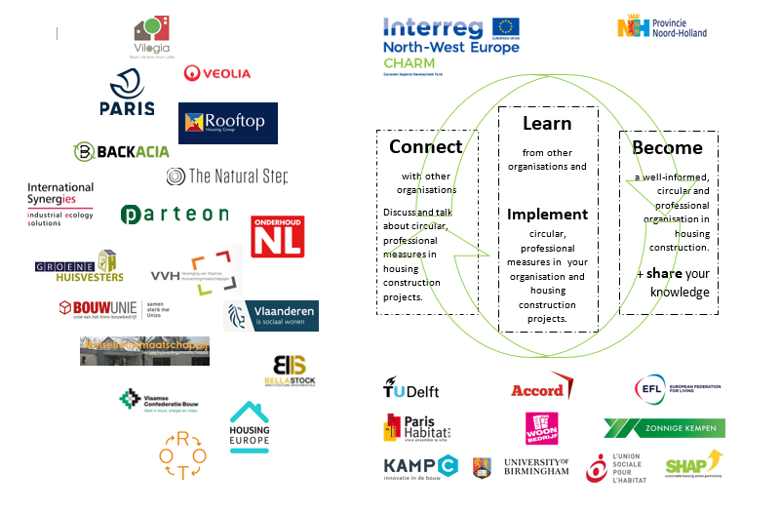

Slide 13
Time span
The project has started in October 2018 and will be completed in October 2022.
Four years to develop and and implement an asset management approach. An approach which is circular, sustainable and which prevents downcycling of materials in renovation and construction of social rented dwellings.

Slide 14

Follow CHARM
www.nweurope.eu/projects/project-search/charm-circular-housing-asset-renovation-management

Slide 15

www.facebook.com/CHARMinterreg
www.twitter.com/CHARM_Interreg
www.linkedin.com/company/charm-interreg

