Slide 1
GenComm Generating Energy Secure Communities
Hydrogen and Alternative Low-Emissions Fuels
Paul McCormack
Innovation Manager,
Belfast Metropolitan College
Thursday 28th November 2019
Place image in this area.

Slide 2
GenComm Animation
https://vimeo.com/366993950/91cafb0bb6

Slide 3
GenComm Focus
GENCOMM – GENerating energy secure COMMunities. Smart Hydrogen -Integrated renewable energy, generation & storage To develop a new model for exploiting remotely generated electricity from renewable sources to provide energy security for remote communities.
GenComm project focuses on increasing the uptake of the local renewable sources by communities, mostly peripheral, in the NWE region, by implementing an energy model that relies on hydrogen as an energy carrier and is utilised to supply the main forms of energy demand: electricity, heating and transportation fuels.
Notes:
hydrogen is a ‘game changing’ technology with extensive applications across transport, stationary power and beyond. Hydrogen, as an energy carrier, and as an enabling technology, will be critical in the delivery of a clean energy future.
As an energy carrier, hydrogen can play a significant role in energy security, carbon reduction and economic growth. It will be the crucial element of any future energy system.

Slide 4
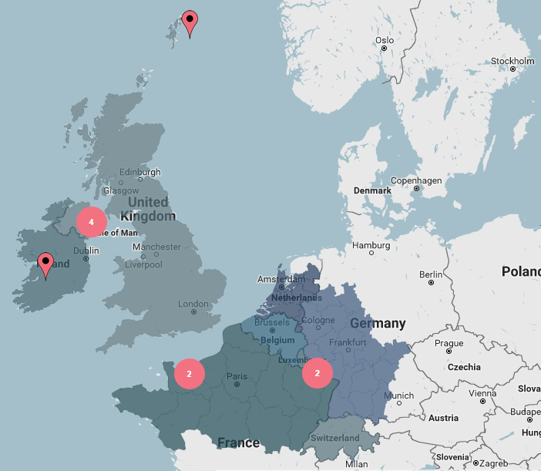
Partners
Belfast Metropolitan College Viridian Energy Supply Limited | United Kingdom United Kingdom
HyEnergy | United Kingdom
Pure Energy Centre | United Kingdom
National University of Ireland Galway | Ireland
IZES gGmbH | Germany
ENSICAEN | France
INSA Rouen Normandie | France
TK Renewables | United Kingdom
BURN Joint Research Group, Vrije Universiteit Brussel | Belgium

Slide 5
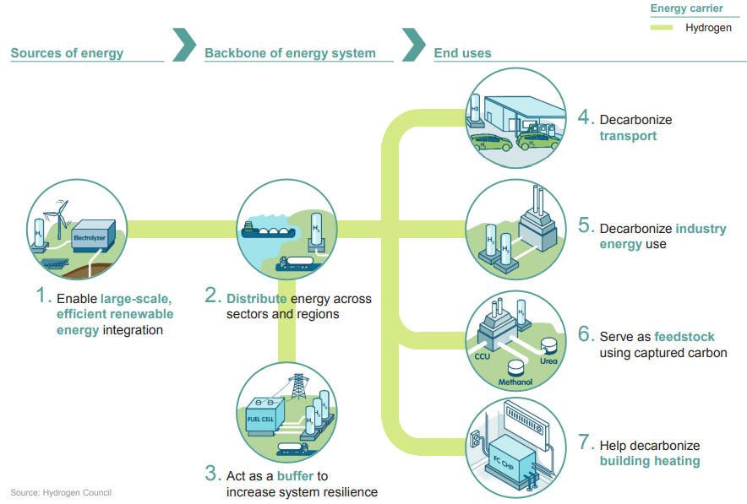
Hydrogen’s Role in the Energy Transition

Slide 6
Green H2 Energy Carrier
GenComm is meeting the needs of the changing energy system by placing H2 as the energy carrier at the centre of the system.
The current energy system delivering electricity, heat and transport fuel maintains the status quo but external forces are driving change .
Network control, storage and management systems
Customer behaviour and insights
Local energy generation and demand side technologies
Are all combining to make Electricity, Heat and Transport flexible to meet demand, need and ultimately SMART delivering a Fuels future energy system

Slide 7
Green H2 Energy Opportunity
Renewable energy sources continue to increase their share of installed capacity worldwide. Their integration, in conjunction with increased energy efficiency and other low-carbon technologies, constitutes the best opportunity to achieve energy sustainability.
Renewable energy sources also constitute the best option to avert the risks that conventional non-renewable sources pose to health, geopolitics, the economy and the environment. In accordance with their commitment to the Paris Agreement of 2015,

Slide 8
Energy Carriers
As we move from a hydrocarbon based economy to a renewable one, there is a need for clean sustainable energy carriers.
Energy carriers have now been identified as the key enabling solution that allow renewable sources to supply different forms of energy demand across these sectors, and thus strengthen their technical and economic viability.
Hydrogen is a key energy carrier. It has the potential to become one of the main energy carriers of the future as it can be easily produced using renewable energy, stored using commercially available technologies and used throughout the entire energy system. The use of hydrogen as an energy carrier however, has been hindered by specific challenges that need to be addressed.
Notes:
Renewable energy sources continue to increase their share of installed capacity worldwide. Their integration, in conjunction with increased energy efficiency and other low-carbon technologies, constitutes the best opportunity to achieve energy sustainability. They also constitute the best option to avert the risks that conventional non-renewable sources pose to health, geopolitics, the economy and the environment. In accordance with their commitment to the Paris Agreement of 2015, 175 parties have created national renewable energy action plans (NREAPs). Each NREAP aims to develop mixed energy systems that rely on a variety of renewable energy sources and energy carriers. These plans involve increasing renewable energy penetration targets for the electricity, heating and cooling and transport sectors. These three sectors alone account for 20%, 40% and 40% respectively of total end-use energy demand. And to shift from a hydrocarbon based economy to a renewable one, there is a need for clean sustainable energy carriers. Energy carriers have now been identified as the key enabling solution that allow renewable sources to supply different forms of energy demand across these sectors, and thus strengthen their technical and economic viability [2].
Hydrogen is one of these carriers that has attracted much support from across many countries across the globe. In fact, it has the potential to become one of the main energy carriers of the future as it can be easily produced using renewable energy, stored using commercially available technologies and used throughout the entire energy system. The use of hydrogen as an energy carrier however, has been hindered by specific challenges that need to be addressed.

Slide 9
GenComm Value Chain
Notes:
Fuel cells and hydrogen energy can:
contribute substantially to a global low carbon economy;
deliver environmental and economic benefits across various sectors, including transportation, power generation, industrial equipment, military power, and consumer electronics;
improve urban air quality and the health of urban populations [1];
contribute to the alleviation of fuel poverty through superior efficiency relative to conventional technologies (particularly in CHP mode) [2];
form the basis of a 21st Century industrial sector that allows sustainable growth of the world economy;
enhance energy security by allowing a wider choice of fuels, extending the life of fossil fuels and optimising renewable energy sources;
help to overcome the intermittency of renewables and deliver improved power management; and
deliver secure and affordable power systems for remote communities, eliminating demand for the use of conventional diesel generators.

Slide 10
GenComm Pilot Plants
Curtailed renewable energy sources
Energy demands
Electrolysis
Handling
N. Ireland pilot
N. Ireland pilot
Industry
Wind Energy
O₂
Mobility
Germany pilot
Germany pilot
Solar Energy
Scotland pilot
Scotland pilot
AD Plant
Stationary Energy

Slide 11
GenComm Deliverables
Curtailed renewable energy sources
Hydrogen could make sense for my community, organisation or company.
But how do I make it happen?
How do I find a hydrogen source or market?
Energy demands
Industry
Wind Energy
Mobility
Solar Energy
Smart H2GO
Decision Support Tool
AD Plant
Stationary Energy
Can I get in contact with like-minded groups across Europe?
CH2F
Community Hydrogen Forum

Slide 12
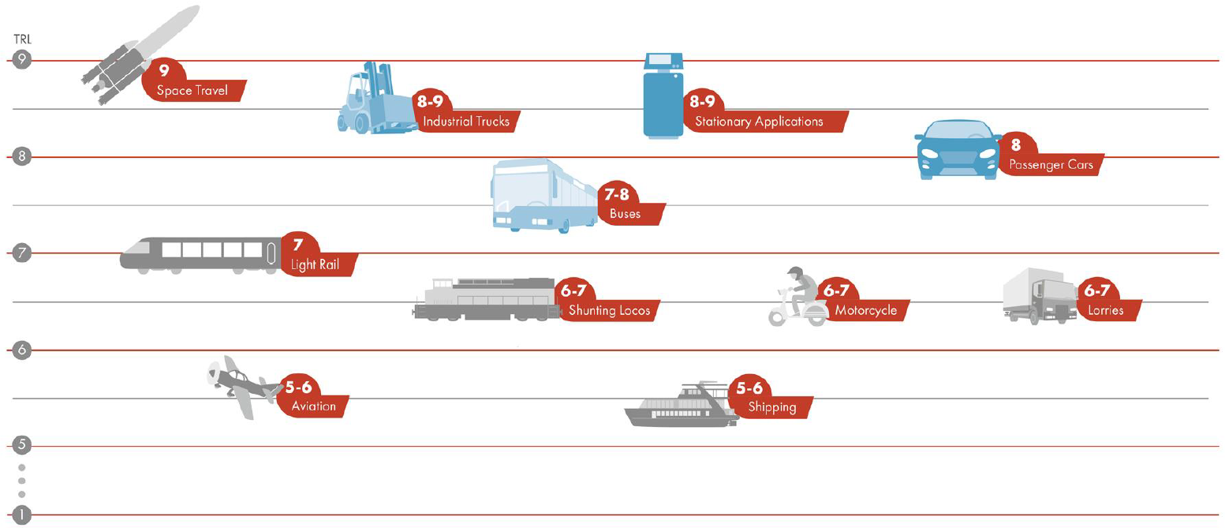
H₂ Mobility Technologies
Commercial
Source: Shell Hydrogen Study: Fuel of the Future ?.(2017). Shell GmbH and Wuppertal Institute.

Slide 13
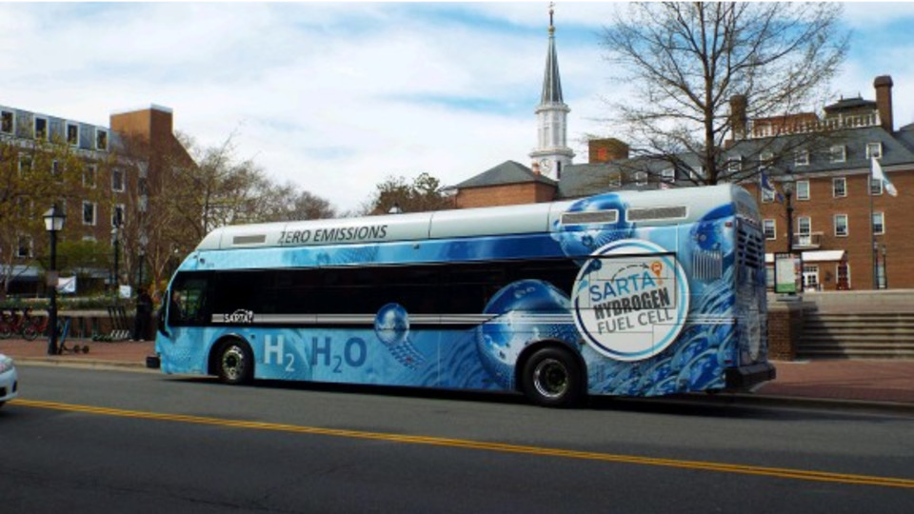
1. Case study in Belfast
If we replace diesel bus to hydrogen bus, where would we source the hydrogen?
Picture source: https://fuelcellsworks.com/

Slide 14
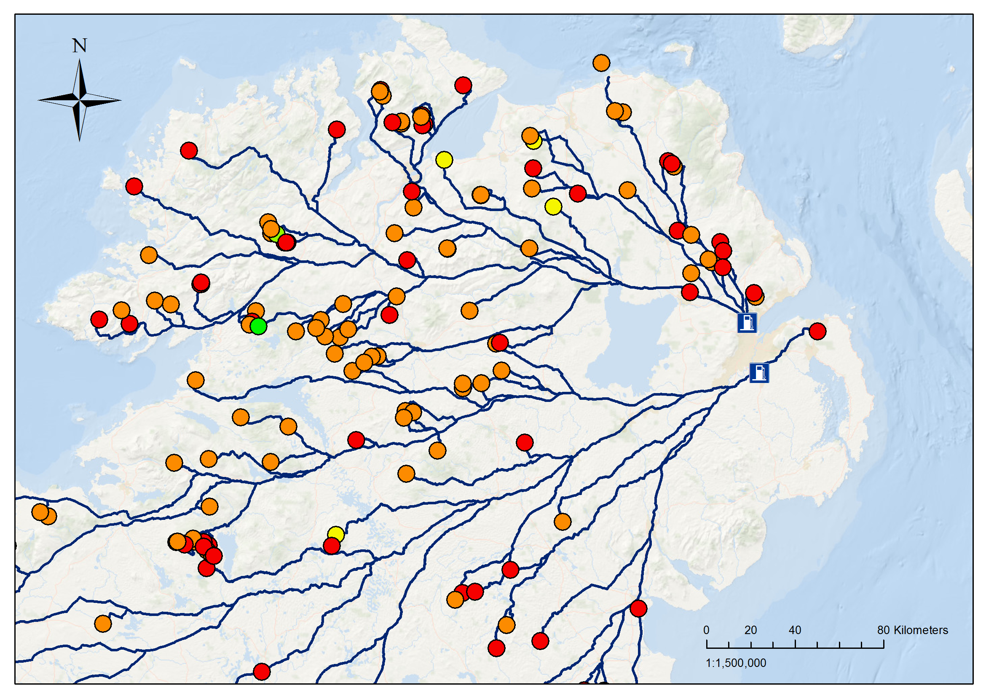
2. Case study in Belfast
H2 production (t/y)
 | < 40
 | 40 – 80
 | 80 – 120
 | 120 – 160
 | 160 – 200
100 km
694 (t/y) ≈ 90 buses
50 km
456 (t/y) ≈ 59 buses
If we replace diesel bus to hydrogen bus, where would we source the hydrogen?

Slide 15
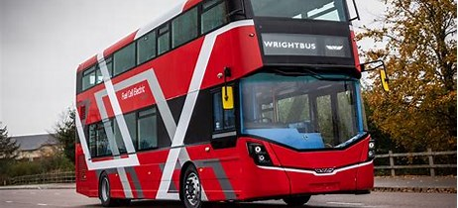
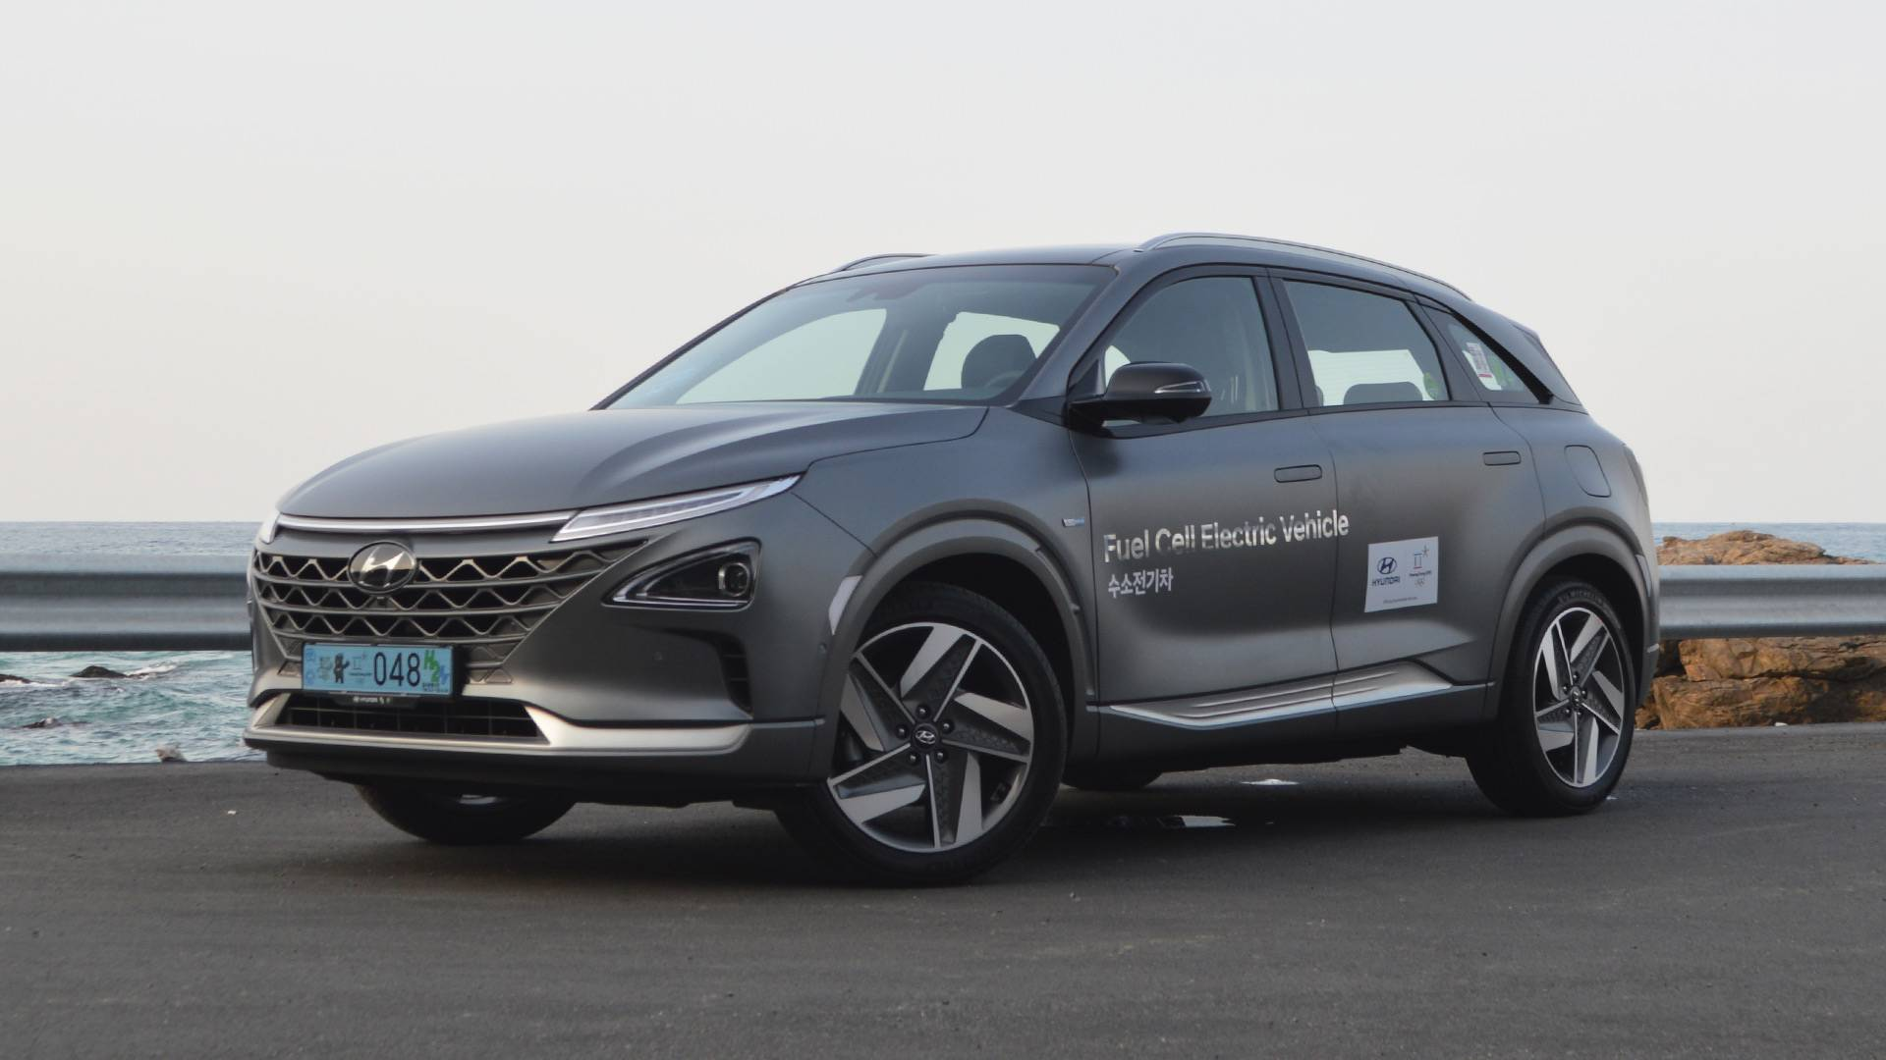
GenComm Progress
H₂ Mobility investments committed
3 H₂ Fuel Cell buses for Belfast
1 Fuel Cell car for Saarbrucken

Slide 16
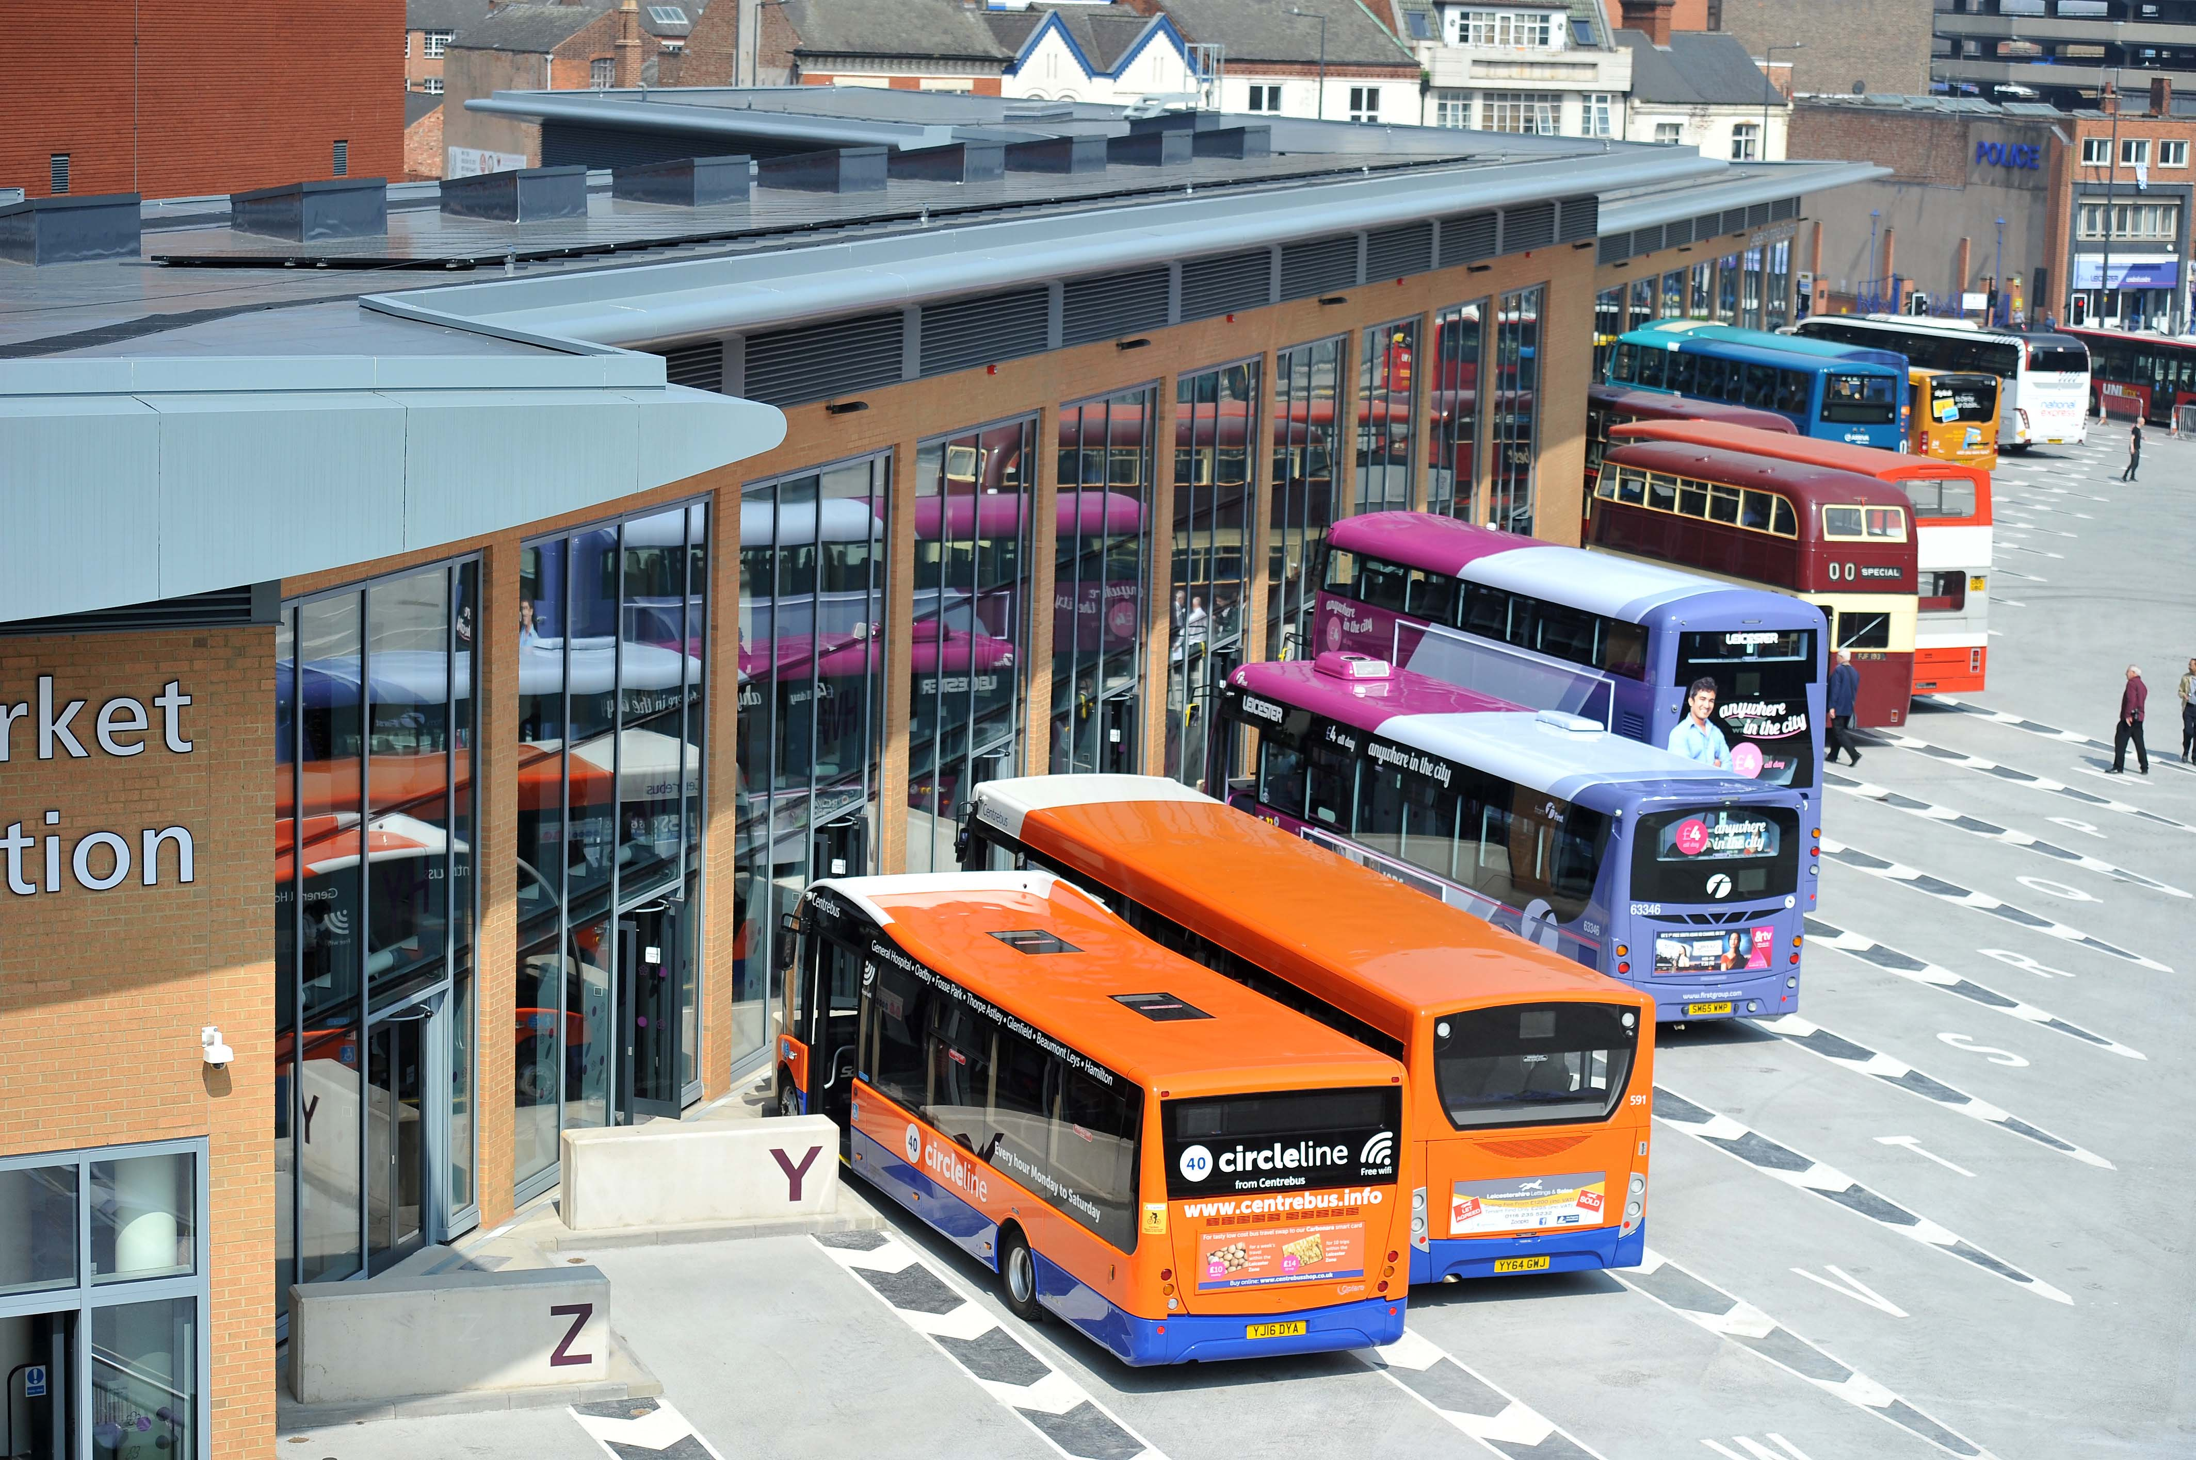
Case study in Northwest Europe
If we replace 10% diesel bus to hydrogen bus, how far we should source hydrogen?
Picture source: https://www.leicester.gov.uk/

Slide 17
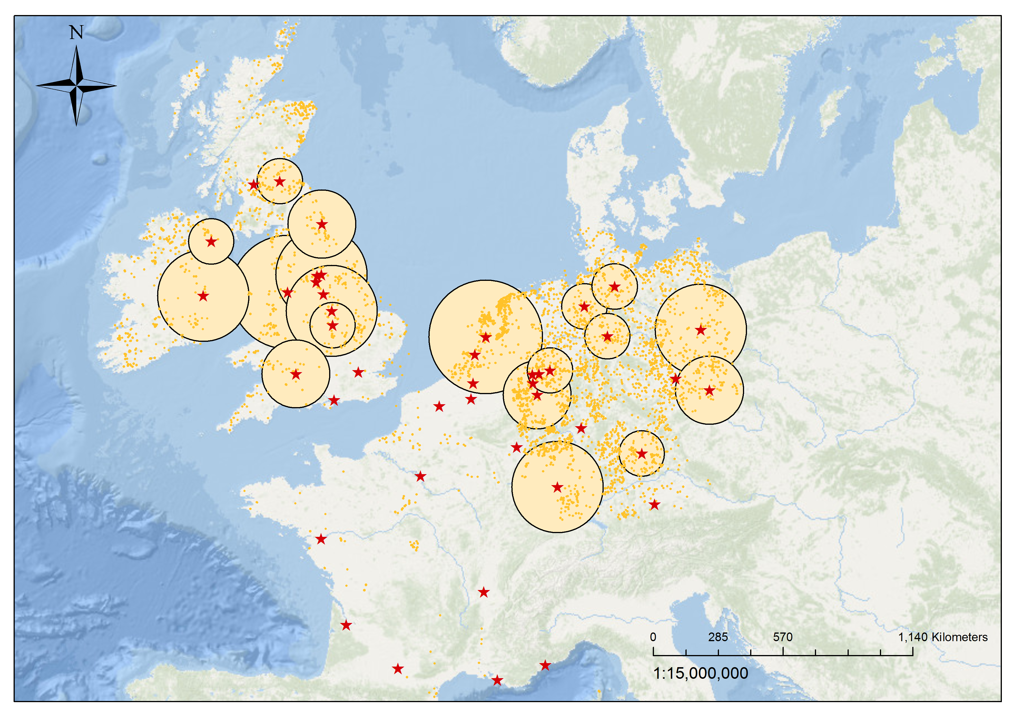
Case study in Northwest Europe
Amsterdam; 250 km for 40 buses
Berlin; 200 km for 110 buses
If we replace 10% diesel bus to hydrogen bus, how far we should source hydrogen?

Slide 18
SMART H2

Slide 19
. SMART H2 work package structure
Management Work Package (WP.M)
Communication Work Package (WP.C)
Route 1: SMARTfuel (WP.I1)
Renewable grid
Three filling stations;
H2 tube trailer transport;
Training delivery, handling and filling of H2 at a station.
WP.T1: POWER TO TRANSPORT TRAINING
H2 Filling Station
P2T
RE, H2, vehicles training courses;
Web portal for training;
On-wheel H2 fueler for training;
H2 vehicle for training.
WP.LTE: LONG
TERM EFFECTS
Route 2: SMARTfleet (WP.I2)
LTE
Public transport;
Market model;
Community transport;
H2 technician and maintenance training.
LTE
Final deliverables
Training courses : REH2 integration, H2 transport and H2 technologies;
Decision Support Tool (DST) with technical and financial models;
2050 NWE H2 Vision.
P2H2P
H2 Bus
2050 roadmap;
H2 Booklets;
H2 vehicle connected to a property;
CAPEX & OPEX H2 vehicles applications.
Route 3: SMARTfreight (WP.I3)
150kW H2 Pilot Plant;
CAPEX & OPEX;
Modelling;
Five mobility levels;
Training freight vehicles.
WP.T2: POWER TO H2 TO POWER
H2 Truck

Slide 20
SMART H2 project Structure

Slide 21
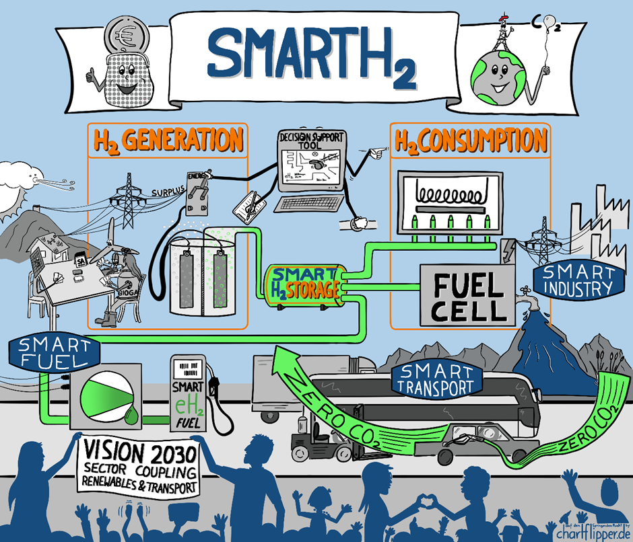

Slide 22
HAZEL - Hydrogen and Zero Emissions Logistics
15 PhD projects

Slide 23
SMART H2 the future
Hydrogen has the potential to fuel the economy while emitting little but clean water.
We are at the leading edge of the “hydrogen revolution”
The world must finally “tap into hydrogen’s potential to play a key role in a clean, secure and affordable energy future”. IEA June 2019
Fuel cell electric vehicles (FCEVs) are powered by hydrogen and are more efficient than conventional internal combustion engine vehicles Emissions from petrol and diesel vehicles include nitrogen oxides, hydrocarbons, and particulates, these are a major source of air pollution. Hydrogen-powered fuel cell electric vehicles emit none of these harmful substance, only water vapour and warm air. As such Hydrogen is a real option for diversifying our transportation energy options whilst at the same time reducing pollution

Slide 24
H2 Mobility Initiatives
Currently in 2020 there are 200 H2 fuelling stations globally
UK H2 Mobility
2020: 65 HRS.
2030: 150 HRS
H2 Mobility Germany
2015: 45 HRS
2025: 400 HRS
H2 Mobility France
2020: 15 HRS
2025: 139 HRS
H2 Mobility Italy
2020: 20 HRS
2025 : 197 HRS
H2 Mobility Scandanvia
2015: 10 HRS
2023 : 50 HRS

Slide 25
In conclusion
GenComm is part of the wider global energy solution.
We are all part of the new energy revolution.
GenComm is helping shape the energy future.
Opportunity for hydrogen as energy carriers.
Diesel buses are potentially to be replaced by EV and hydrogen buses.
Hydrogen can play important role to increase energy security and resilience in renewable-rich, energy-remote communities.

Slide 26
Thank you for your attention

