Slide 1
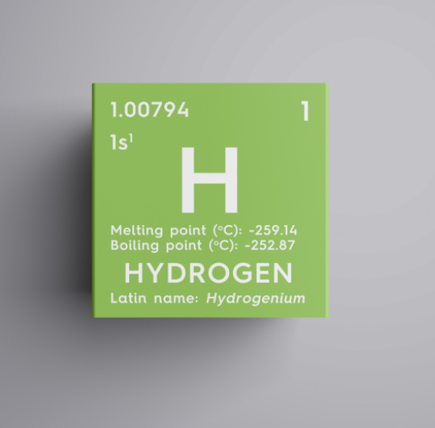
Green Hydrogen
Neil Morrow
Energia
SCOPE
28th November 2019
Hydrogen and Low Emissions Alternative Fuels Seminar

Slide 2
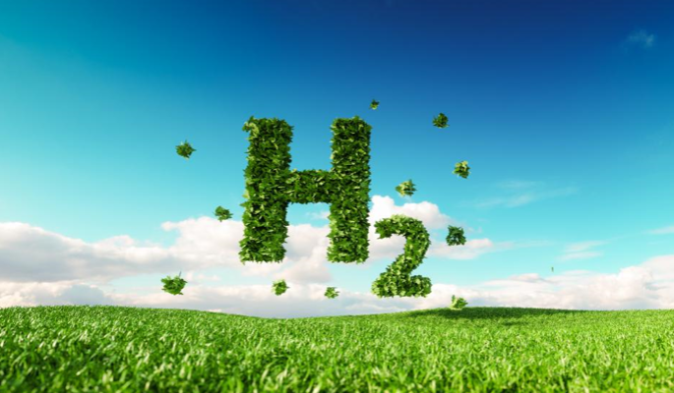
What in Green Hydrogen?
Hydrogen is a non-toxic colourless gas, even when it’s referred to as green hydrogen. It’s the most abundant element – it’s estimated that 90% of all atoms are hydrogen atoms, comprising around three quarters of the total Mass of the universe.
There are no natural hydrogen deposits on earth, it has to be extracted from other compounds by a chemical process. The vast majority of industrial hydrogen is currently produced from natural gas through a process known as steam methane reforming or SMR. Producing hydrogen in this way is sometimes referred to as brown or grey or even blue hydrogen!

Slide 3
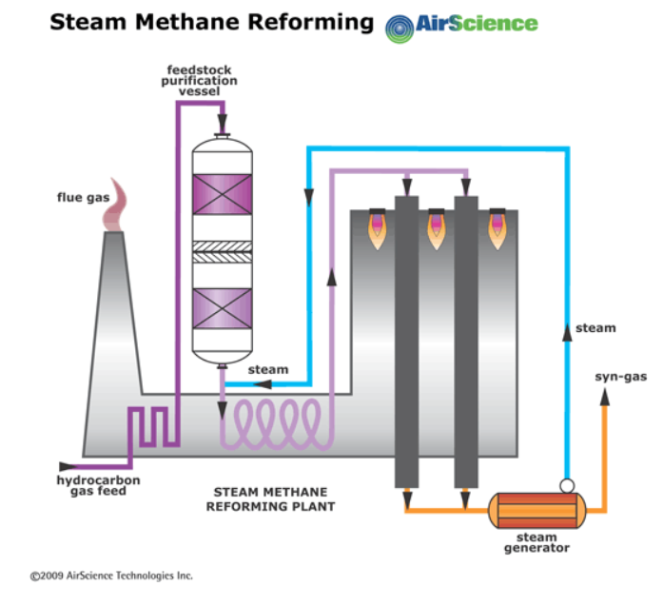
Today, more than 95% of the hydrogen produced comes from the processing of natural gas, oil and coal using steam reforming. In this process, the fossil fuel is broken down using 700-1100°C steam. While steam reforming is the most economical way to produce large quantities of hydrogen, it also produces 9 to 12 tons of CO2 and other greenhouse gases (GHG), depending on the feed material, for every ton of hydrogen gas produced.
Hydrogen Production
Steam Reforming
Today, more than 95% of the hydrogen produced comes from the processing of natural gas, oil and coal using steam reforming. In this process, the fossil fuel is broken down using 700-1100°C steam.
While steam reforming is the most economical way to produce large quantities of hydrogen, it also produces 9 to 12 tons of CO2 and other greenhouse gases (GHG), depending on the feed material, for every ton of hydrogen gas produced.

Slide 4
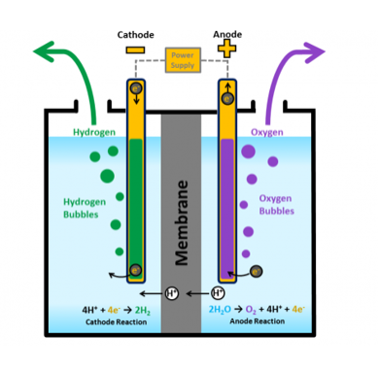
Today, more than 95% of the hydrogen produced comes from the processing of natural gas, oil and coal using steam reforming. In this process, the fossil fuel is broken down using 700-1100°C steam. While steam reforming is the most economical way to produce large quantities of hydrogen, it also produces 9 to 12 tons of CO2 and other greenhouse gases (GHG), depending on the feed material, for every ton of hydrogen gas produced.
Hydrogen Production
Electrolysis
Hydrogen can also be produced by the electrolysis of water (using an electric current to break water, H₂O, into its component elements of hydrogen and oxygen).
If this electric current is produced by a renewable source (e.g. Solar PV or a wind turbine), the clean hydrogen produced is known as green hydrogen.

Slide 6
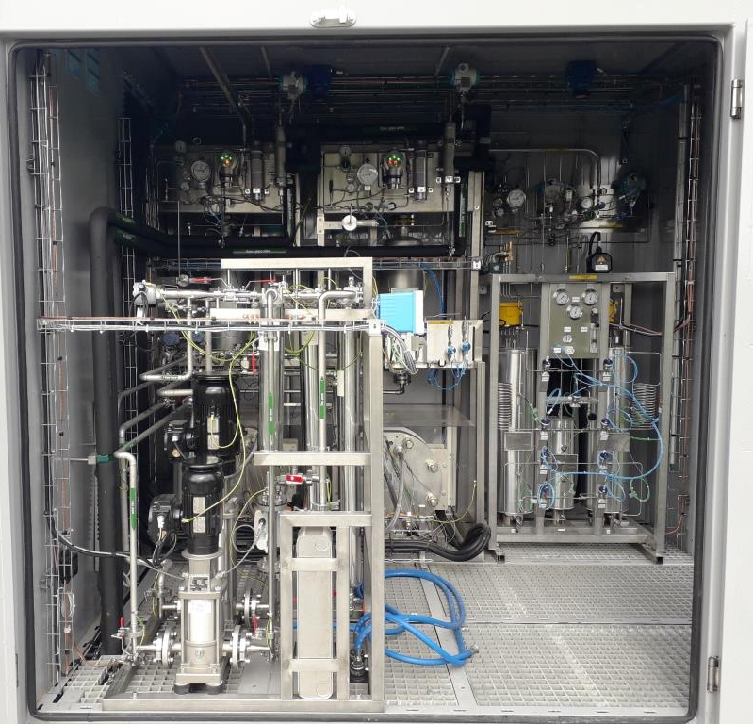
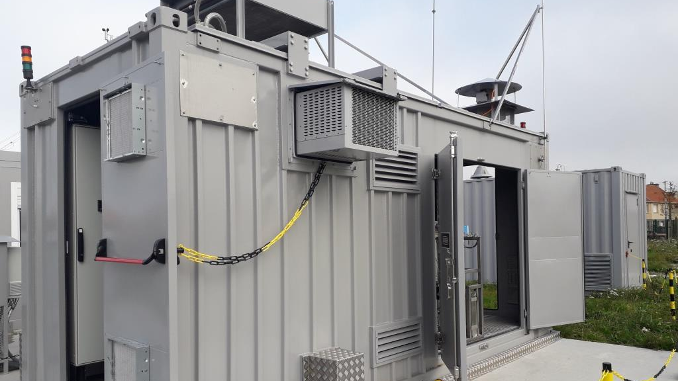

Slide 8
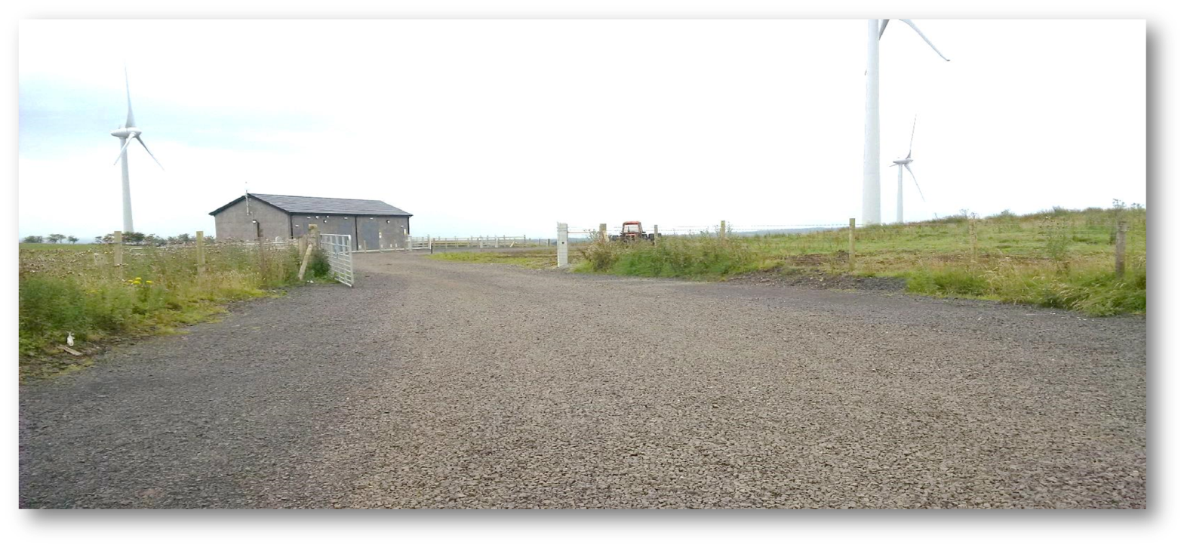
Energia and GenComm - Long mountain Wind Farm

Slide 10
Energia and GenComm
Long mountain Wind Farm

Slide 11
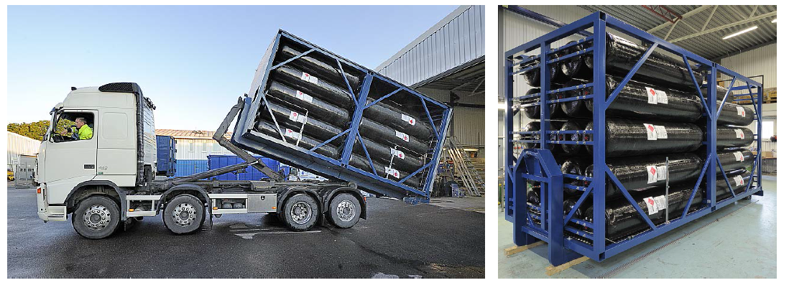
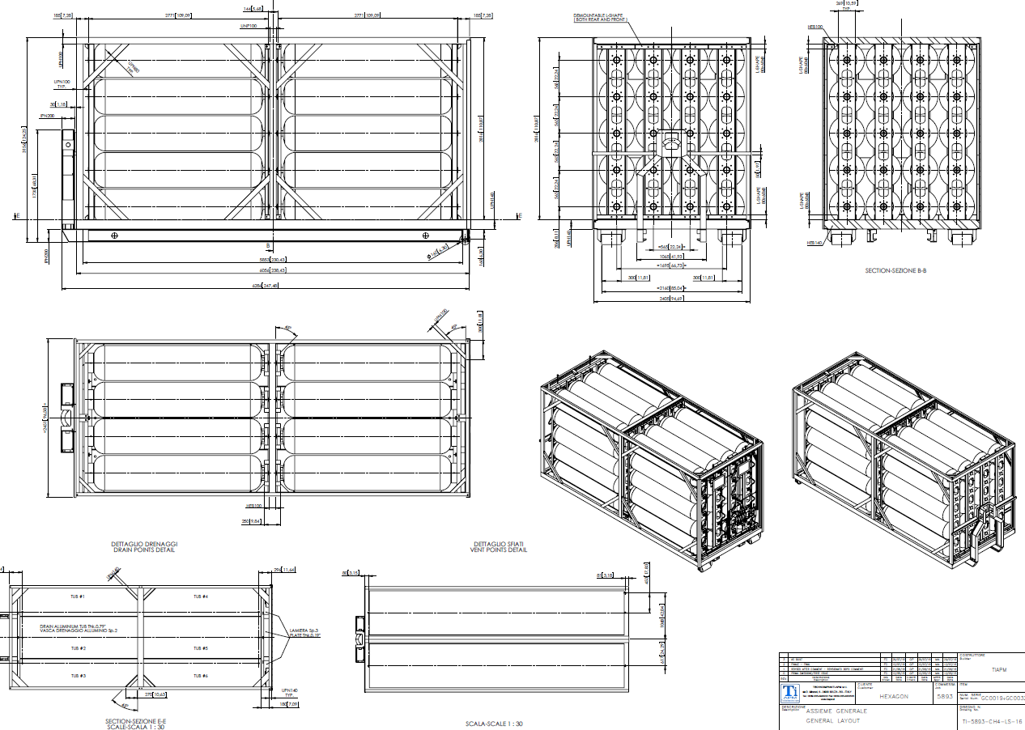

Slide 12
What are we gong to do with the hydrogen?
Department for Transport - Office For Low Emission Vehicles
Hydrogen Transport Programme - Stage 2
Commited almost £14 million funding to five projects which will serve to enhance and expand the UKs refuelling network and increase station utilisation with new vehicles. A wide range of consortium partners will contribute to individual projects including UK and global OEMs, A research institute, Local authorities and combined authorities as well as hydrogen suppliers. The combined contribution of these projects will be to deploy 5 new hydrogen refuelling stations, 73 fuel cell electric vehicles and 33 fuel cell electric buses. The winning projects are dispersed across the UK with activities in Northern Ireland (Belfast), Scotland (Aberdeen), Wales (Monmouthshire) and England (Crawley, St. Helens, Middlesbrough and Stockton on Tees).

Slide 13
Northern Ireland Hydrogen Project
Partners
Energia
Translink
HyEnergy
The consortium were awarded £1.9M for
A Hydrogen fuelling station and three double decker fuel cell hydrogen vehicles.

Slide 14
Neil Morrow neil.morrow@energiagroup.com
Tel: 0044 2890 380641
Mob: 0044 77950603239
Energia Group
Beechwood House
Newforge Lane
Belfast
BT9 5NW

