Slide 1
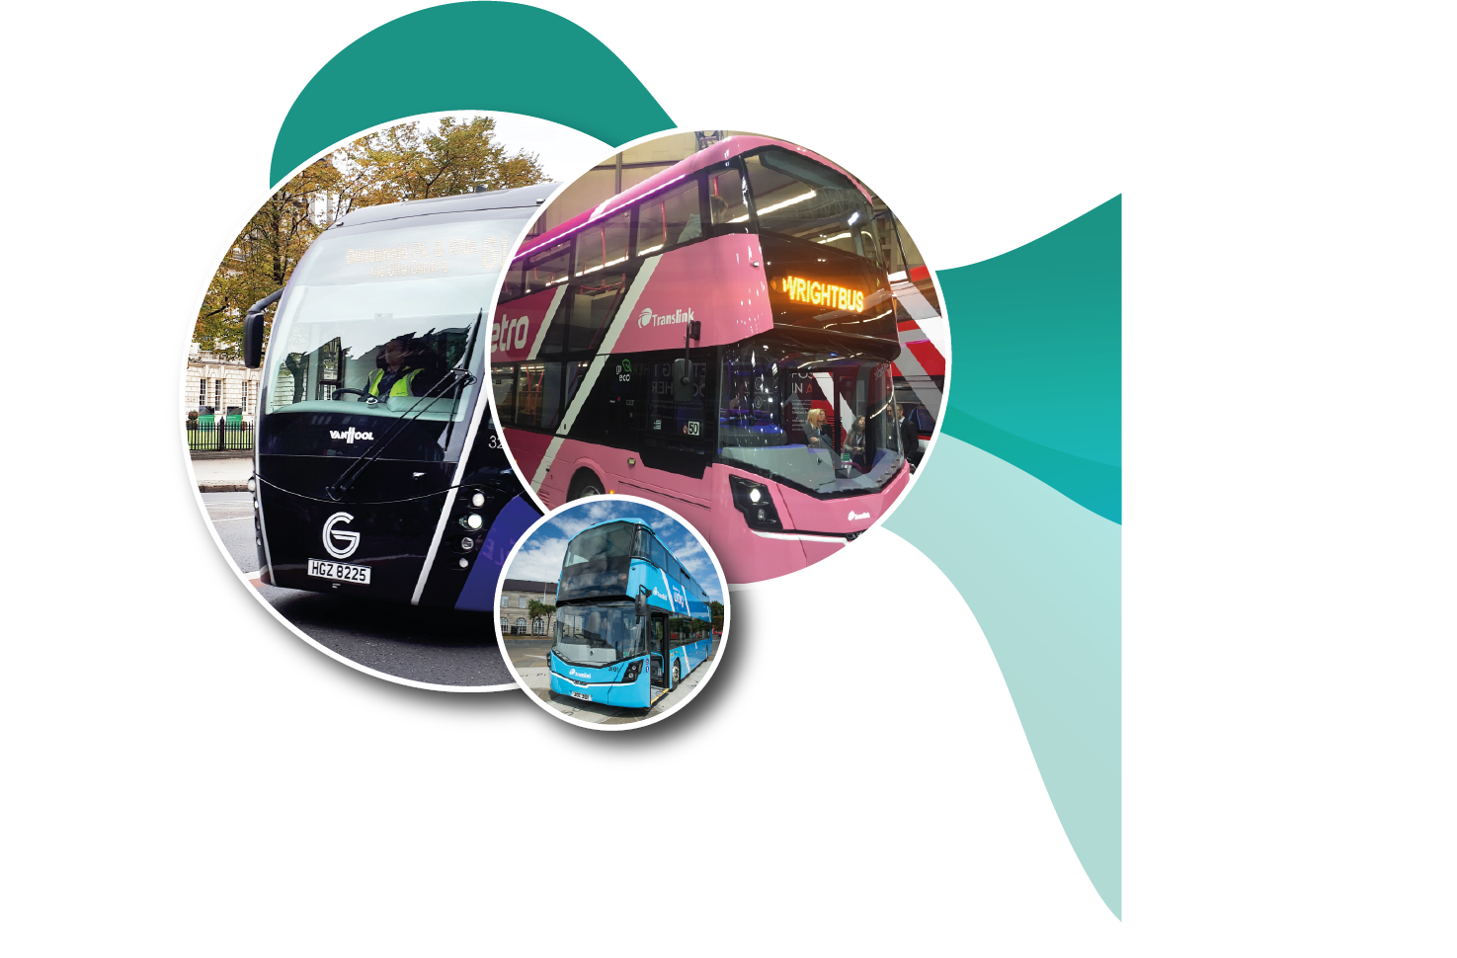
Hydrogen Bus in the context of Northern Ireland Public Transport
Brian Elliott Technical Manager, Engineering

Slide 2
Presentation Outline
Genesis of Hydrogen Bus Project
The need for change
Bus Technology
Translink’s Clean Air, Zero Carbon Road Map

Slide 3
Genesis of Hydrogen Bus Project
Gen Comm Project – Hydrogen Production
Energia had Hydrogen to sell
Agreed to submit Joint Submission to OLEV
Applied for funding
Success!

Slide 4
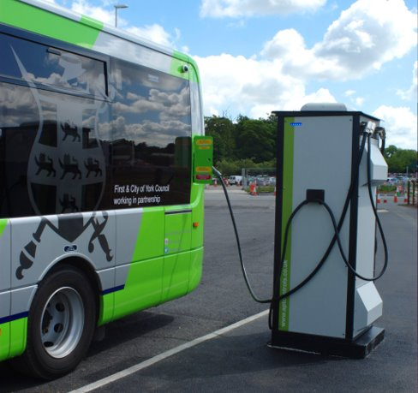
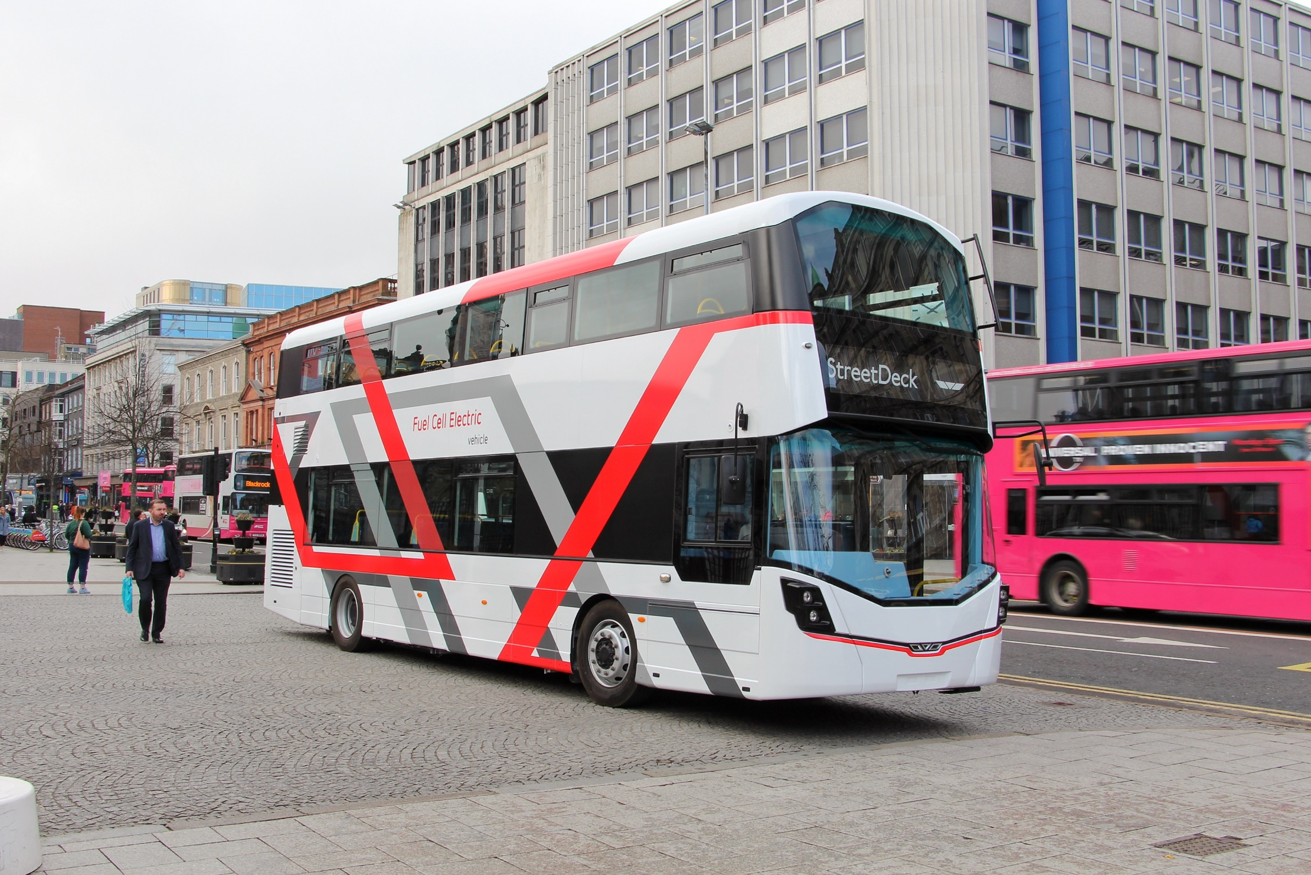

Slide 5
Why are Translink interested in this?
Global Scale
Global Warming

Slide 6
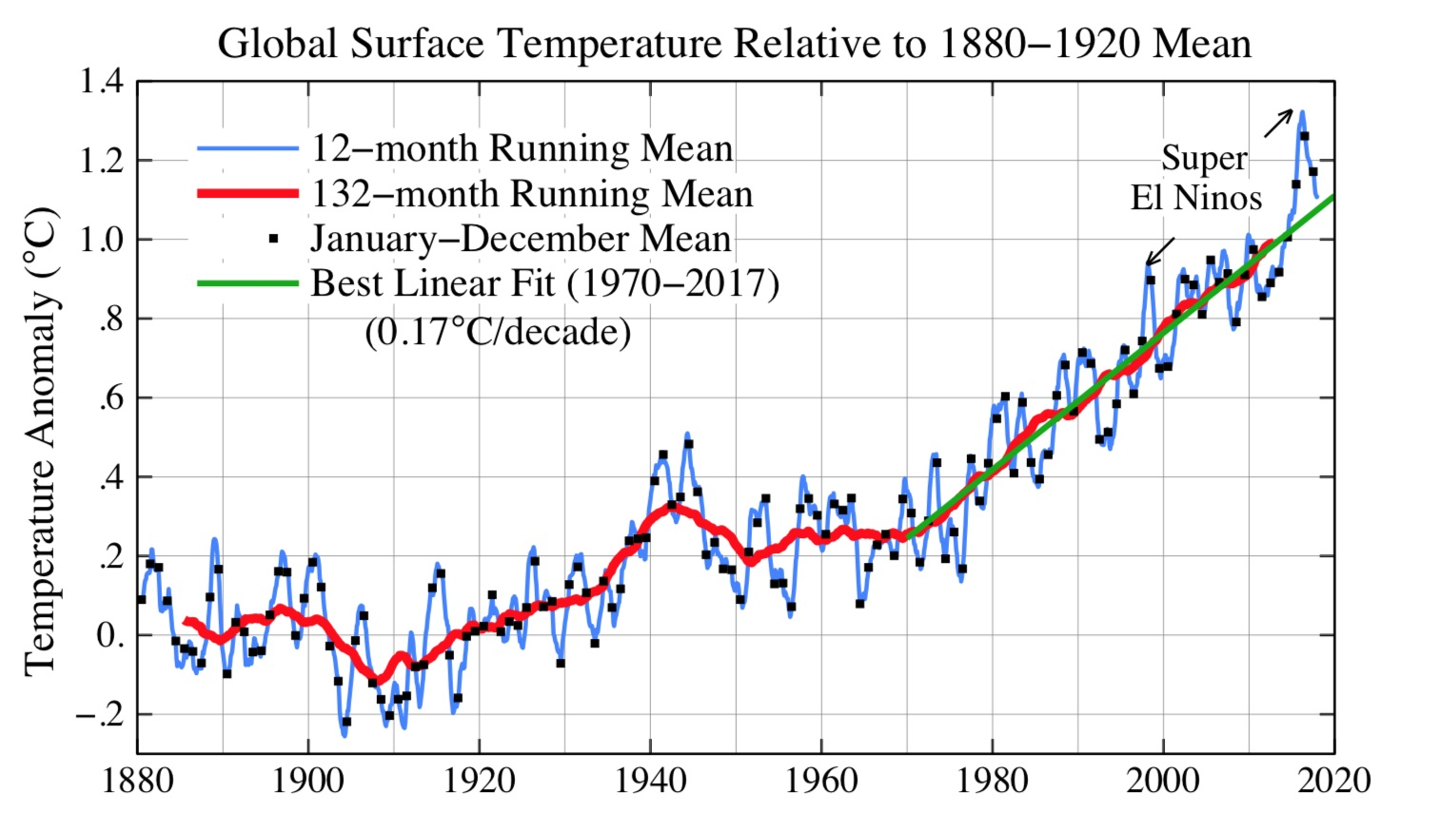
The need for CHANGE

Slide 7
Why are Translink interested in this?
Global Scale
Global Warming
Increased Greenhouse Gas Emission

Slide 8
Since 1990 – an increase of 43% in warming effects
C0₂ concentration in Artic reached 407.8ppm; up from 405.5ppm on previous year
CO₂ is at 147% of Pre Industrial levels

Slide 9
Translink are also interested because of
National Scale
Government Targets 2050
Harmful Emissions from Exhaust

Slide 10
Increasing concern over Exhaust emissions especially from diesel engine
PM linked to increased risk of cardiovascular disease and lung cancer
NOx can cause breathing problems, trigger Asthma, etc.
Eco System
Acidification
Eutrophication
Ground level ozone

Slide 11
Translink are also interested because of
National Scale
Government Targets 2050
Harmful Emissions from Exhaust
Local Scale
Programme for Government

Slide 12
Programme for Government Outcome
Outcome 2
We live and work sustainably – protecting the environment

Slide 13
Programme for Government Outcome
Outcome 11
We connect people and opportunities through our infrastructure

Slide 14
Translink are also interested because of
National Scale
Government Targets 2050
Harmful Emissions from Exhaust
Local Scale
Programme for Government
Company Scale
Long Life of Asset

Slide 15
Typical Fleet Retirement Ages
Minibus 12 Years
Goldline 8 Years
Metro 15 Years
Ulsterbus 18 Years

Slide 16
Bus Technology Development
Zero Emission
Hybrid with Zero Emission
Hybrid
Mild Hybrid
Euro 6 Engine Technology

Slide 17
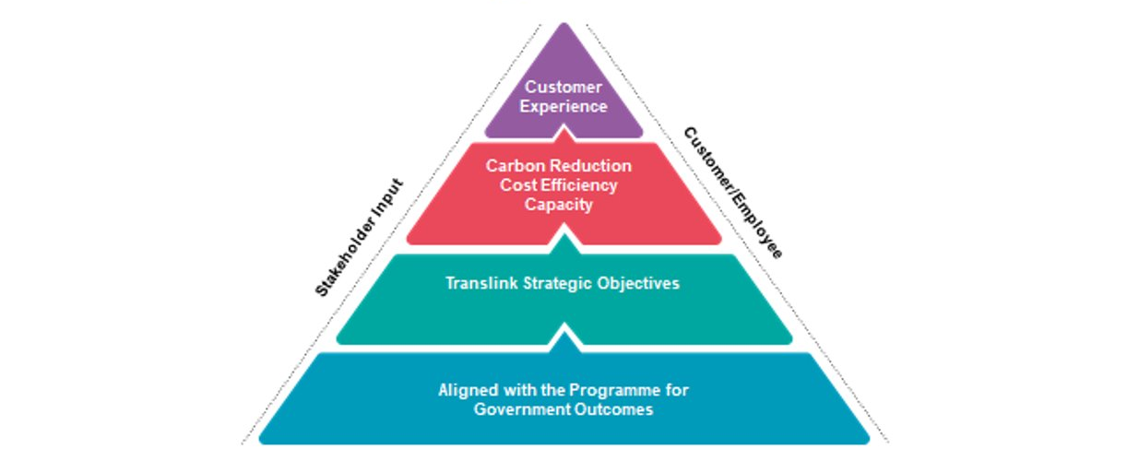
Translink Fleet – Strategic Context

Slide 18
Transport Action Required
Modal shift to Sustainable transport (Bus, Rail, Cycling, Walking)
Infrastructure development to support and prioritise Sustainable transport
Incentives for, and investment in electric/hydrogen infrastructure
Demand management measures adopted
Switch to zero carbon public transport vehicles (electric/hydrogen)

Slide 19
Translink Fleet Strategy
Migration to zero emissions fleet by 2040
Conversion of Belfast Metro, Foyle Metro, and Goldine to Euro 6 2019-2022
Hybrid electric 2019
Hydrogen Fuel Cell Bus 2020
Full Electric Bus 2021
Zero Emission/Zero Carbon for Belfast/Foyle Metro 2030

Slide 20
Thank You!

