Slide 1
LNG for the Transport Industry 28/11/2019

Slide 2
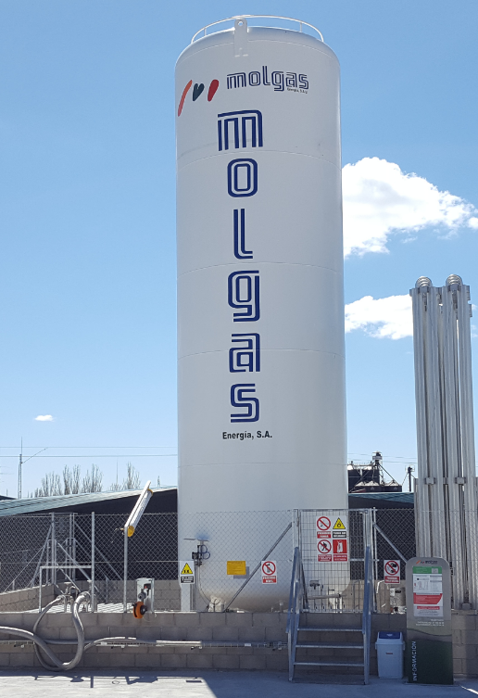
Contents
LNG/Molgas Overview
What is LNG?
Molgas Introduction
Molgas Activities
Turn Key Solution
LNG for Road Transport
Why LNG for Trucks
Option for Heavy Transport
Filling Station Set-Up
Molgas LNG Stations
LNG Station Overview
LNG for Ship Bunkering
Molgas Activities
Types of Bunkering
Contact Information

Slide 3
LNG/Molgas Overview

Slide 4
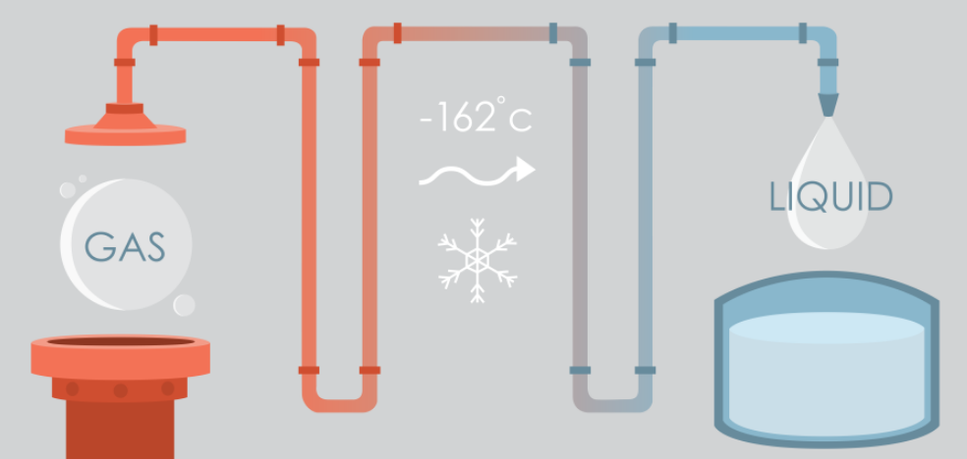
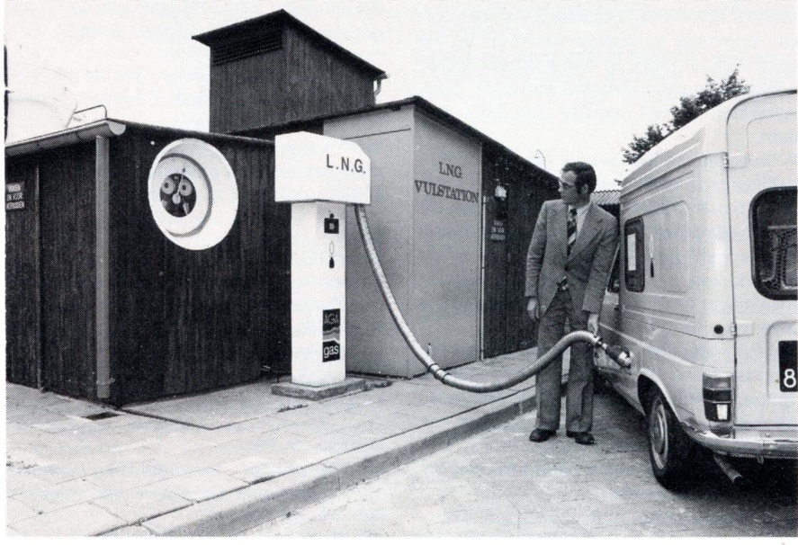
What is LNG? – Liquid Natural Gas
LNG is a Cryogenic liquid
Boiling point of -162 Celsius
Cleanest buring fossil fuel
Main constituent is methane (typically >90%)
As liquid, volume is reduced 600 times
Energy content of 15.2 MWh/ton HHV
Typical density 0.43 ton per cubic meter
Natural Gas is a Flammable Fuel
Lighter than air
Non-Toxic & Non-Corrosive
Flammable in a mixture of 5-15% with air
LEL (Lower Explosion Limit) of LNG more favorable than LPG
Technology has been available for a century

Slide 5
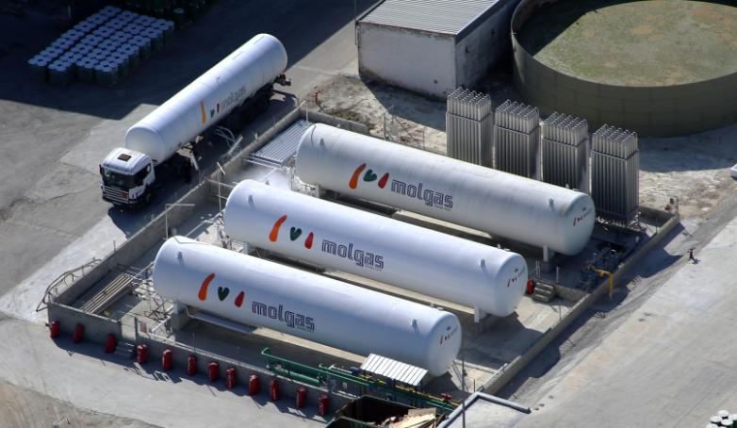
Introduction to Molgas Energy

Slide 6
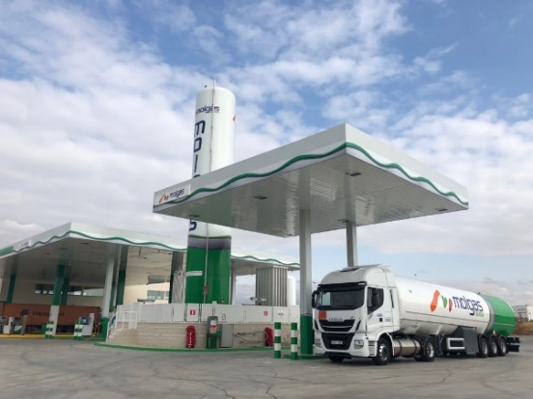
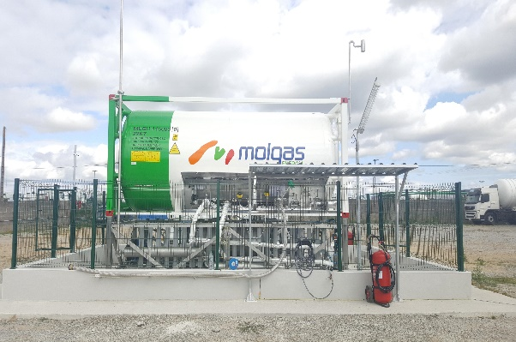
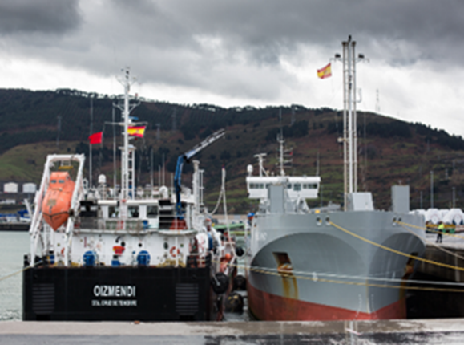
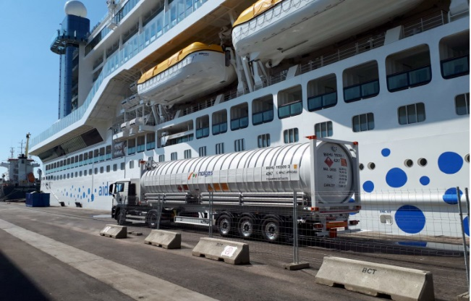
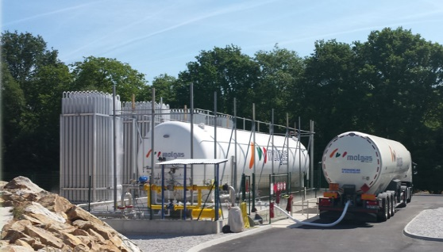
Molgas Energy Activities
Supply & Transport of LNG for Industrial, Vehicular & Ship Bunkering

Slide 7
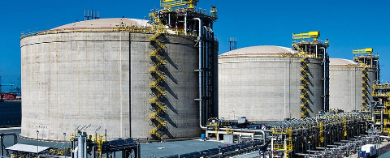
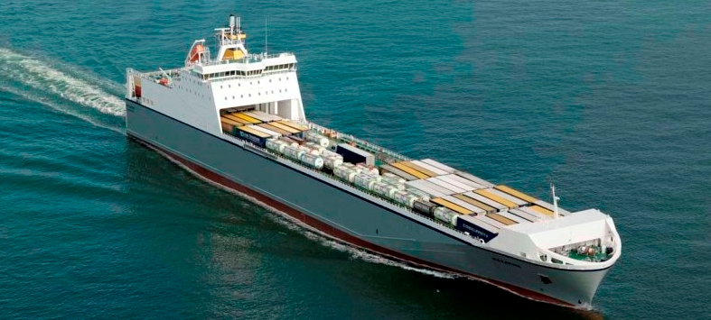
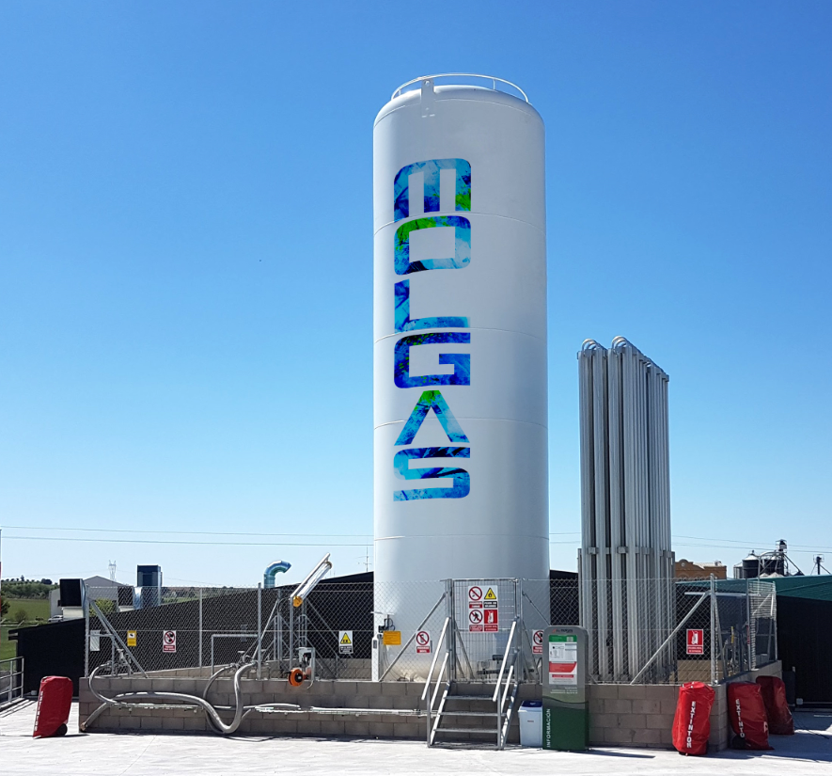
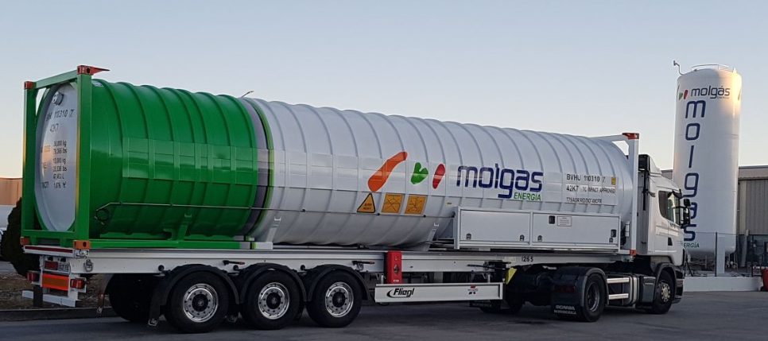
Turn Key Solution
“Molgas Turn Key Solution”
LNG supplied from Gate or Fluxys terminal
Seafreight: T75 40FT ISO Container for shipping LNG
ISO Container offloaded on site
Storage of LNG on site for customer use

Slide 8
LNG for Road Transport

Slide 9
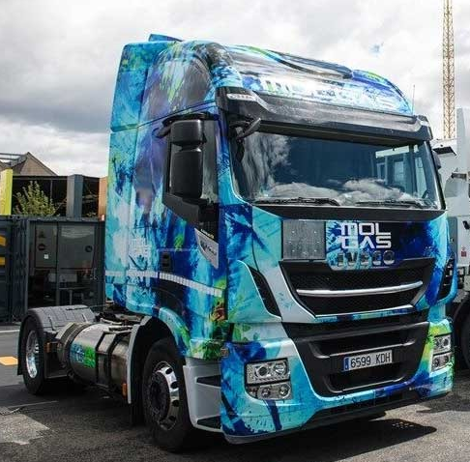
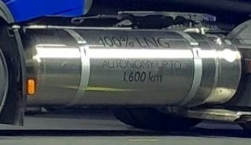
Why LNG for Trucks?
Environmental Benefits
CO2 Emission
Reduces CO2 Emissions by 20%
compared to diesel
Noise Pollution:
Reduces noise pollution
Air Quality:
Almost fully eliminates other emissions
like PM10, SOx & NOx
Total Cost of Ownership
Reduce cost per km
Savings of up to 30%
Increased Range for Heavy Vehicles
Up to 1,600Km
Natural Gas
Bridge to BioMethane
Molgas LNG Trucks
18,000 truck loads transported per annum
Molgas operate 60 LNG trucks

Slide 10
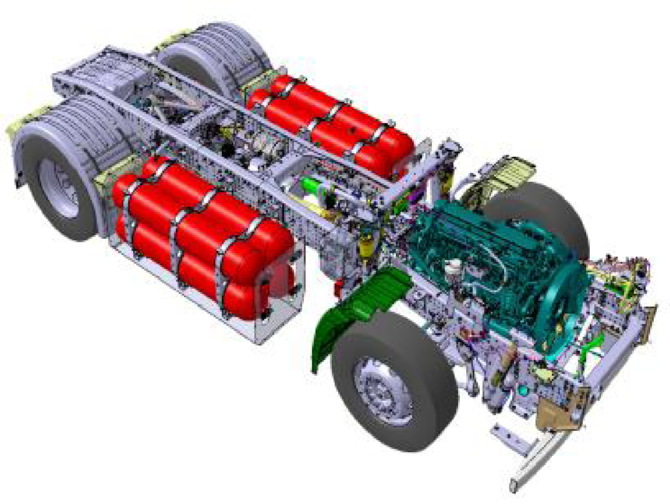
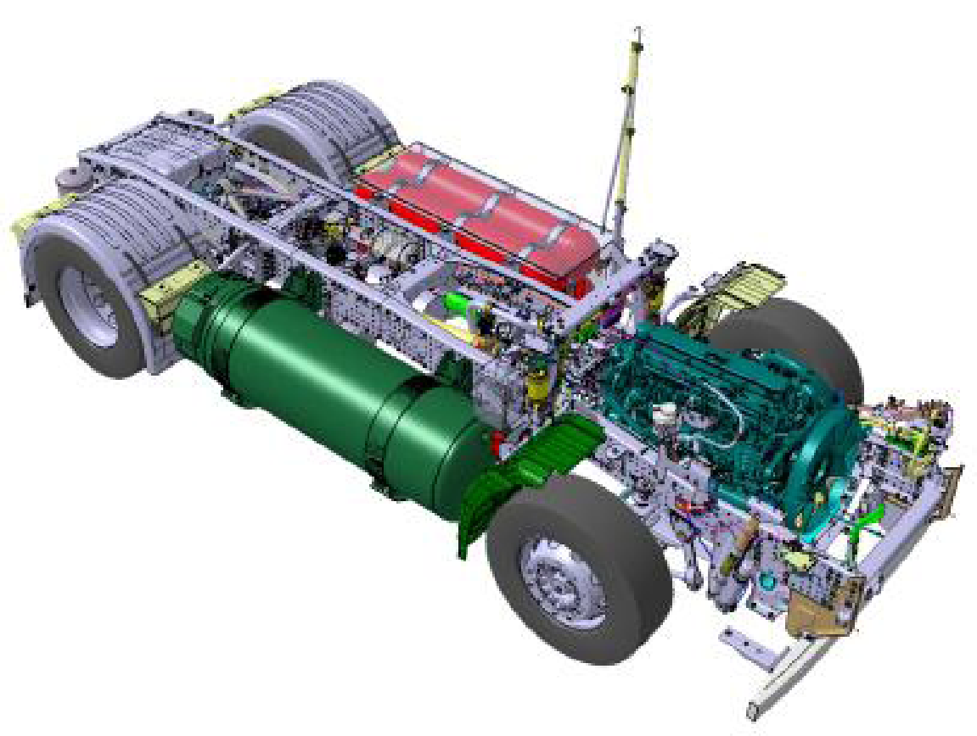
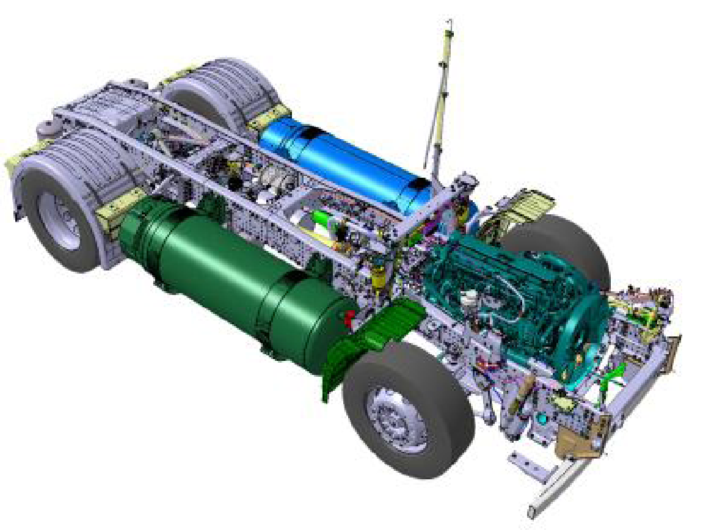
Truck Options for Heavy Transport
 | DIESEL | FULL ELECTRIC | HYBRID | PLUG-IN HYBRID | CNG | LNG
URBAN | WILL NOT BE PROFITABLE WITH LEGAL, ADMINISTRATIVE AND TAX OBSTACLES | POSSIBLE | NOT IDEAL | POSSIBLE | POSSIBLE | MAXIMUM PROFITABILITY AND ENVIROMENTAL BENEFITS
REGIONAL |  | DIFFICULT | NO BENEFIT | NOT IDEAL | POSSIBLE
NATIONAL |  | IMPOSSIBLE | NO BENEFIT | NO BENEFIT | POSSIBLE
INTERNATIONAL |  | IMPOSSIBLE | NO BENEFIT | NO BENEFIT | IMPOSSIBLE
 | CNG | C-LNG | LNG
AUTONOMY | 575 Km | 1,200 Km | 1,600 Km
NET LNG CAPACITY | - | 460 L | 1.080 L
CNG CAPACITY | 920 L | 540 L | -
Kg OF GAS | 150 Kg | 270 Kg | 390 Kg
POWER OPTIONS | 270 – 460 cv | 270 – 460 cv | 270 – 460 cv
10
Notes:
IVECO Stralis NP460 HP, 4x2 Pulling tri-axel, Gross 30T, London to Madrid,
1,728Km without refueling, 22.6Kg per 100Km,
€0.80/Kg – Including Duty €0.14/Kg VAT extra €0.18/Kg Dublin Port €1.12Kg

Slide 11
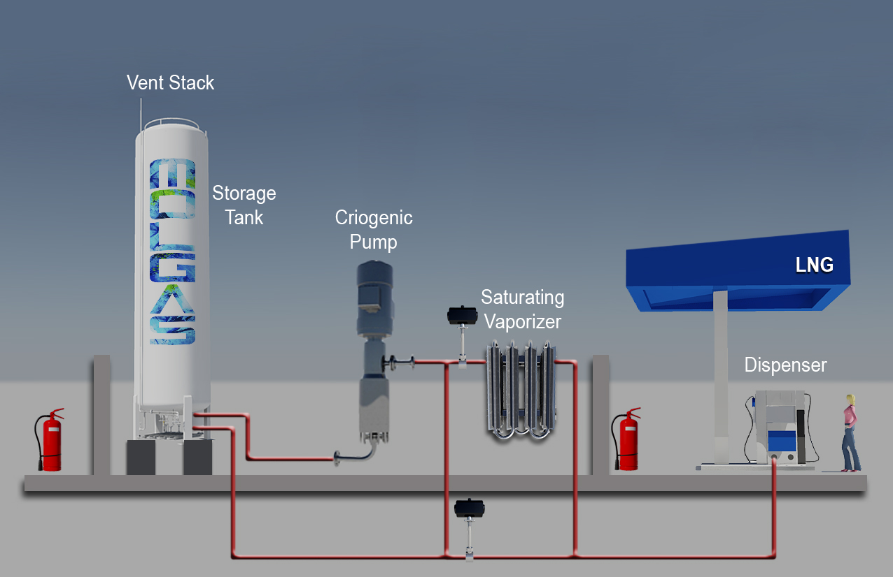
LNG Filling Station for LNG Transport

Slide 12
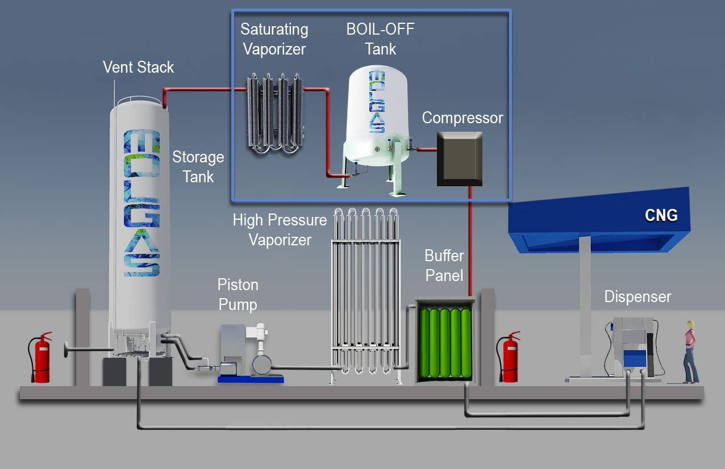
L-CNG Filling Station for CNG Transport
Notes:
Dibujar un planta en 3d pequeña

Slide 13
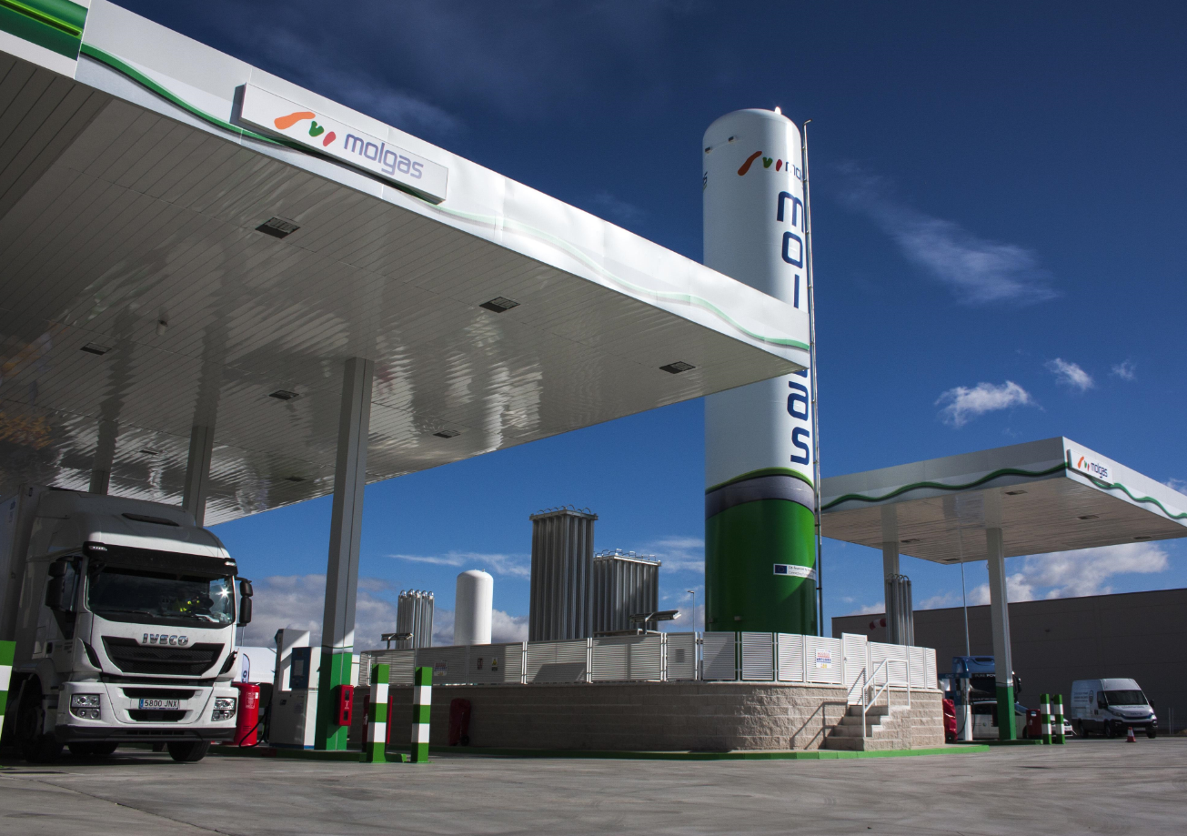
Molgas LNG & CNG Filling Station

Slide 14
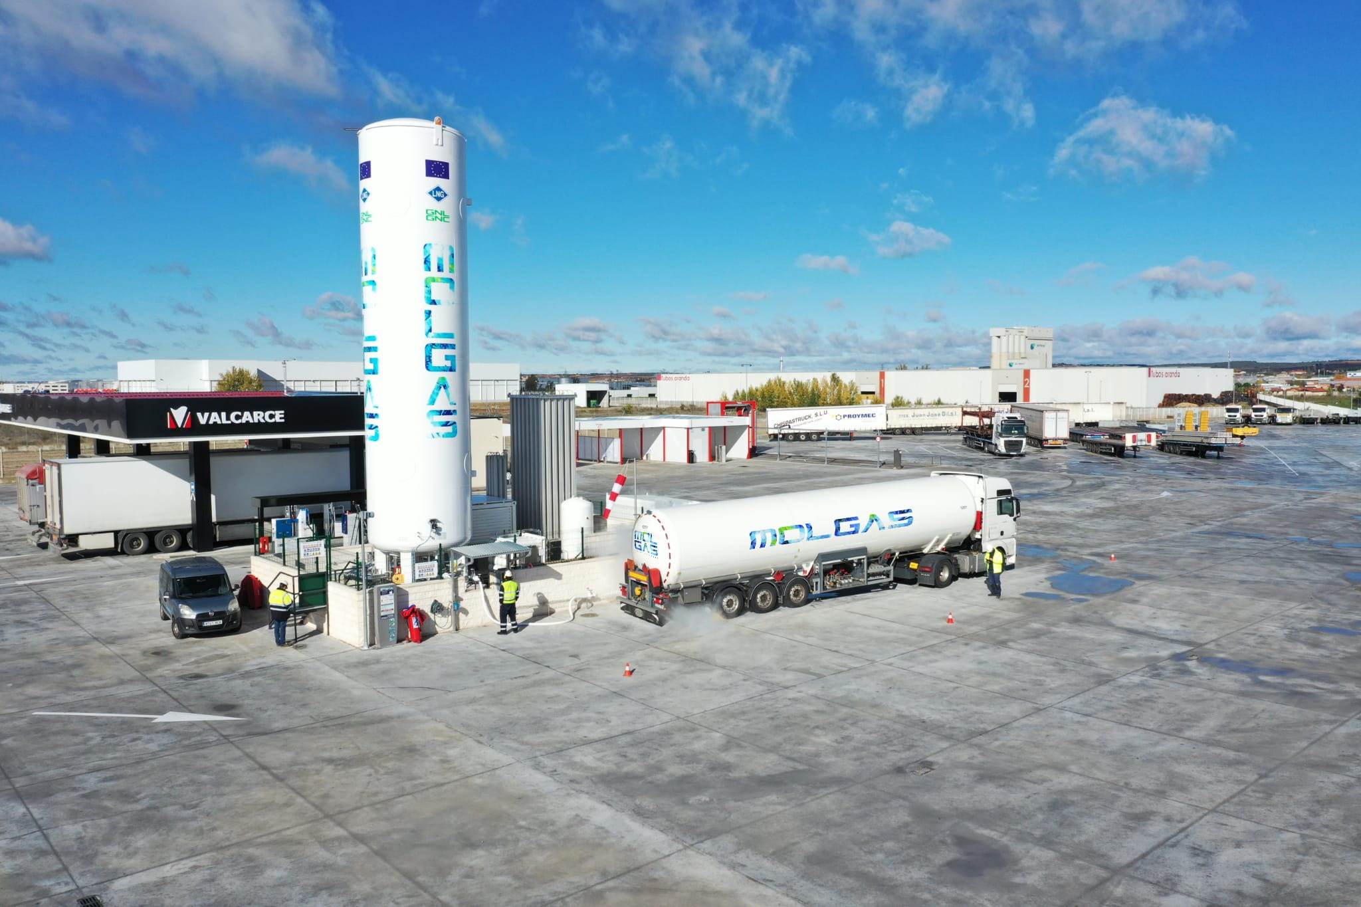
Molgas LNG & CNG Filling Station

Slide 15
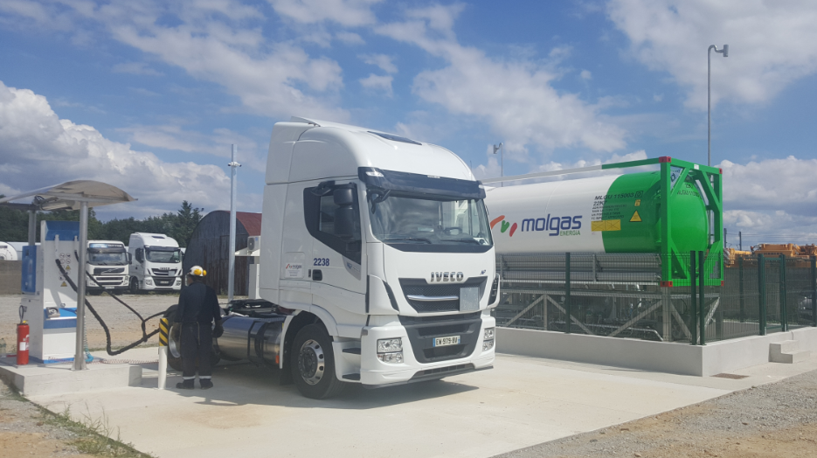
Private Truck LNG Filling Station

Slide 16
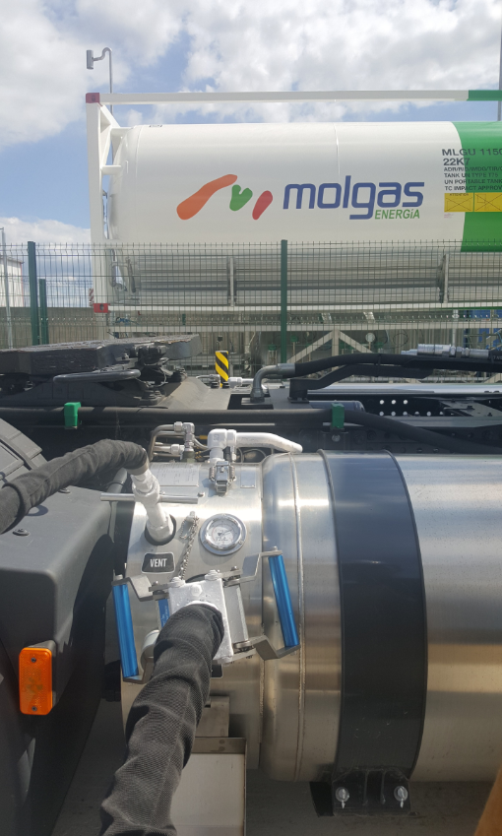
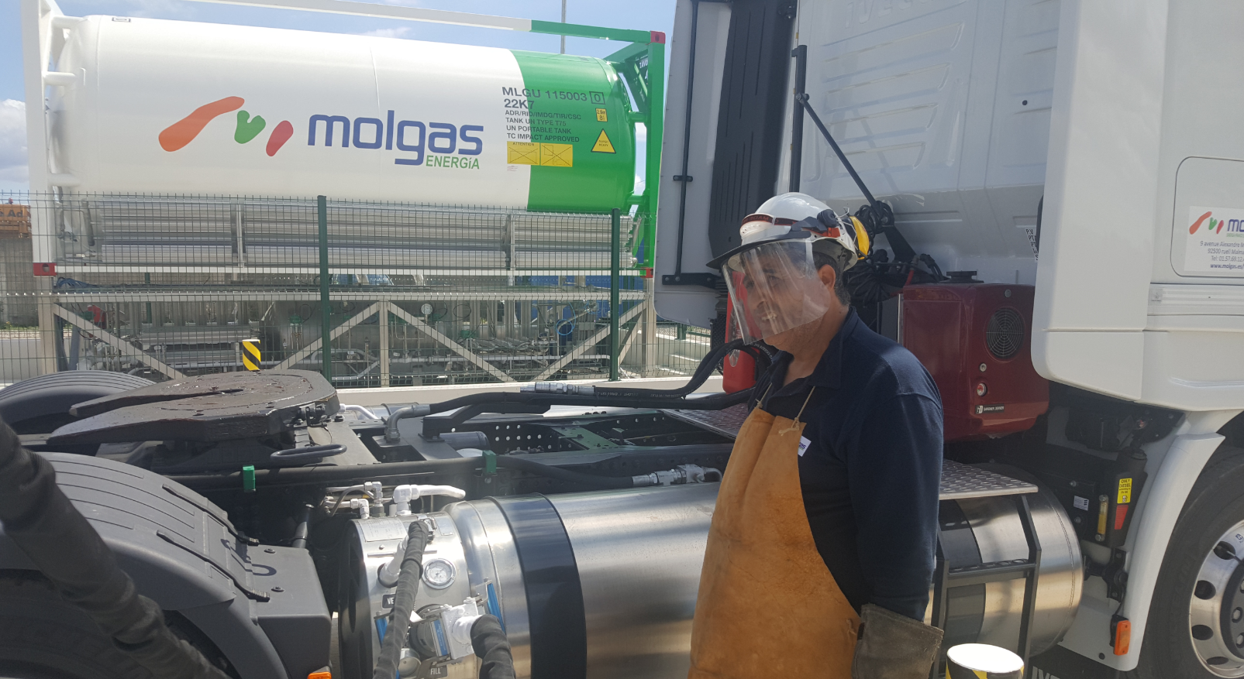
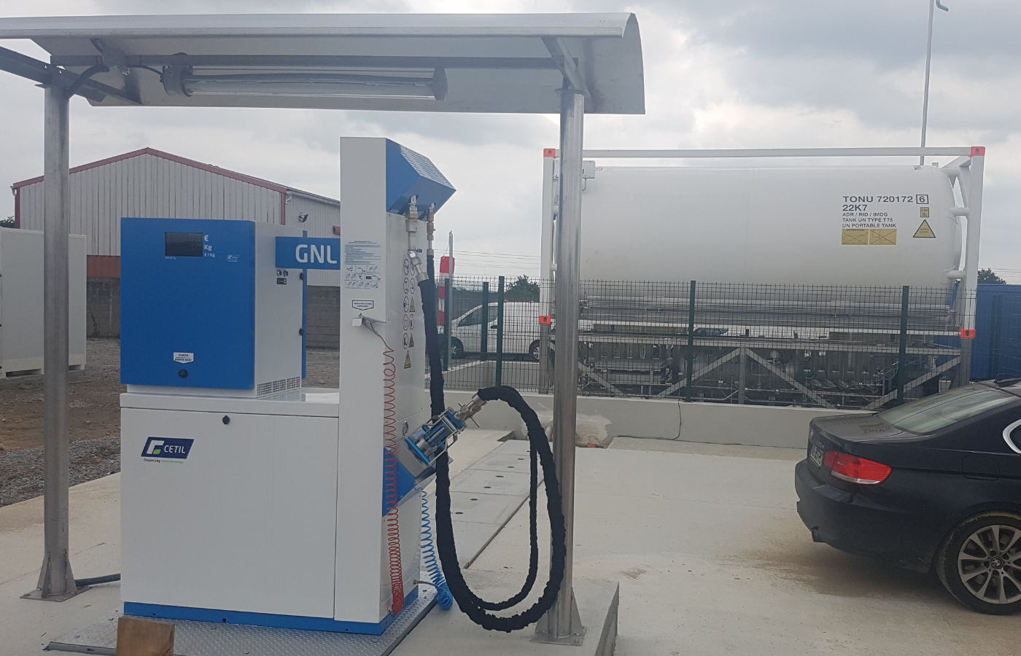
Truck Filling Operations

Slide 17
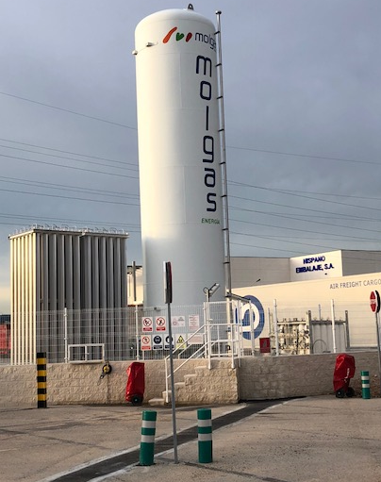
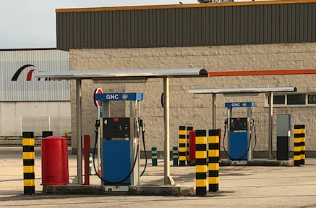
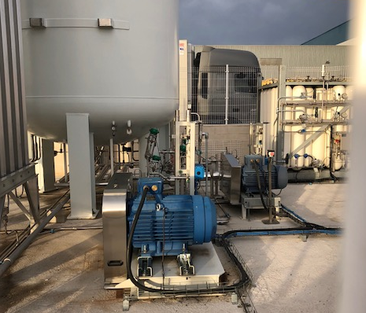
L-CNG Bus Filling from LNG Storage

Slide 18
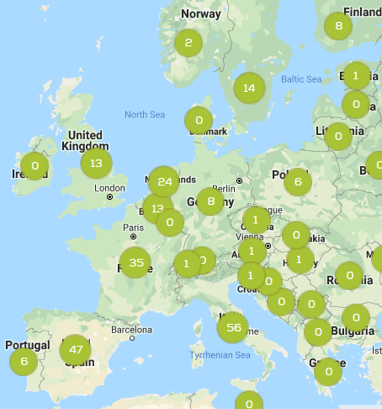
LNG Station Overview
238 LNG Public Station (LNG & L-CNG) Source: ngva.eu

Slide 19
LNG for Ship Bunkering

Slide 20
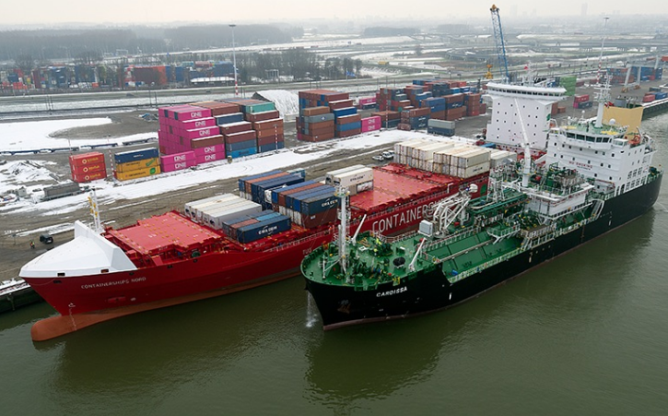
Ship to Ship Bunkering
Use within the vicinity of a LNG terminal, Port of Rotterdam
Large volumes of LNG ship traffic required
Notes:
Norway Hammerfest
Operated by sister company Barents Natural Gas

Slide 21
Molgas Bunkering Activities
Norway Bunkering Station
Hammerfest 1,250cbm
Lodingen 250cbm
Moskeness 150cbm
Kjopsvik
Spain
Vigo
Gijon
Santander
Bilbao
Barcelona (Aida Prima)
Algeciras
Cartagena
Valencia
Sweeden
Gothenburg: Jetty 519/521
Malmo
Netherlands
Rotterdam
Amsterdam
Belgium
Zeebrugge (Hoppe terminal)
Antwerp
UK
London Thames Port

Slide 22
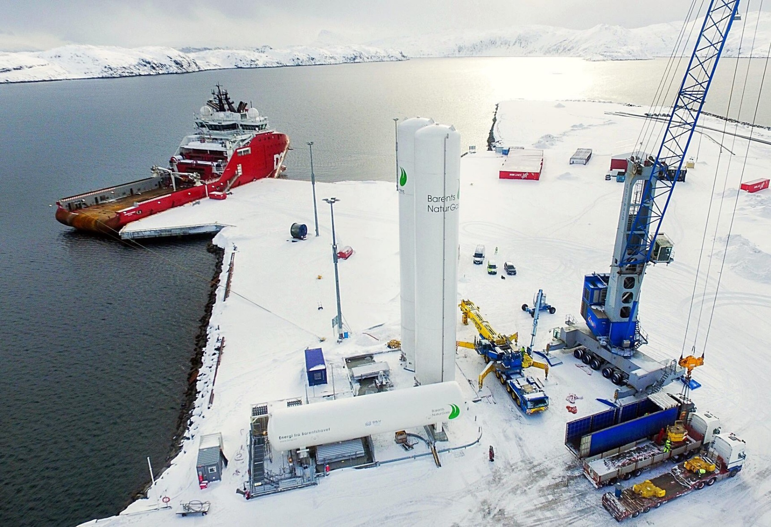
Shore to Ship Bunkering
Notes:
Norway Hammerfest
Operated by sister company Barents Natural Gas

Slide 23
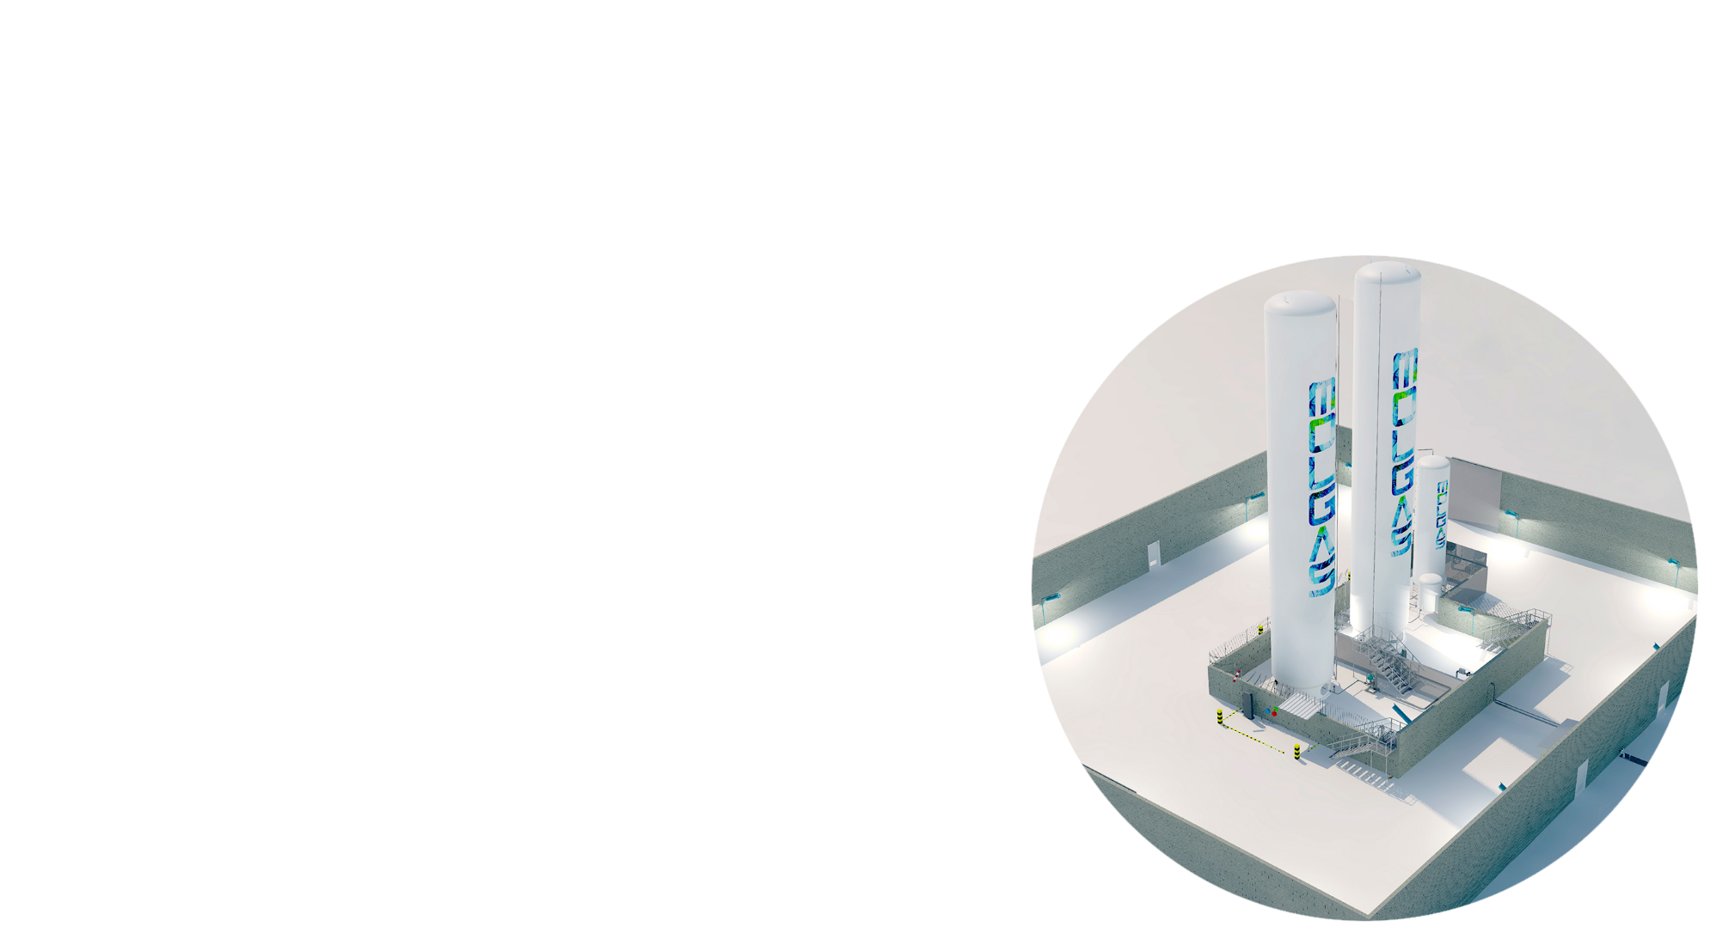
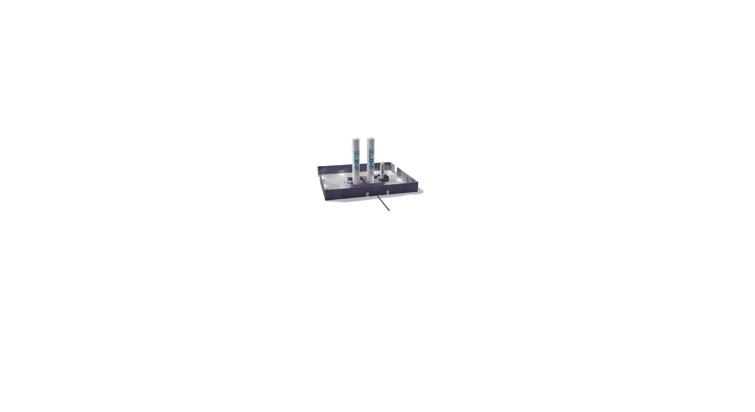
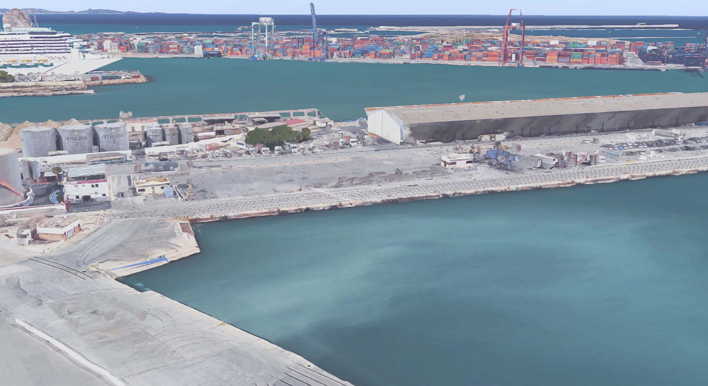
Port of Valencia (New Build)
Notes:
2x 200m3 tanks
Crane to allow ship filling from 2m to 12m

Slide 24
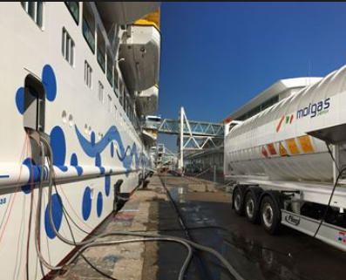
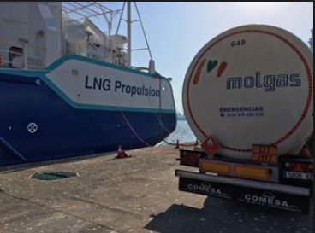
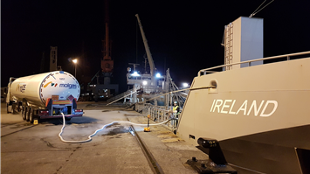
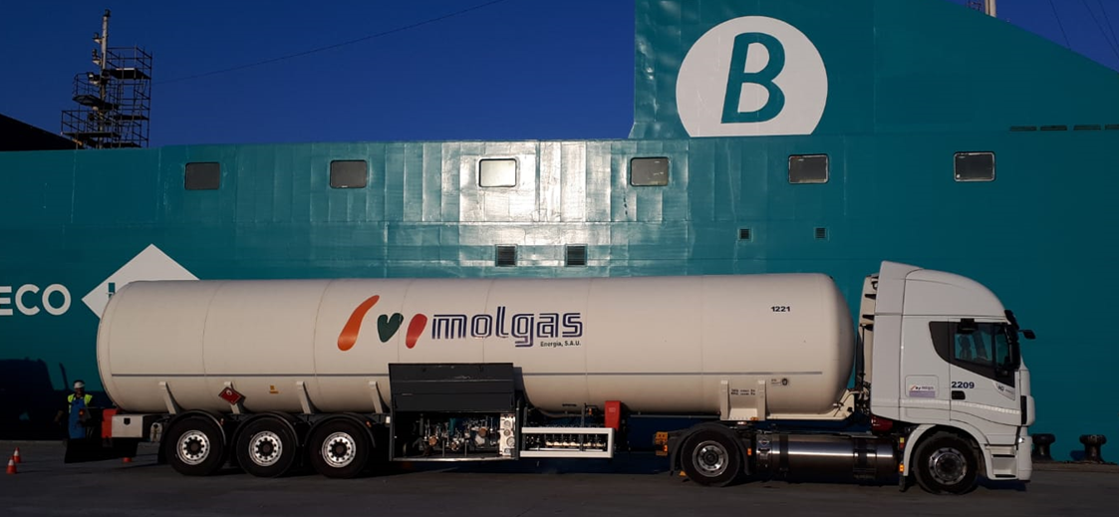
Truck to Ship Bunkering
Notes:
40FT Semi-Rigid or 40FT ISO container

Slide 25
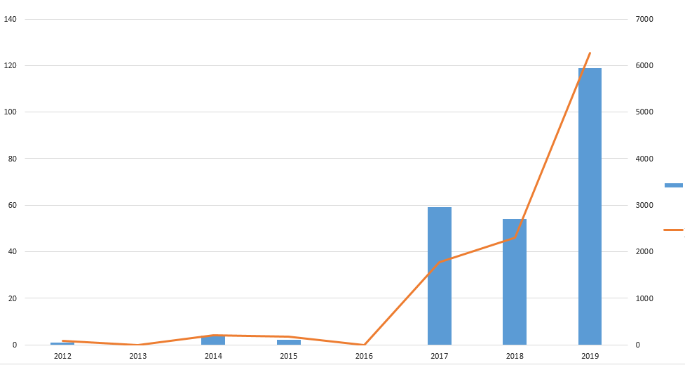
Truck to Ship Bunkering Growth in Spain
# of Operations
Volume m3
Notes:
40FT Semi-Rigid or 40FT ISO container

Slide 26
Thank
You
Ken Treacy
Kenneth.treacy@molgas.es
+353 87 6755754

