Slide 1
GenComm 28 Nov 2019 Biomethane in Transport
Dr Peter Watters CEng FIMechE FIEI

Slide 2
Biomethane in Transport
Introduction to Biomethane
Biogas Upgrade to Biomethane
Biomethane to Gas Grid
CNG Vehicle Refuelling
Renewable Fuel Obligation

Slide 3
1. Biomethane Costs
 | Density | Calorific Value | Pressure | Cost/Kg | Cost/kWh
Petrol | 0.75 | 46.7 | 0.5 | £1.60 | £0.12
Diesel | 0.83 | 43.1 | 100/250 | £1.71 | £0.14
LPG | 0.49 | 50.0 | 7 | £1.24 | £0.09
CNG | 0.17 | 55.0 | 250 | £0.72* | £0.05*
BioCNG | 0.17 | 55.0 | 250
LNG | 0.40 | 55.0 | 3 | £1.00
H2 (Gas) | 0.035 | 140.0 | 700/900 | £7.50 | £0.19
H2 (L) | 0.0708 | 140.0 | 11@-240C |  | N/A
WIP | Kg/Litre | MJ/Kg | Bar(g) | £/Kg | £/kWh

Slide 4
1. Biomethane - Benefits
NET Zero 2050
“UK and Ireland Governments 2019”
Climate Emergency
“Scotland, Wales, UK and Ireland, 28 Apr – 9 May 19”
Climate Change Hunger Striker
“Dail, 21 Nov 2019”
CNG/LNG versus Diesel -20% CO2 Reduction
Biomethane Versus Diesel -100% CO2 Reduction
“Volvo, Ballyclare 27 Nov 2019”

Slide 5
1. Biomethane – Renewable CNG
Natural Gas – Methane CH₄
Found in oil/gas deposits, Shale Gas (Unconventional)
Un-sustainable, price independent of Oil
Renewable Natural Gas - Biomethane
Anaerobic Digestion (with CO2)
Land Fill gas (with CO2)
Transport applications
LNG - Trucks and Ships
CNG - Cars, Trucks and Buses

Slide 6
1. BioLNG

Slide 7
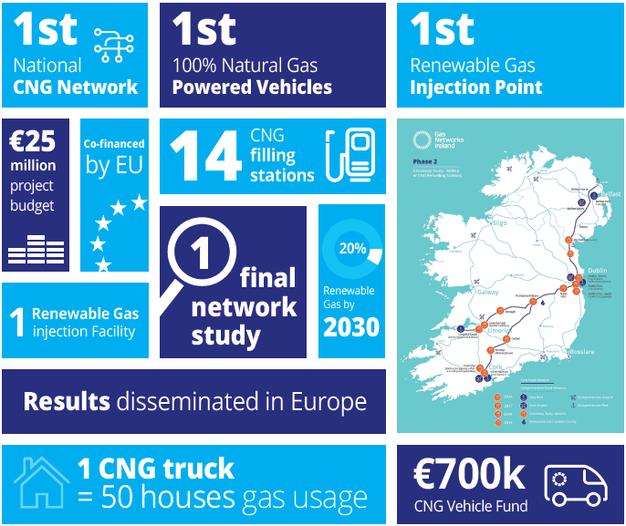
2. Biogas to Biomethane
Causeway Project
Vision 2050

Slide 8
2. Biogas to Biomethane
Anaerobic Digestion Biogas - Causeway Project
Reference | CH4 Min | CH4 Max | CO2 Min | CO2 Max | H2O Min | H2O Max | N2 Max | O2 Max | H2 Max | NH3 Max | H2S min | H2S Max
SEAI 04_11 | 50.0% | 75.0% | 25.0% | 45.0% | 2.0% | 7.0% | 2.0% | 2.0% | 1.0% | 1.0% | 20 | 20000

Slide 9
2. Biogas to Biomethane - Basics
Increase Pressure to 7 – 10 Bar.
Remove Impurities
H₂O
H₂S
NH₃
Separate or Vent CO₂
Analyse, add Odorant (and Propane)

Slide 10
2. Biogas to Biomethane - Technology
Chemical addition into digester
Filters, Separators, Coalescers
CO₂ removal (6 gas technologies)
Cryogenic Separation < -78C
Water Scrubbing
Pressure Swing Absorption
Chemical Treatment
Amine Scrubbing
Membrane Separation

Slide 11
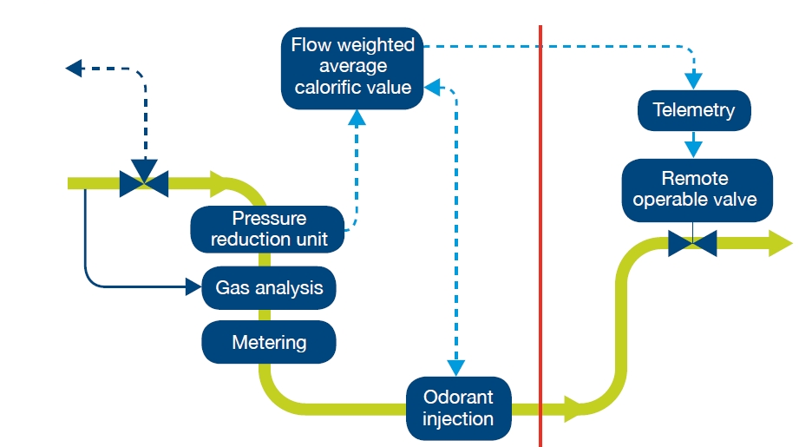
3. Biomethane Gas 2 Grid
CRU approved & published on 15th Oct 18
Transcribed into the GNI Connection Policy V5.0
NFO
GNI

Slide 12
3. Biomethane Gas 2 Grid
Biomethane Producer (NFO) sells gas to Gas Grid
Gas Grid sells gas to the CNG station
UK Gas 2 Grid; 2017
GNI Gas 2 Grid; 2018/19 – Cush, County Kildare
N. Ireland - Q4, 2020 – UREGNI Work Plan 2019
Biomethane Producer sells into Biogas CHP Market
One Biomethane filling point in N. Ireland, “off-grid”

Slide 13
4. Biomethane Filling
CNG Filling – 2 Skids
Natural Gas mains pressure 4 Bar
CNG filling pressure 200/250 Bar to Vehicle UNECE R110
~ 90 kWe 500m³/hr 4 Stage Gas Compressor
Electrical Supply
Cooling of Compressor
Buffer Gas Storage and cooling
Standard Dispenser Standard Installation

Slide 14
4. Biomethane Filling

Slide 15
4. Biomethane Filling -
Who is going to build CNG/Biomethane Refuelling facilities?
“How much will a station cost?”
“How much do the trucks cost?”
Need to provide information to
Stakeholders, Stakeholders
Planners/HSE/Environment agency
Road Hauliers
Young people considering a long career in renewables

Slide 16
4. CNG Refuelling - Dublin

Slide 17
4. CNG

Slide 18
5. Renewable Transport Obligation
Renewable Transport Fuel Obligation
Fuel supplier obliged to buy more renewables each year
UK Government Policy in place, Biomethane certification
Ireland Government – Consultation, 15 Nov 19
Value of a Renewable Transport Fuel Certificates
Market for certified Biomethane
Value to Biomethane producer
Work in Progress

Slide 19
GenComm - Biomethane
Thank you
Belfast Metropolitan College; Paul & Joanna
Energia; Mark & Neil
Molgas; Ken
CNG Installations; Chris
IMechE; Patrick & Carlos
And everyone else!

