Slide 1


Slide 2


OUTLINE of CNG
Formed by compressing natural gas to 200 / 250 Bar
It is stored as a supercritical fluid (scf) at ambient temperature and high pressure.
Used in the transport industry as a viable alternative to diesel.
Globally 19 million CNG vehicles and 70 in Ireland
Comparison to Diesel, 22% < CO₂ and 17 – 35% cheaper
2025, Gas Networks Ireland aiming to have 5% of HGV’s on CNG.

Slide 3



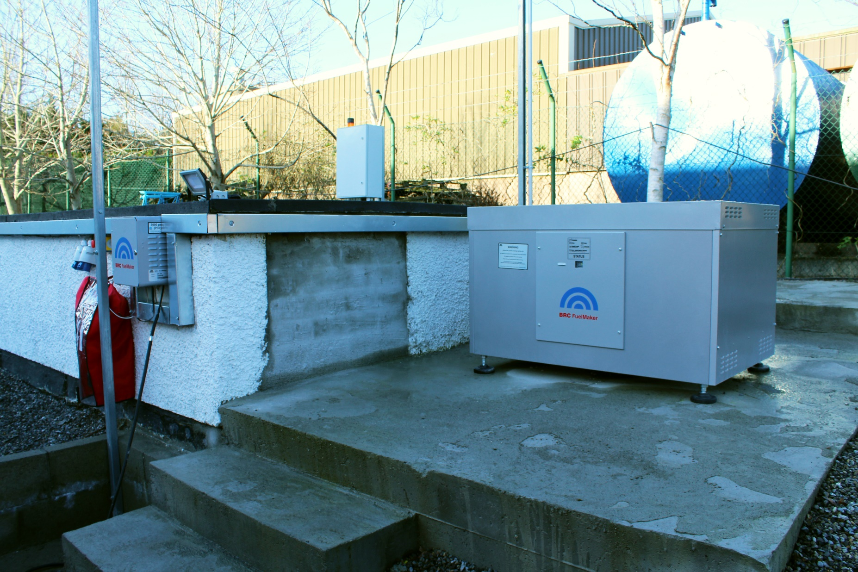
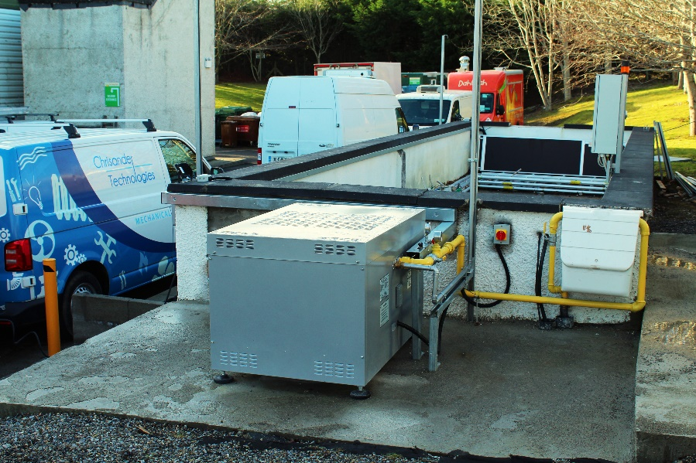
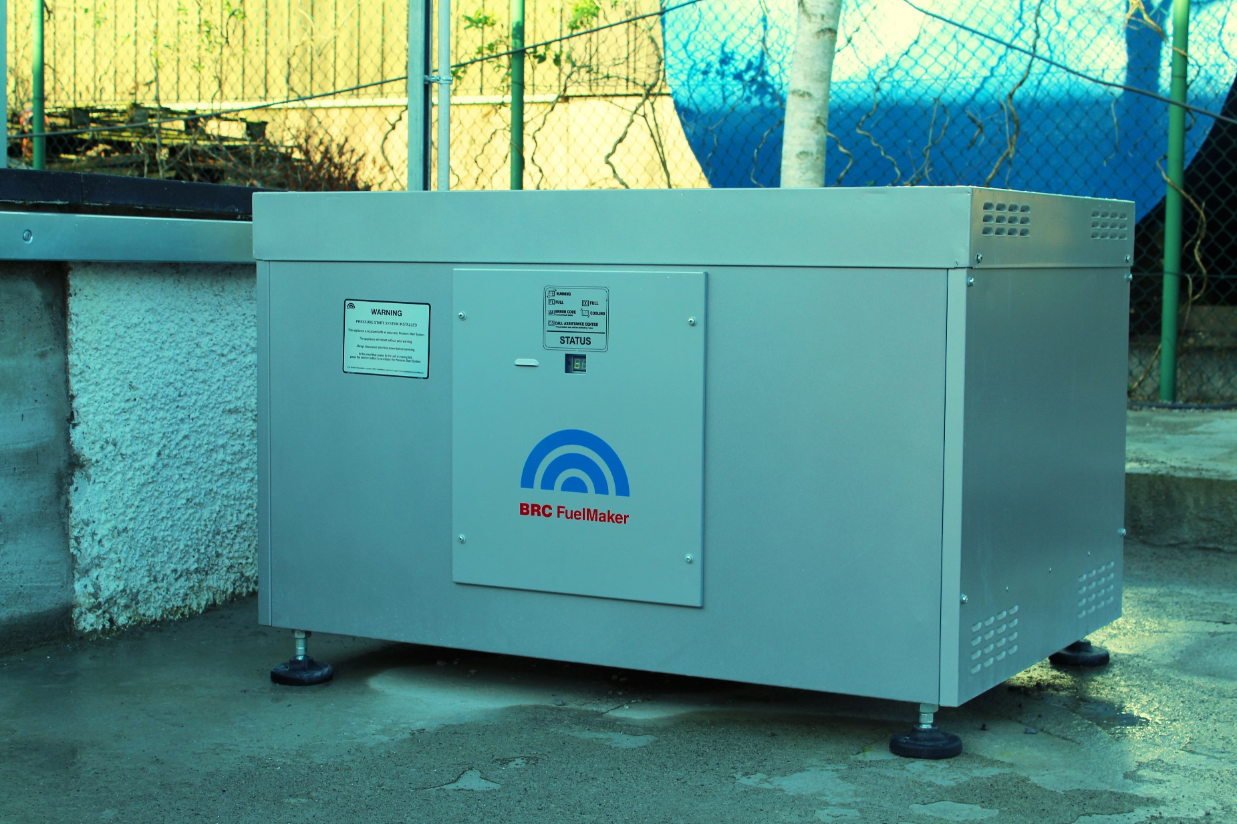

Slide 4












Slide 5

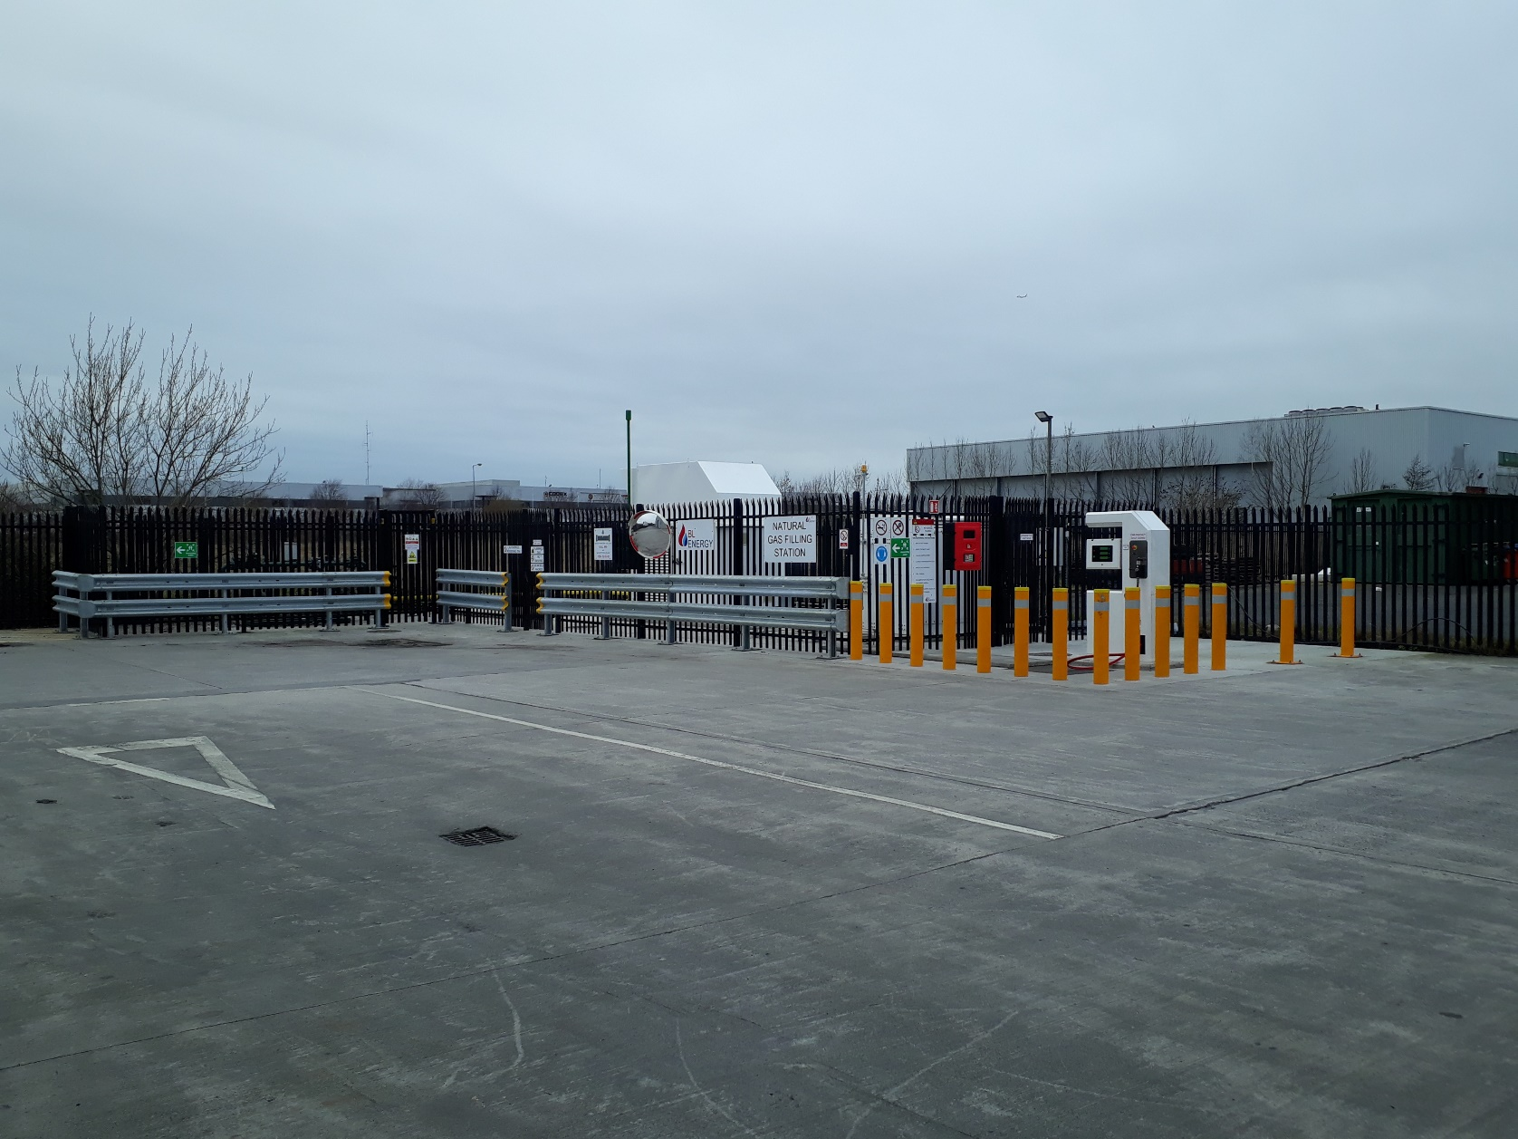



Slide 6
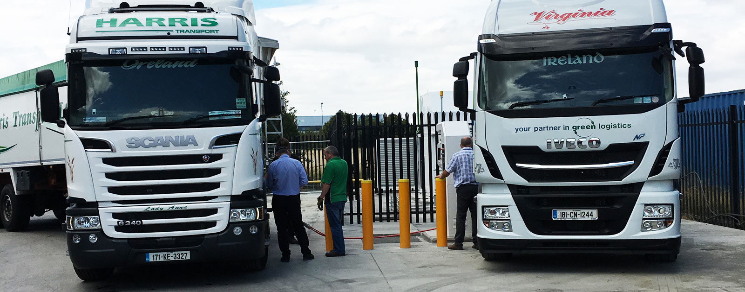

Slide 7








Equipment Suppliers

Slide 8
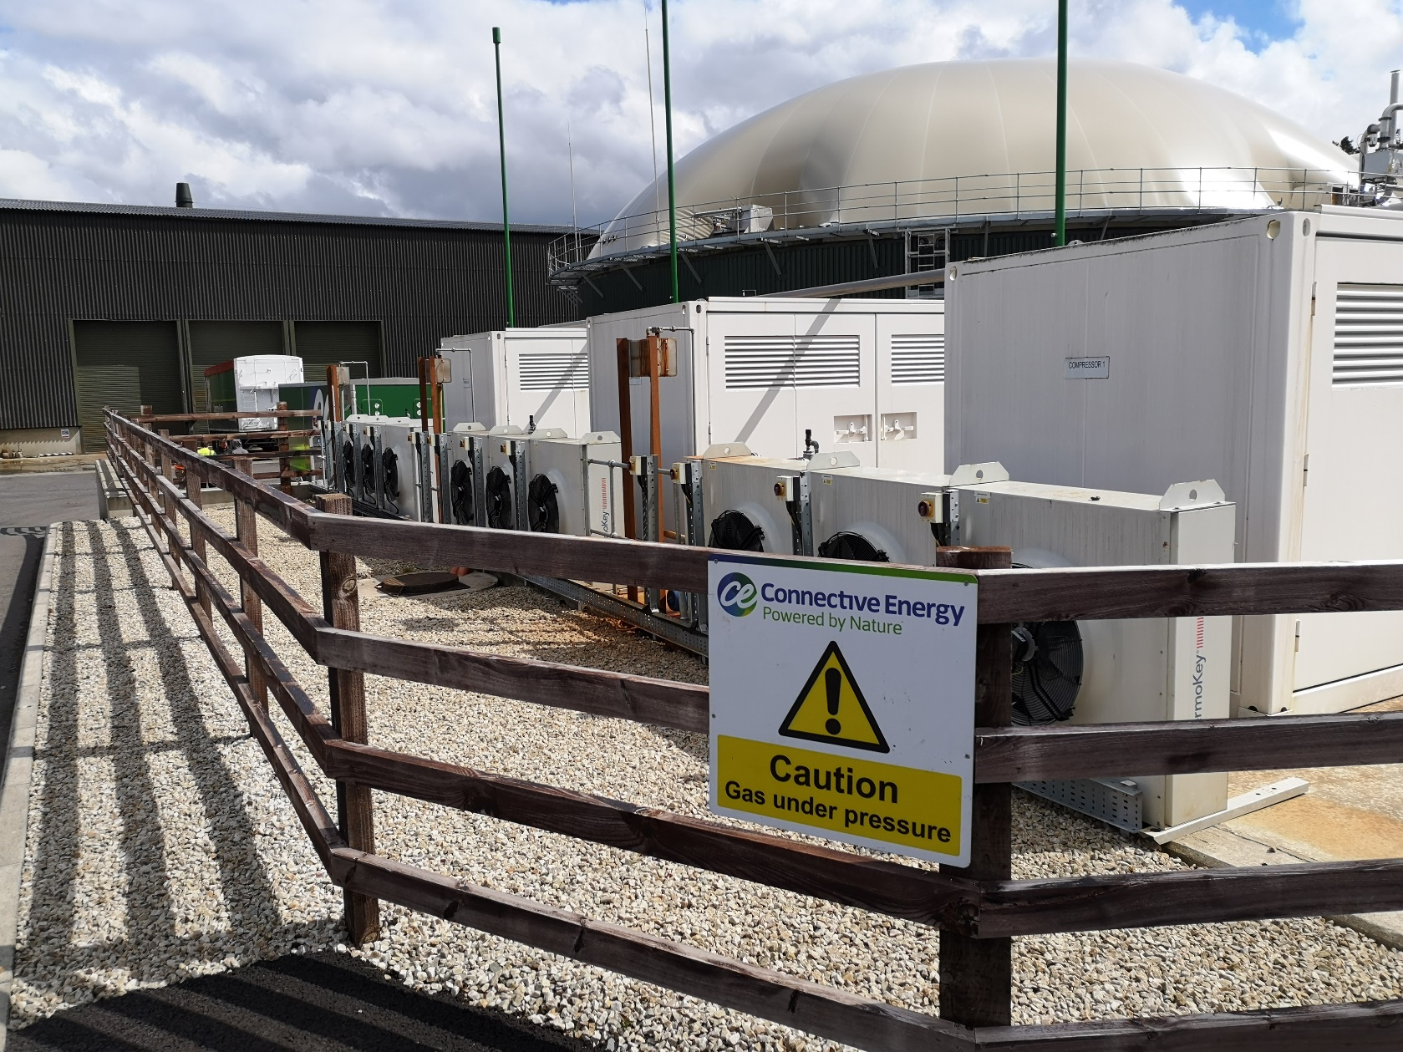
Use in Anaerobic Digestion

Slide 9



CNG Causeway Project

Slide 10


