Slide 1
Anaerobic Digestion - Introduction
14 Slides from 120 Pack to support open discussion for
Causeway Project Dissemination
Copyright Gas Networks Ireland 2019

Slide 2
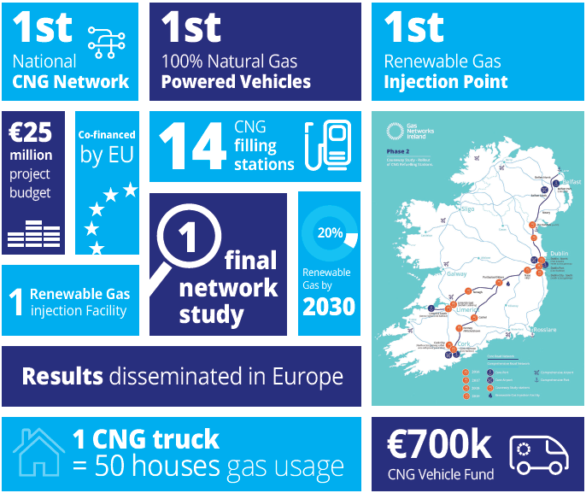
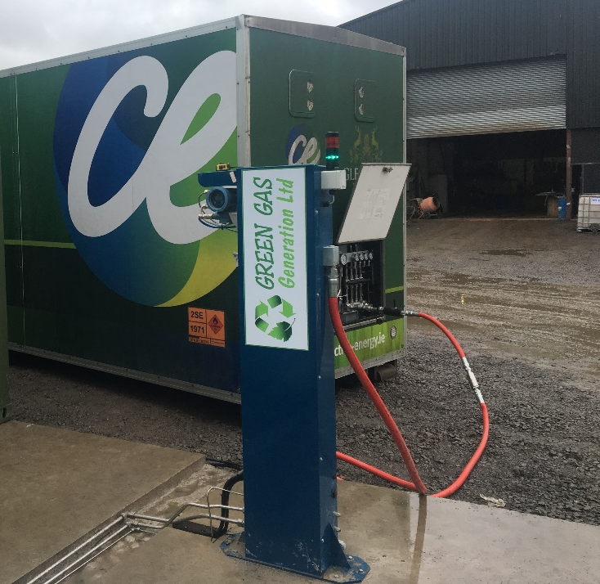
1. Causeway Project

Slide 3
2. EU Report 2017 – Biogas potential
Biogas Potential in Ireland

Slide 4
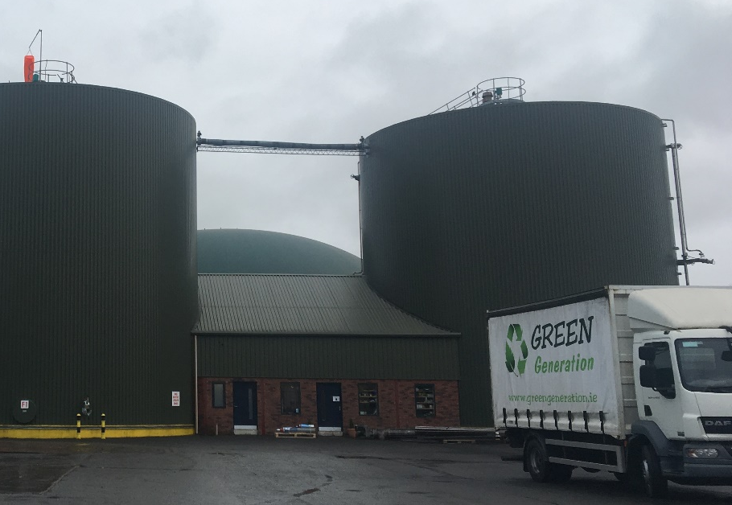
3. Anaerobic Digestion – Green Generation
Nurney AD
1MWe CHP
Biomethane
Business Culture

Slide 5












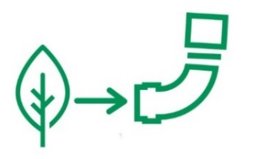
4. Anaerobic Digestion : Agri – AD Plants
20 GWh/yr.
3-4 tank system which can integrate within a rural farm setting
16,000 tonnes slurry within 3km radius
Land requirement of 445 ha dedicated to organic feedstock delivering 22,000 tonnes
2% land in 10km radius
3km
10km
40GWh/yr.
Larger scale plant in a large or non-farm setting
32,000 tonnes slurry/waste; high energy food industry waste also an appropriate feedstock
Land requirement of 890 ha dedicated to organic feedstock delivering 44,000 tonnes
4% land in 10km radius
50km

Slide 6


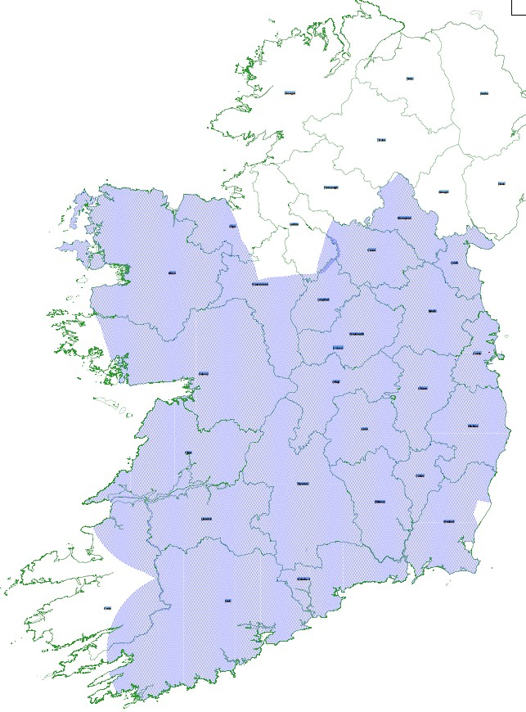



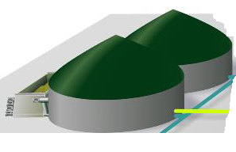



4. Anaerobic Digestion – Agri-AD Design Concept
Commercial Design
Standardisation
Dedicated Fund
Plant Size
Centralised & Direct Injection Points
Supply Chain
Feedstock Supply
AD Plant Site
Logistics and Gas Injection
20 GWh Plant
40 GWh Plant
Private Sector
Central Grid Injection (CGI)
Agriculture:
Slurry & Produce
Direct Injection

Slide 7
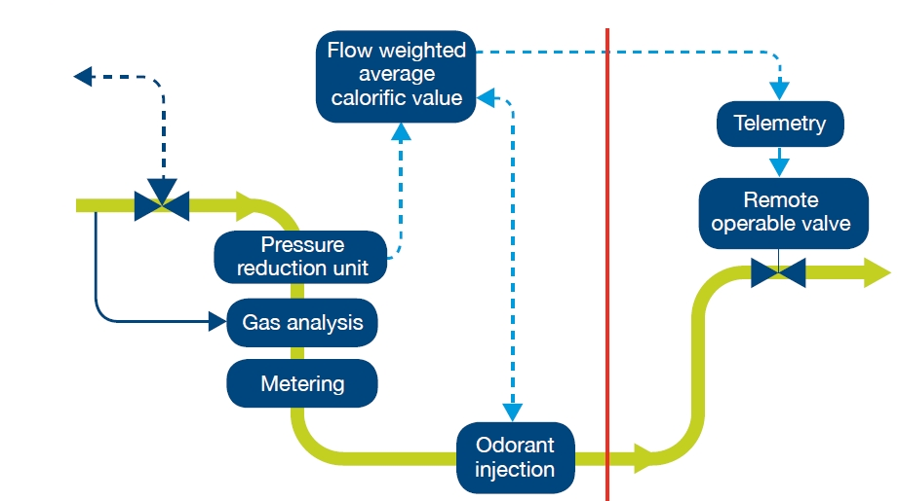

4. Renewable Gas Connection Policy
CRU approved & published on 15th October 2018
Key Points
  Pay 30% capital contribution (subject to +ve NPV),
  Appraisal assessed over 10 year horizon
Overall, very favourable for Renewable Gas producers
Transcribed into the GNI Connection Policy V5.0
NFO
GNI

Slide 8



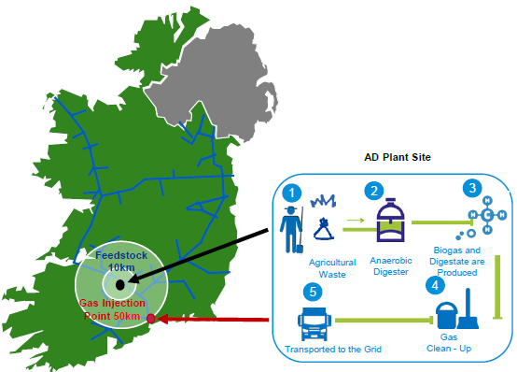

5. Project GRAZE – Nov 2018
Central Grid Injection (CGI) with Bio-CNG Logistics
  Optimum for medium scale AD in large catchment area.
  No capacity constraint.
  Expandability for community and commercial demand.
  Local Bio-CNG fuel supply.
CNG Stations & Vehicle Grant Fund
15 to 20 Agri-AD Facilities
  Farmer & Community Ownership
  Green Gas Fund
  Common Design
  Common EPC
  Common O&M
Project GRAZE
Green Renewable Agricultural Zero Emissions Gas

Slide 9
5. Anaerobic Digestion – RGFI Paper Oct 2019

Slide 10
5. Anaerobic Digestion – RGFI Paper Oct 2019

Slide 11
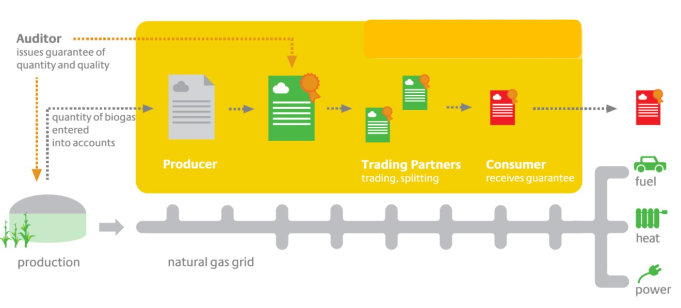




6. Green Gas Certification Scheme for Ireland
Reference: dena BiogasRegister.de
11
Notes:
Legitimate & legally enforceable means of transacting property rights – inclusive of “biogenic & renewable fuel” attributes of the specific gas production.
Provide a robust tracking system with assurance around data quality and double issuance.
Compliance with Guarantee of Origin obligations under the RED2.
Accredited Nationally (NSAI), at European Level (ErGAR & CDP-Carbon Disclosure Project), and Internationally (WRI – World Resource Institute).
Provide audited / accredited reporting information to the relevant State Authorities / Agencies.
11

Slide 12
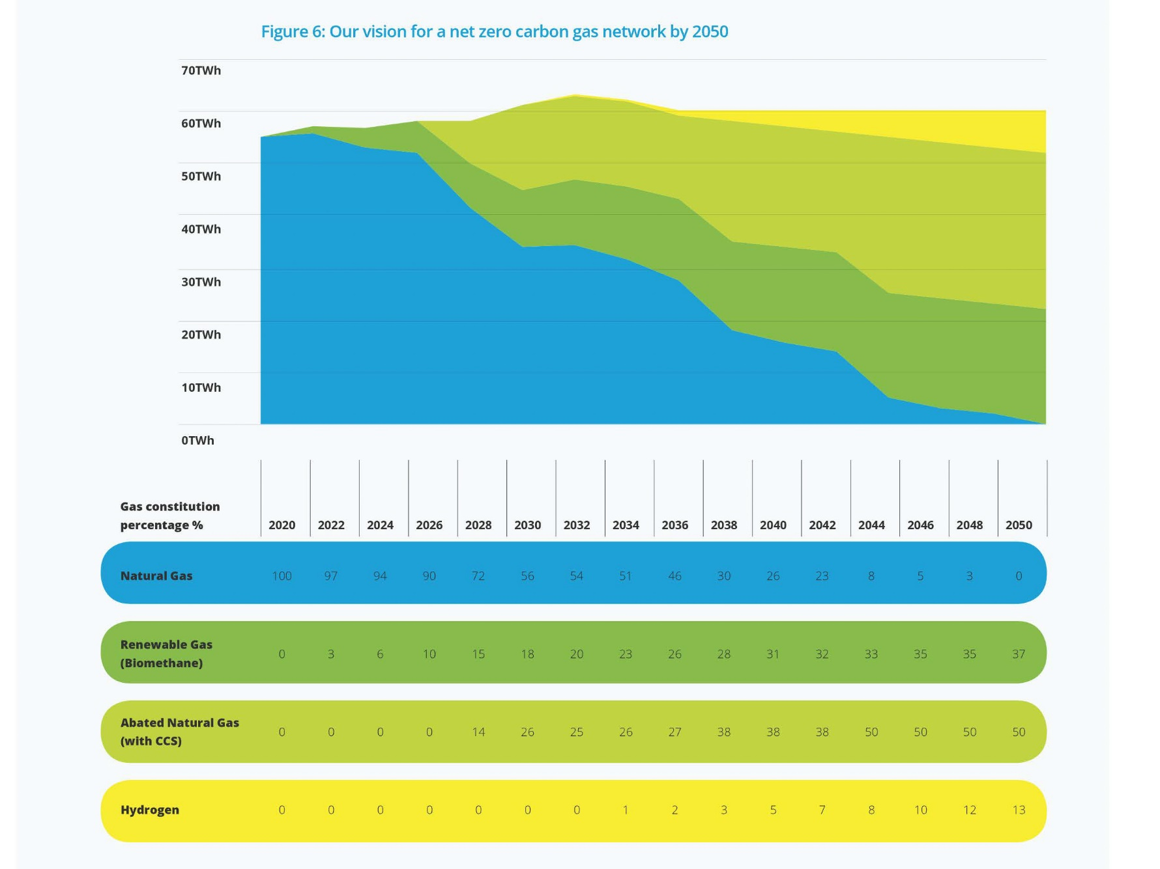

Slide 13
7. Anaerobic Digestion – Development in Ireland
Causeway Project
Nurney AD Plant with Biomethane Upgrade, compression and MEGC filling
Cush RNG 2018, Co. Kildare MEGC receipt, heating and Gas to Grid.
Graze – Nov 2018
Mitchelstown Central Grid Injection Facility, CGI, 2019 - 2022 and
Biomethane logistics (MEGC) (First of 17 CGI in Ireland)
Surrounded by 15 – 16 Agri-AD Facilities
2 x CNG Stations (of 70 in Ireland)
74 Trucks, Vehicle Grant Funding.
Direct Gas Injection to the Grid – Oct 2018
GNI – 170 Enquiries, 60 Connection offers

Slide 14
8. Anaerobic Digestion – Open Science
120 Slides & references on
  Causeway Project dissemination web site
  Linked to GenComm project
  Used Valorgas project 2013 Data etc.
Attracting young people into industry
3500 – 700 Agri Jobs across Ireland

