Slide 1
GenComm 28 Nov 2019
Building Filling Stations
Dr Peter Watters CEng FIMechE FIEI

Slide 2
Filling Stations
Alternative Fuels Directive
Petroleum Licensing & Blue Book & Hydrogen
CNG/LNG
Electric Vehicles
Alternative Fuels Workshop 12 Feb 2019 &
NSAI – CNG Technical Committee Aug & Oct 2019

Slide 5
1. Filling Stations - Future

Slide 6
1. Filling Stations - Future

Slide 7
2. ITM presentation Feb 2019 to CEN WG
Petroleum Licensing & Blue Book & Hydrogen

Slide 13
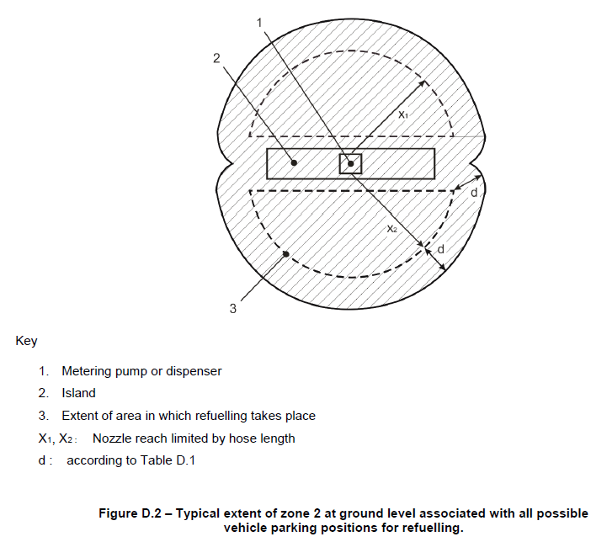
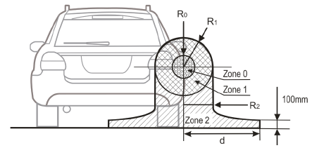
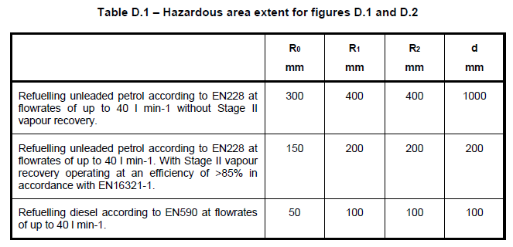
Proposed informative annex in EN13617-1 for petrol/diesel refuelling

Slide 15
Dutch initiative multifuel refuelling stations
Concept prepared, open for discussion

Slide 16
5 meter
3 meter
Site boundary
Petrol refuelling installation
LPG refuelling installation
CNG refuelling installation
Storage
Dispenser
Storage
Dispenser
Compressor
Storage
Dispenser
Tank trailer
Storage
Vehicle
Tank trailer
Storage
Vehicle
Storage
Vehicle
Storage
Storage
Storage
10 meter
no internal safety distance
when automatic shut off
in case of emergency
High power charging
15 meter
10 meter
Dispenser
Shop or
internal Vulnerable Object
Electrical connection
3 meter
CNG Storage to
vehicle refuelliing
10 meter
Vehicle
15 meter
3 meter
8 meter
5 meter
Diesel refuelling installation
LNG refuelling installation
Hydrogen refuelling installation
Pipeline
Storage
Dispenser
Storage
Dispenser
Compressor
Storage
Dispenser
Tank trailer
Tank trailer
Tube trailer
200 bar
Storage
Vehicle
Storage
Vehicle
Tube trailer 500 bar
Storage
Vehicle
Storage
Storage
On site production
Storage
3 kW/m2: 8 meter @ 500 bar
3 kW/m2: 5,5 meter @ 200 bar
3 kW/m2: 2,5 meter @ 8 bar
3 kW/m2: 3 meter
3 kW/m2: 3 meter
3 kW/m2: 4 meter @ 1000 bar
3 kW/m2: 3 meter @ 350 bar
Site boundary

Slide 17
3. NSAI & CRU – CNG
CNG stations built to EN Standards
CRU Requested Safety Case
CRU requirement of ALARP standard
EN Standard meets ALARP
Move towards common EU standards

Slide 18

3. CNG & LNG Standards
Published standards
EN 13423:2000, Compressed natural gas vehicle operations
EN ISO 16923:2018, Natural gas fuelling stations – CNG stations for fuelling vehicles (ISO 16923:2016)
EN ISO 16924:2018, Natural gas fuelling stations – LNG stations for fuelling vehicles (ISO 16924:2016)
Active work items
prEN 13423:2000rev, Compressed natural gas vehicle operations
prEN 17278, Natural gas vehicles – Vehicle fuelling appliances
Natural gas fuelling stations — Guidance for implementation of European standards on CNG and LNG stations for fuelling vehicles

Slide 22
2030 – Filling station?

Slide 23
Filling Stations
Multiple Options
VHS Vs Betamax Vs Netflix
Education and Communications
Moving towards 2050

Slide 24
GenComm 28 Nov 2019
Biomethane
Vision 2050
Filling Stations
Questions & Answers ?

