Slide 1
The Association for Energy, Mobility, Industry and Community
Mark Welsh
@IrelandHydrogen

Slide 2
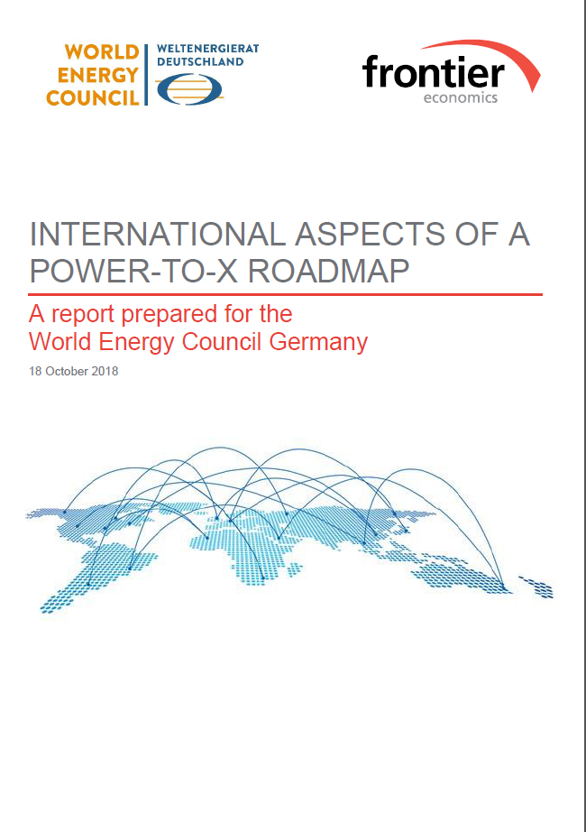
Hydrogen Activities – Global!
https://www.worldenergy.org/wp-content/uploads/2019/02/WEC-Netherlands-Hydrogen-Industry-as-Catalyst.pdf
https://www.frontier-economics.com/media/2642/frontier-int-ptx-roadmap-stc-12-10-18-final-report.pdf
https://www.worldenergy.org/publications/entry/innovation-insights-brief-new-hydrogen-economy-hype-or-hope

Slide 3
Hydrogen Activities - Global
Key Messages:
Need for coherent low carbon regulation to ensure short term profitability of hydrogen solutions
Need for extensive communication, education and future workforce training to enhance social acceptance of hydrogen technologies
https://www.worldenergy.org/wp-content/uploads/2019/02/Hydrogen-an-enabler-of-the-Grand-Transition-FEL-WEC-2018-2.pdf

Slide 4
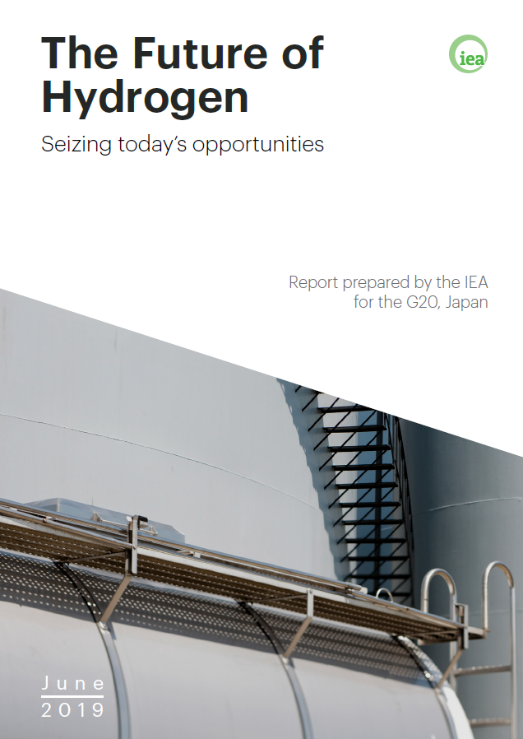
Our Energy Transition Needs Hydrogen!
https://irena.org/publications/2018/Sep/Hydrogen-from-renewable-power
www.iea.org/topics/hydrogen

Slide 5
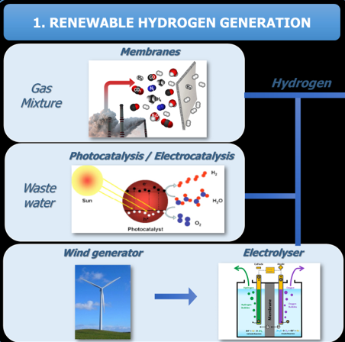
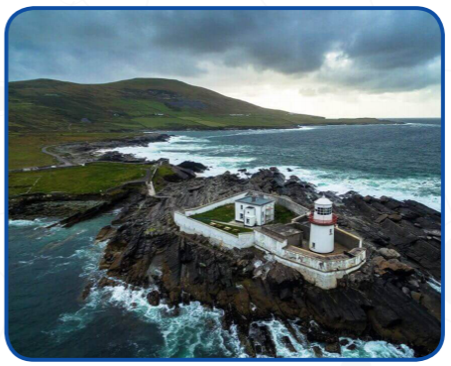
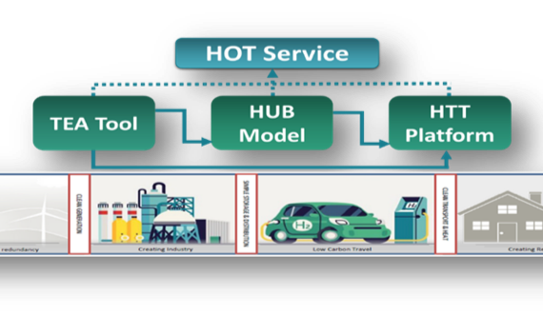
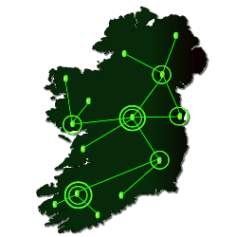
Hydrogen Projects on the Island… NOW!
Valentia Island
Ambitions
http://www.seafuel.eu/
http://www.energyco-ops.ie/hydrogen-production-plans-for-irelands-valentia-island/
http://hylantic.com/
https://huge-project.eu/

Slide 6
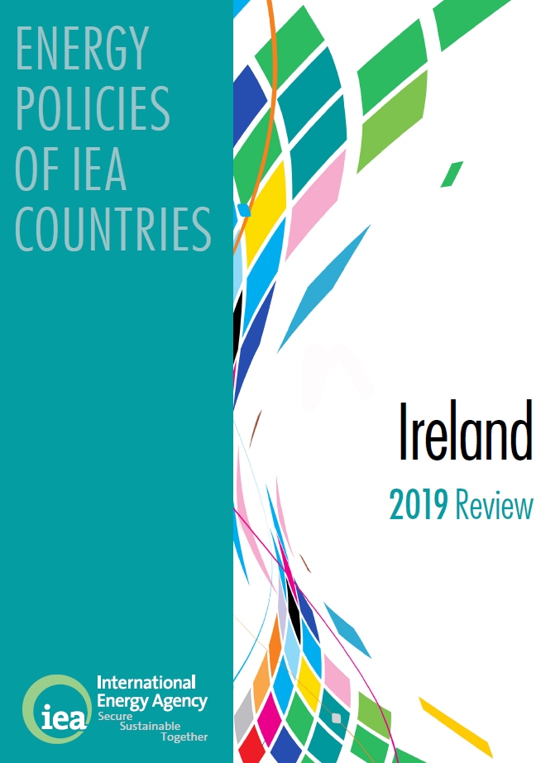
Hydrogen Policy - Ireland
http://www.eirgrid.ie/site-files/library/EirGrid/EirGrid-TES-2019-Ireland-Consultation.pdf
https://www.ervia.ie
https://webstore.iea.org/energy-policies-of-iea-countries-ireland-2019-review

Slide 7
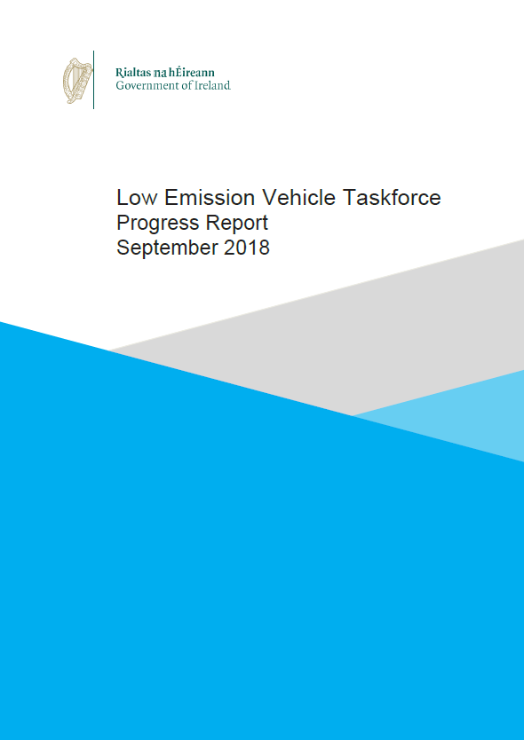
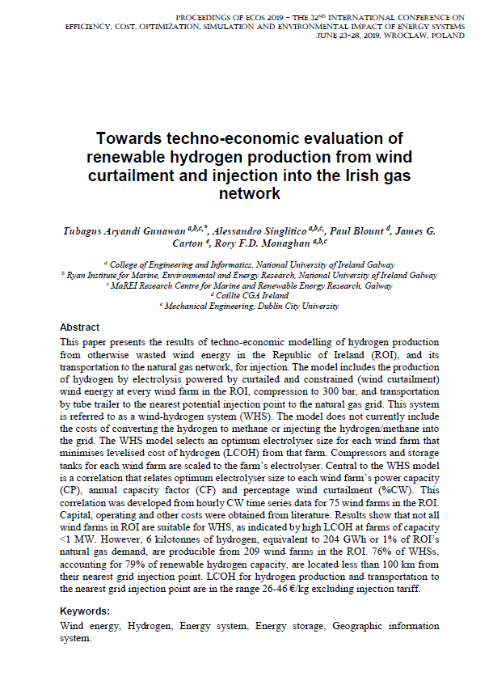
Hydrogen Activities
https://www.gov.ie/en/publication/99a2cb-low-emission-vehicle-lev-taskforce-progress-report/
Proceedings of ecos 2019 - the 32nd international conference on Efficiency, cost, optimization, simulation and environmental impact of energy systems June 23-28, 2019, wroclaw, poland

Slide 8
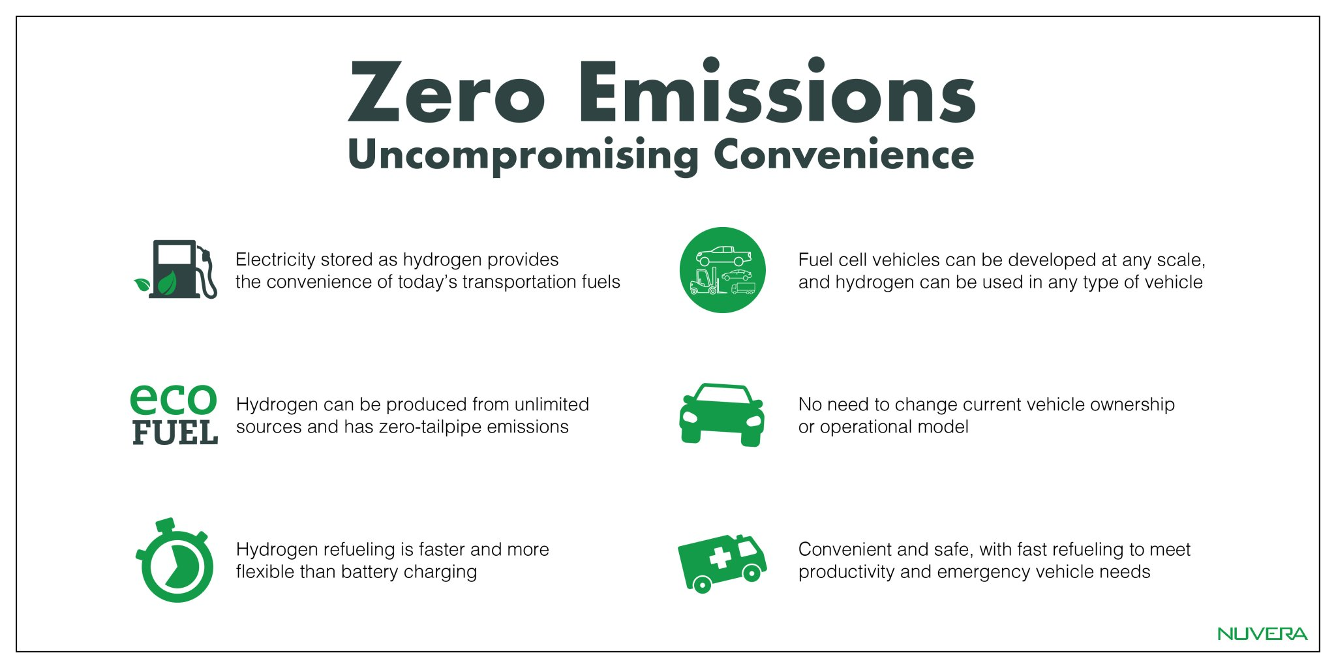
Hydrogen in Mobility

Slide 9
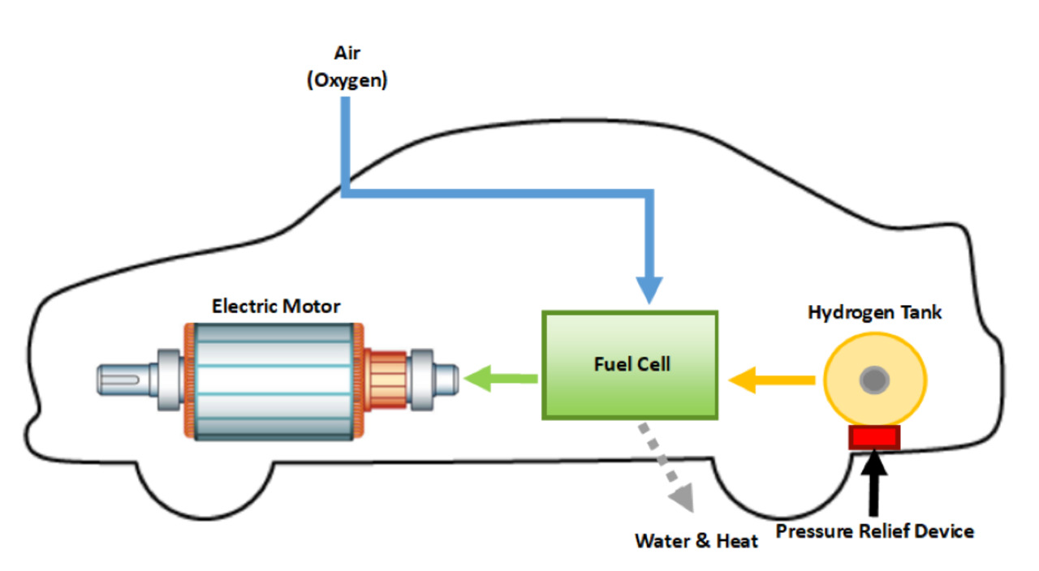
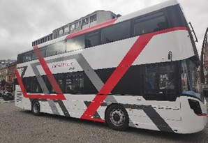
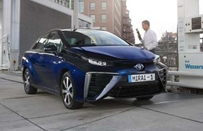
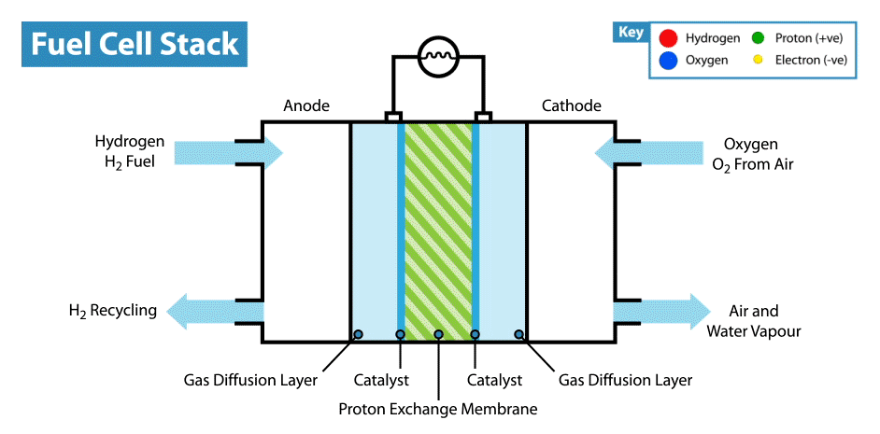
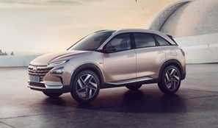
Vehicles
Are
here
NOW:
giphy.com

Slide 10
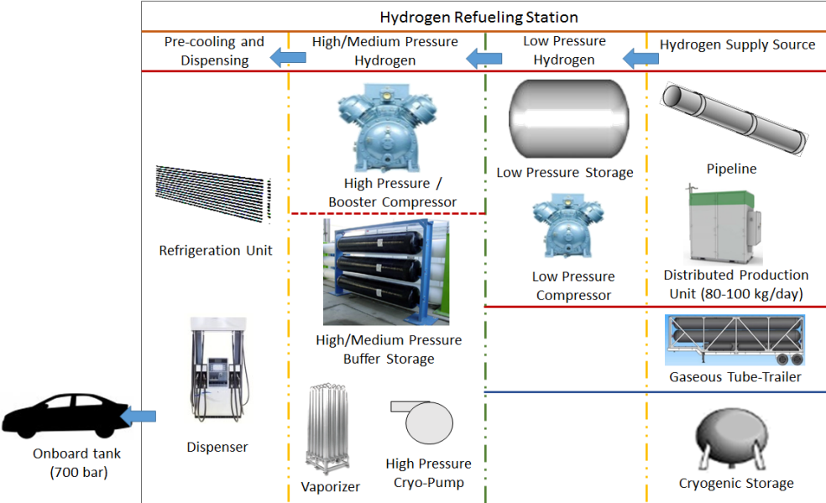
Hydrogen Fueling Stations are here NOW:

Slide 11
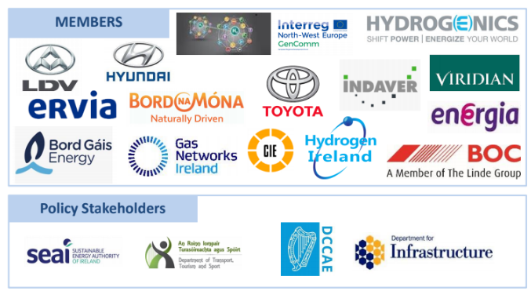
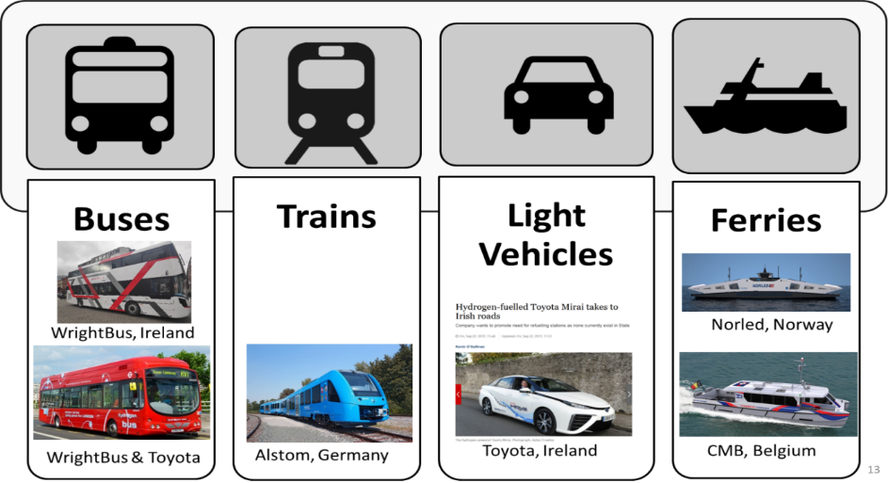
Hydrogen Mobility
A Hydrogen Roadmap for Irish Transport 2020-2030
http://hydrogenireland.org/news/
Industry
Are
here
NOW:

Slide 12
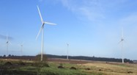
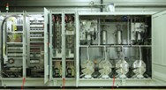
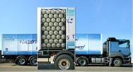
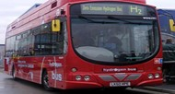
Hydrogen Mobility – Northern Ireland
Wind Turbines
Long Mountain produces electricity
Electrolyser
Electrolyser (owned by Energia) at wind farm produces hydrogen
Hydrogen Road Transportation
Pressurised hydrogen transported from wind farm to fuelling station
Refuelling Station
Vehicles
Energia to own and operate
Wrightbus to supply and Translink to own and operate 3 hydrogen buses
Energia Translink Project
Electrolyser and Trailers
EU Interreg Funding (awarded)
Refuelling Station and Buses
Hydrogen Transport Programme Fund OLEV (awarded)
Long Mountain Wind Farm
Converting zero emission electricity into hydrogen
€9.3m Hydrogen Project
Largest Interreg funded scheme to come to Northern Ireland
Hydrogen Fuelling Station for Translink and other third parties
Surplus Renewable Gas

Slide 13
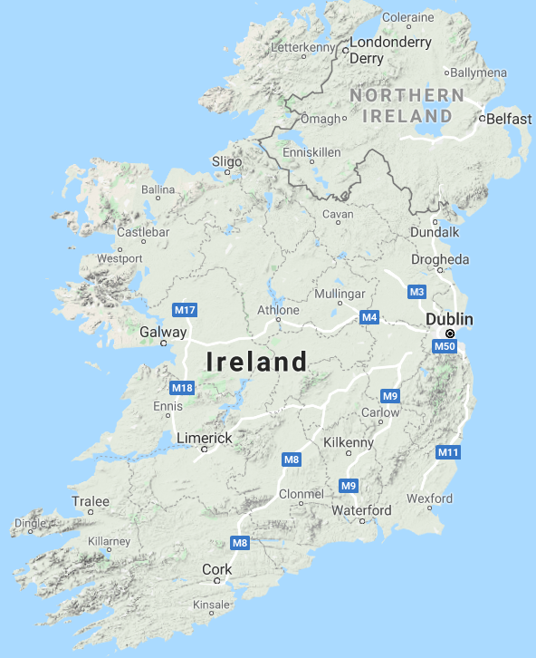
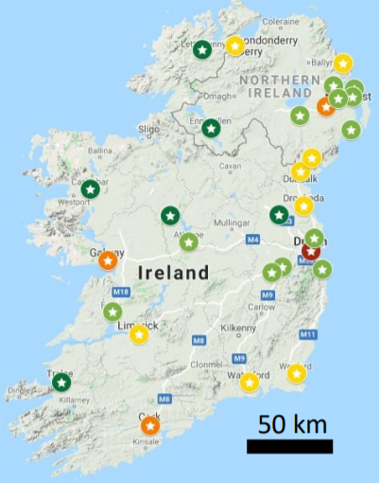
Hydrogen Activities
Proposed
Hydrogen
Station
Rollout

Slide 14
In Conclusion
Zero Emissions are good for Climate & good for your Health!
The technology exists!
Clean Renewables & Hydrogen can work!
We must manage transition from Fossil Fuel!
Education, Education!
The voice of people matter - Listen to Communities!

Slide 15
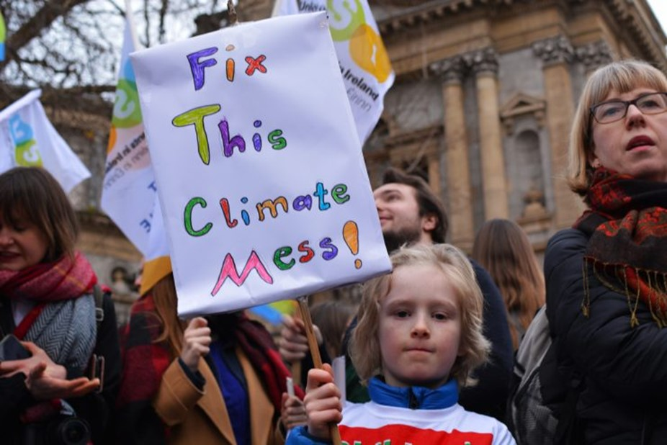
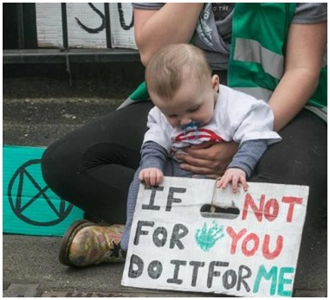
Thank You.

Slide 16
The Association for Energy, Mobility, Industry and Community
Mark Welsh
info@hydrogenireland.org
@IrelandHydrogen

